Slide 1
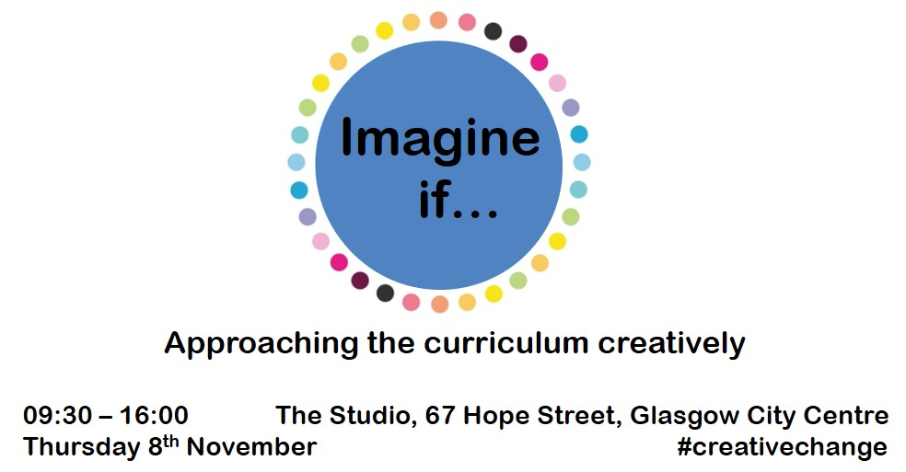
#creativechange

Slide 2
If curriculum means ‘the totality of young people’s learning experiences’, how might we do things differently to truly listen to learners, to engage them and equip them for life, learning and work in the 21st Century?

Slide 3
How many ways can you think of to
catch a bear ?
http://bit.ly/ToyboxBear
Notes:
This is a front cover page and can only be used at the beginning of a PowerPoint presentation once. Do not add anything else to this screen if it is being used.

Slide 4
Imagine if…
you were the King of schools and you could change everything and anything you wanted – what would it be like?

Slide 5
Draw a circle, a square and a triangle.
Now turn them into something new!
http://bit.ly/ToyboxDraw
Notes:
This is a front cover page and can only be used at the beginning of a PowerPoint presentation once. Do not add anything else to this screen if it is being used.

Slide 6
Imagine if…
you could take your best, or happiest, or most useful moment of school or learning, and make sure that this moment happens more of the time, or even, all of the time.

Slide 7
Imagine if…
you could take your worst, or unhappiest, or least useful moment of school or learning, and make sure that this moment happens less of the time, or even, never.

Slide 8
Rename something in this room…
Better!
http://bit.ly/ToyboxBear
Notes:
This is a front cover page and can only be used at the beginning of a PowerPoint presentation once. Do not add anything else to this screen if it is being used.

Slide 9
Imagine if…
there were no schools, no teachers. Imagine they had never been invented. How would you learn the things you need to learn to get a job and to have a great life?

Slide 10
Imagine if…
your statements

Slide 11
Imagine if…
reflection
Focus on the what and the why.
Not the how.

