Slide 1



Supporting Young Carers in Education
‘There are an estimated 30,000 young carers in Scotland under the age of 18.
Three out of five of us will become carers at some stage in our lives.’
Carers Trust
For Scotland's learners, with Scotland's educators
Notes:
Welcome to the ‘Supporting Young Carers in Education’ Professional Learning Activity. This activity is designed for anyone working with young carers in an educational setting or context. This module of learning is part of a set of 4 modules. Each modules should take between 30 minutes and an hour depending on how it is undertaken. They can be studied as a group or as in-service activities with some discussion around the reflective questions or as an individual professional learning activity with written reflections in a log. Module one is designed specifically for all educational practitioners and should help them identify and support young carers. Module 2 is designed for anyone with leadership responsibility for organizing supports for young carers in their setting and includes their legal duties. Module 3 is designed for anyone hoping to develop a whole school approach towards supporting young carers. Module 4 addresses the specific challenges of transitions for young carers.

Slide 2
Module 2: Young Carers and The Law, Their Rights, and Their Voice
Module 2A: Legislation and Young Carers Statements
This module is suitable for anyone with specific responsibility for supporting young carers
For Scotland's learners, with Scotland's educators
Notes:
This second module helps those with a leadership responsibility towards young carers to know their legal duties and responsibilities including information about the young carers statement. It consists of 3 short presentations and some optional reading tasks. This first presentation highlights the key information regarding the Young Carers Act and Young Carer Statements.

Slide 3
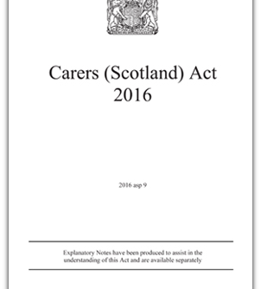
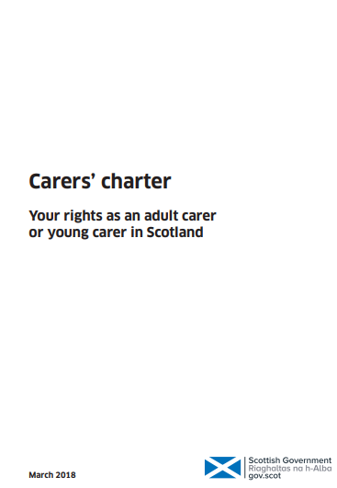
The Legal Bit - Legislation, Policies and Guidance
In April 2018, the Scottish Government launched the Carers (Scotland) Act 2016.
Under the Carers (Scotland) Act the definition of a young carer is anyone aged 18 and under, or 18 and still in school, who provides, or intends to provide care.
The Carers' charter summarises the key provisions and rights from the Carer’s Act
The Carers (Scotland) Act 2016 places specific duties on local authorities to support carers’ health and wellbeing and help make caring more sustainable.
These duties include:
providing support to carers, based on their identified needs which meet the local eligibility criteria
providing a Young Carer Statement to identify young carers’ needs and personal outcomes
to have an information and advice service for carers

Slide 4
Implications of the Carer’s (Scotland) Act
In your educational setting if you identify a young carer, you should inform them about their right to have a Young Carer Statement.
This Young Carer Statement will detail any additional support needs the young carer may have and how they would like to receive that support. This includes support in education.
Your local authority will be able to tell you who is leading on Young Carer Statements. It may be education, social work or a commissioned service such as a local young carer service. It may also be the health board where a young carer is in early learning and child care.
Details for each local authority can be found on the Carers Trust Digital Education Hub

Slide 5
What is the Young Carers Statement?
When and how the Young Carer Statement conversation is to take place is agreed with the young carer
The young carer gets a copy of the Statement and any other person that the young carer requests, unless there is a reason that this would not be appropriate. For example, it might not be considered appropriate (or there may not be consent) to share sensitive medical information about the person who is cared for
When a young carer turns 18 their Statement will continue until they are provided with an Adult Carer Support Plan. If they do not wish to continue providing care, they can choose not to have an Adult Carer Support Plan.
Notes:
https://www.youtube.com/watch?v=2ti-R-NsT-U&list=PLV0wpVbwgJcEdkHVBu0YyvwD1ieBvn0Lm&index=6

Slide 6
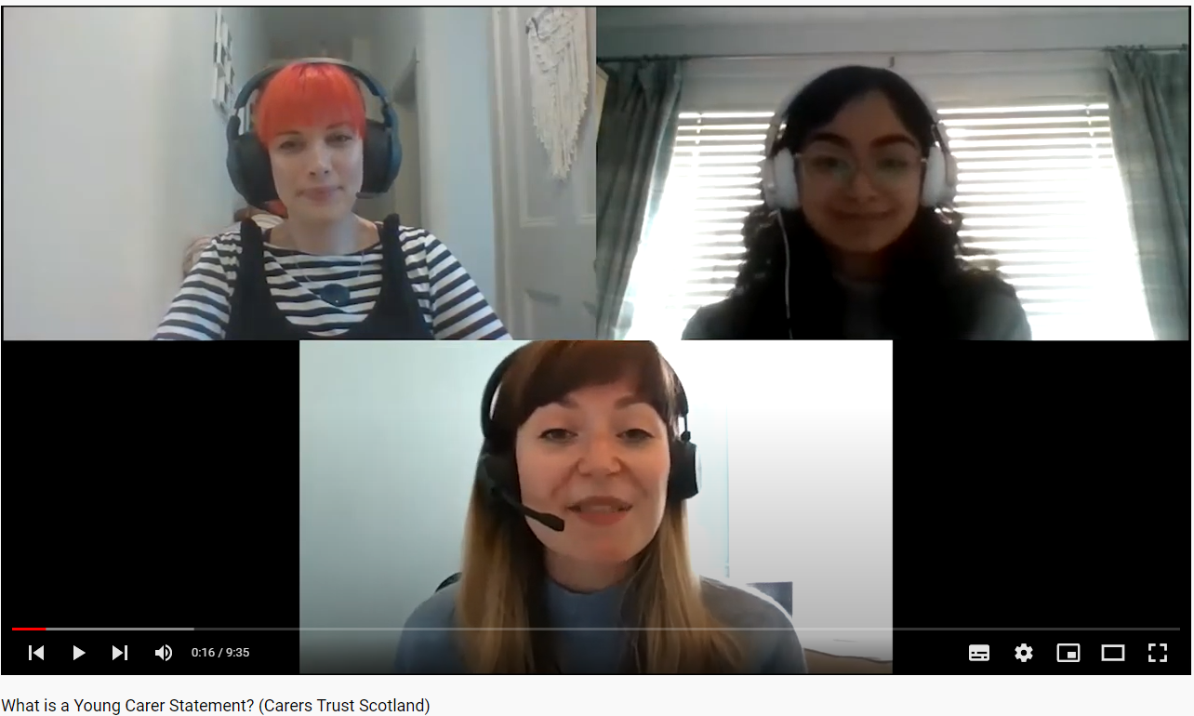

More about Young Carers Statements
Listen to a Young Carer ask about the Statements:
what they are,
how to get one, and
who should help them get one
For easy read information about Young Carers Statements please visit:
What is a Young Carer Statement? – Young Scot
What is a Young Carer Statement?
https://www.youtube.com/watch?v=2ti-R-NsT-U&list=PLV0wpVbwgJcEdkHVBu0YyvwD1ieBvn0Lm&index=7 (9min 35sec)
Notes:
https://www.youtube.com/watch?v=2ti-R-NsT-U&list=PLV0wpVbwgJcEdkHVBu0YyvwD1ieBvn0Lm&index=6

Slide 7
In summary a Young Carer Statement should contain
information about the young carer’s circumstances and caring role, such as:-
the nature and extent of the care provided and the impact on the young carers wellbeing and day-to-day life including education
the extent to which the young carer is able and willing to provide care
emergency and future care planning, including any arrangements that are in place
what 'personal outcomes' matter to the young carer in order continue to provide care, to have a life alongside caring, and to improve their health and wellbeing
support available if they live in a different local authority from the person they care for
whether support should be provided as a break from caring
any support which the responsible authority intends to provide to the young carer
the circumstances in which the Young Carer Statement is to be reviewed.
Notes:
Responsible authorities must offer a ‘Young Carer Statement’ to anyone they identify as a young carer. In each local authority the Young Carer Statement is different some come in the form of an app and others as a short colourful document or professional form. For any young carer who accepts this offer they must prepare a statement which should contain information about the young carer’s circumstances and caring role such as:-
the nature and extent of the care provided and the impact on the young carers wellbeing and day-to-day life
the extent to which the young carer is able and willing to provide care
whether the responsible authority thinks that it is appropriate for the young carer to be a carer for the person they care for
emergency and future care planning, including any arrangements that are in place
what 'personal outcomes' matter to the young carer in order continue to provide care, where that is appropriate, to have a life alongside caring, and to improve their health and wellbeing
support available if they live in a different local authority are from the person you care for
whether support should be provided as a break from caring
support available locally
any support which the responsible authority intends to provide to the young carer
the circumstances in which the Young Carer Statement is to be reviewed.
When a young carer turns 18 their statement will continue until they are provided with an adult carer support plan. If they do not wish to continue providing care, they can choose not to have an adult carer support plan.

Slide 8
Young Carer’s Policy at Local Level
Why have a Young Carer School Policy:
  To ensure that all young carers are identified and supported
  To ensure all learners, staff and parents/carers are aware of who a young carer is
  To promote partnership working across services
Local authorities/schools may choose to have a separate policy for young carers or explicitly incorporate young carers considerations into other key policies such as Attendance, Inclusion, Wellbeing etc. policies
See supporting resource for an example of a local authority policy
Notes:
Why have a Young Carer School Policy:
To ensure that all young carers are identified and supported
To ensure all learners, staff and parents/carers are aware of who a young carer is
To promote partnership working across services
Local authorities/schools may choose to have a separate policy for young carers or
Explicitly incorporate young carers considerations into other key policies such as Attendance, Inclusion, Wellbeing etc. policies
See our supporting resource for an example of a local authority policy

Slide 9

Activity Reflection question 4
In your educational authority who is responsible for supporting a young carer to complete their Young Carer Statement and can you view a template of it?

Slide 10
Module 2: Young Carers and The Law, Their Rights, and Their Voice
Module 2B: Young Carers - Additional Support Needs and Rights
This module is suitable for anyone with specific responsibility for supporting young carers
For Scotland's learners, with Scotland's educators
Notes:
This is a front cover page and can only be used once. Use the corresponding blue internal and back pages if you are using this page. You may add a title and a subtitle if needed only. Do not add anything else or move elements around.

Slide 11
Other relevant legislation and guidance
Like all children in Scotland Young Carers have rights and should also be considered legally in terms of their additional support needs. These legislative entitlements are outlined in the following Acts and policy guidance:
Getting It Right For Every Child (GIRFEC)
Policy supporting families to receive the right help, at the right time, from the right people.
Education (Additional Support for Learning) (Scotland) Act 2004
Legislation for educational provision for any learner considered to have additional support needs
United Nations Convention on the Rights of the Child (Incorporation) (Scotland) Act 2024
Act to ensure children’s rights are legally protected
Children and Young People (Scotland) Act 2014
Legislation for children’s services provision
Additional support for learning 2017 (Code of Practice)
Statutory guidance
Attendance Guidance 2026
Explicitly recognises young carers additional support needs with respect to attendance and engagement.
Notes:
Legislation | Policy for Scottish education | Scottish education system | Education Scotland
In the last presentation we found out about how the Carers Scotland Act protects young carers in terms of their caring responsibilities however we have a raft of other legislation and guidance which mean we should be protecting young carers in terms of their education. So like all Scotland’s children YC have rights and in terms of education they have the legal right to whatever additional support they require to effectively access and engage in education. We have a number of laws, bills, policies, and guidance which lay out how educational practitioners should fulfil their legal duties. Some of these include the policy guidance around Getting it Right for Every Child, The Additional Support for learning Act and the Code of Practice associated with it, the Children and Young People’s Act and the United Nations Convention on the Rights of the Child (Incorporation) (Scotland) Act. Also, in Policy Guidance such as the Schools National Attendance young carers are specifically mentioned as a group of learners who may need extra support in or to maintain good attendance and to be able to engage with learning.

Slide 12

Linking Additional Support Needs and Young Carers
The ASfL Act states that children and young people may require additional support because they:
are young carers
are interrupted learners
are living with parents who are abusing substances
are living with parents who have mental health problems
are not attending school regularly
have emotional or social difficulties
are looked after by a local authority or who have been adopted
are being bullied
are children of parents in the Armed Forces
have experienced a bereavement
are affected by imprisonment of a family member
have a learning difficulty, such as dyslexia
have English as an additional language
are on the child protection register
are refugees
[This is only part of the list in the Additional support for learning: statutory guidance 2017 section 1.2]
Being a young carer is explicitly listed however a young carer may also be affected by one or more of the other factors on the list particularly those in orange
Notes:
Caring is rarely the only thing that a young carer is coping with. For example many, many ‘looked after’ or care experienced children and young people will also be, or were formerly young carers. They may be caring for a parent who isn’t able to care for themselves or their family well. They may also be caring for their siblings. This could have been happening for a very long time before their own care needs have been noticed and addressed. Even after moving into the care system formally many young people will feel the need to continue to care for and/or protect a parent or their siblings. Typically these children or young people may struggle at school and may be reported as requiring additional support due to social, emotional and behavioural needs rather than their caring responsibilities.

Slide 13
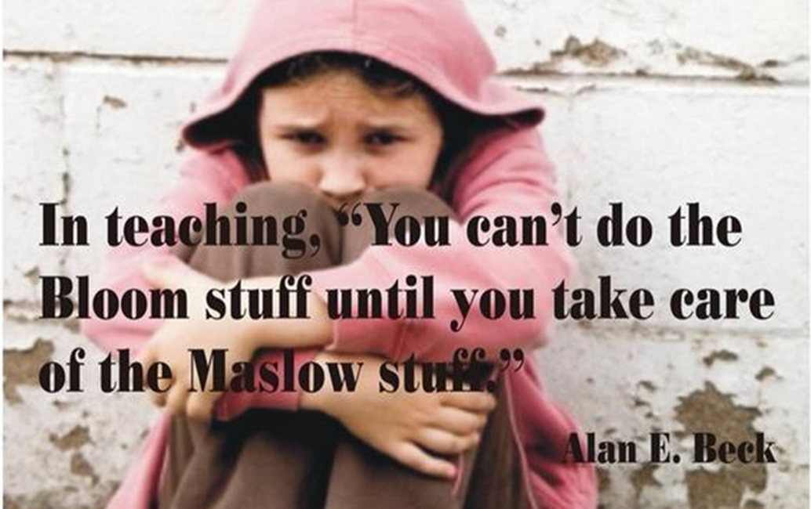
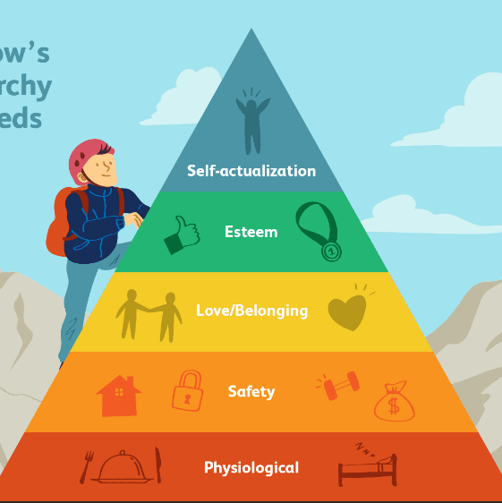
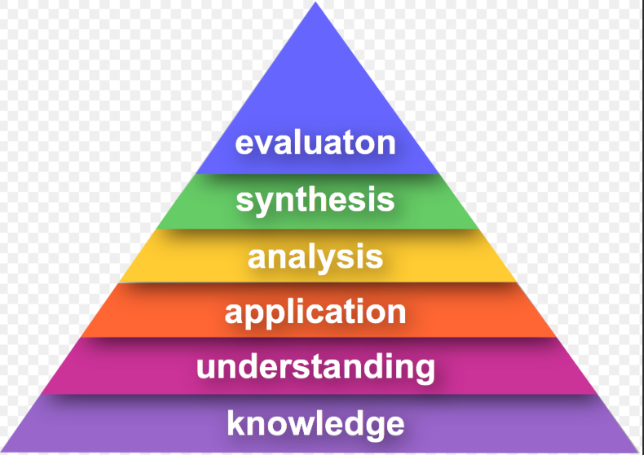
Why is considering all of a young carers support needs important?
Maslow before Bloom

Slide 14
From the ASfL Implementation Review
Section 1 Information relating to ASN pupils in Scotland (Trends)
In percentage terms there have been significant increases in pupils receiving additional support as a result of; communication support needs (293% increase), young carers (636% increase), bereavement (300% increase), family issues (353% increase). These increases are welcome as they reflect a wider recognition of additional support needs within the
framework of the legislation and recognise needs arising from circumstances beyond health and disability, which would have traditionally been the case.
Whilst the young carers figures have increased significantly, the number of pupils identified as young carers is likely to be a underreporting of those who are young carers, due to the stigma and reluctance of young carers to identify themselves, or to be identified as a young carer.

Slide 15
Practical implications of ASfL Act and supporting young carers
For example, supporting transitions
Additional support for learning: statutory guidance 2017, Section 37-38 states education authorities will carry out their duties to plan post-school transitions of those leaving school who… are otherwise at risk of not making a successful transition such as looked after children and young carers.
Transitions are hard for all young people however from Module 1 we know that moving on from school can be particularly hard for young carers emotionally and practically.
Young carers may be:
be pressured to continue with their caring role making it difficult for them to attend college, university, training or work
feel guilty about leaving their caring role to someone else
be worried about the person they care for and how they will be cared for if they don’t do it
To learn more about supporting young carers through transitions please complete Module 4

Slide 16
Activity Reflection Question 5
What policies or guidance, specific to your setting, have relevancy for young carers?
Supplementary questions (optional):
  Do you know who the young carers in your educational setting?
  Are your young carers recorded in SEEMIS as having additional support needs?
  For the young carers that you teach do you know if their caring role is having an impact on their learning or educational progress?

Slide 17
Module 2: Young Carers and The Law, Their Rights, and Their Voice
Module 2C: What works well for all learners including Young Carers
This module is suitable for anyone with specific responsibility for supporting young carers
For Scotland's learners, with Scotland's educators
Notes:
This is a front cover page and can only be used once. Use the corresponding blue internal and back pages if you are using this page. You may add a title and a subtitle if needed only. Do not add anything else or move elements around.

Slide 18


Linking Young Carers to Children’s Rights
General Underpinning principles
Article 2 without discrimination.
Article 3 best interests of the child
Article 6 survival & development
Article 12 views of the child
Education specific Articles
Article 28 Right to an education that:
Article 29 develops every child’s personality, talents and abilities to the full
Article 31 Relax, play and take part in cultural and artistic activities
EQUALITY & EQUITY
OVERRIDING FACTOR
SAFEGUARDING
PARTICIPATION
INCLUSION
FULL CURRICULUM
FULLTIME
WHOLE SCHOOL EXPERIENCE
SUITED TO THEIR NEEDS:
FLEXIBLE and ADAPTABLE
Notes:
Universal: Applies to ALL children, regardless of abilities or family circumstances Unconditional They do not have to be earned Inalienable Thy cannot be taken away if they aren’t being responsible. Inherent They cannot be separated from the individual. Indivisible They are all inter-related.
Underpinning rights in the context of the two reviews:
2 the principle of Universality – additional support needs and care experience Example
3 puts the best interest of the child first – overriding factor – but what’s in the best interests of one child would not necessarily be in the best interests of another – so do blanket policies or rules work. Can one size fit all in terms of planning.
12 Is a gateway right & Participation is often the first step to Getting It Right for Every Child (ALL Children)
Education focussed:
28 Right to an education. This must respect children’s dignity
29 Education must develop every child’s personality, talents and abilities to the full
31 Relax, play and take part in a wide range of cultural and artistic activities
also consider the implications of:
5 Right of my family - to help me know about my rights
15 Right to meet with friends and to join groups
16 Right to privacy
23 Right to get information in lot’s of ways, so long as it’s safe
39 Right to get help if I have been hurt, neglected or badly treated
40 Right to legal help and to be treated fairly if accused of breaking the law
Participation: This really stands for the rights to do things (learning, socialising with finds, join clubs, ….), express ourselves, and have an effective voice. If this is truly to happen we need to move from adult domination around for example decision making to social participation.
Provision: is about how we use our resources to ensure that CYP receive their RIGHTS – supported - and I think you’ll start to see the direct links to the Morgan Review and The Promise
Protection: linked to the right to be shielded from certain acts and practices – not just child protection – it is close to parenting – ”All parenting is shared between the family and the wider kinship and friendship network, and between this system and state provision”. There is a very obvious link her between this and ‘corporate parenting’ and why this is important, as many of the thinks that a family or wider kinship group may be less or even missing for a care experience child or YP, we often refer to it as social capital, that’s were and when we as Corporate Parents ned to step in.

Slide 19
What children and young people said would make a difference to them:
Some key messages from the ASfL Implementation Review which are particularly relevant to young carers:-
Meaningful relationships
More knowledge and understanding of their support needs
Consistency of support from all the adults working with them
A safe place
Not to have their ability or capability underestimated
More empathy from peers
Timely responses to bullying
Improved communication
Involvement in decision making
‘Listening must start with the assumption that it will lead to change.’ The Promise, 2020
Notes:
I’m summarising this massively BUT…
Children and young people want to be included in their schools and communities.
They feel it is important that those working in schools are aware of additional support needs and sensitive to their individual needs.
Schools should have a whole school approach to inclusion, respect children and young people’s rights, and support individuals to achieve their potential. We can only do this by talking with and listening to CYP at every level and about every aspect of the curriculum! (Back to the 4 contexts) This approach wouldn’t just benefit CYP with ASNs but would benefit all children and young people.
So what did the review say that CYP who require additional support say they needed and wanted?

Slide 20
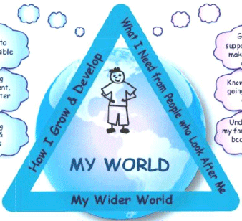
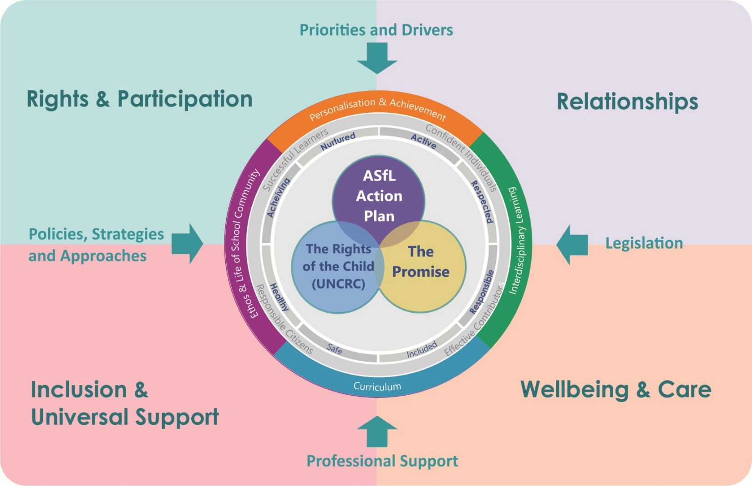
So how can we ‘Get It Right For Every Young Carer’?
Consider the whole child (or young person)
- their development and their needs
Physical, Social, Educational, & Psychological
-in the context of their family & their caring role
In terms of education focussing on these 4 key areas practitioners, schools and local authorities can Get It Right for Every Young Carer

Slide 21
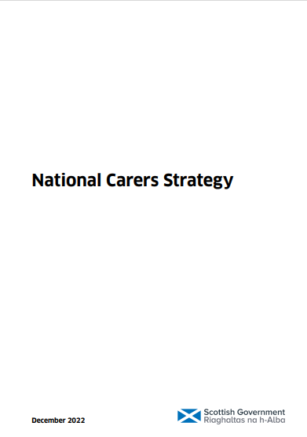
National Carer’s Strategy (2022)
Section 5 Strategic outcome for Young Carers
SUPPORT
• Young carers are supported and protected from inappropriate caring and negative impacts on their education, social lives and future opportunities
TRANSITIONS*
• Young adult carers are supported when moving from education to training and work while balancing an ongoing caring role
*To learn more about supporting young carers through transitions please complete Module 4
https://www.gov.scot/publications/national-carers-strategy/

Slide 22
Activity Reflection Question 6
Considering the Young carers in your setting – which of their rights might we not be fully recognising or upheld?
In your setting what universal supports, already in place (based around the 4 themes), will help your young carers?

