Slide 1
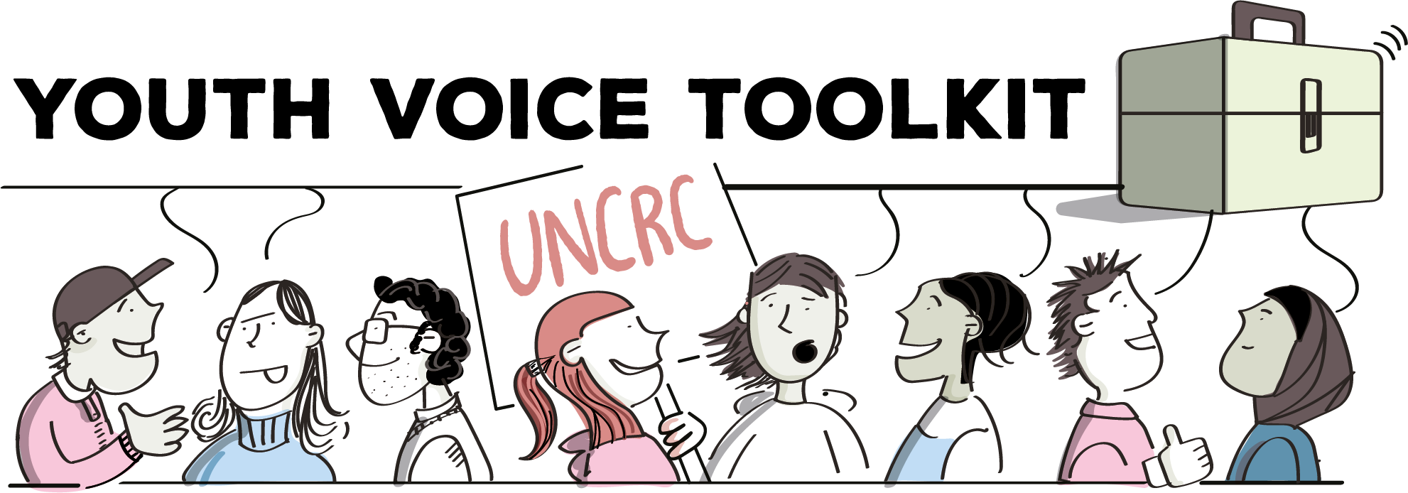
Empowering Youth Voices
A youth voice and participation resource pack for practitioners working with children and young people across school and community settings

Slide 2


Acknowledgements
with thanks to Stirling Council
This resource has been developed from the original Social Justice Ambassadors Toolkit created by Stirling Youth Participation Team over a number of years.
This was developed and co-designed over time, with previous young people from Stirling Youth Forum, alongside a whole council approach that was crucial to its success.
The original Toolkit then shaped the successful Social Justice Ambassadors programme within Stirling Council.
This resource builds upon the original core concepts of peer-research, empowerment and skills development.
Thank you to the Stirling Youth Participation staff and young people for their guidance, support and challenge throughout.
For Practitioners

Slide 3
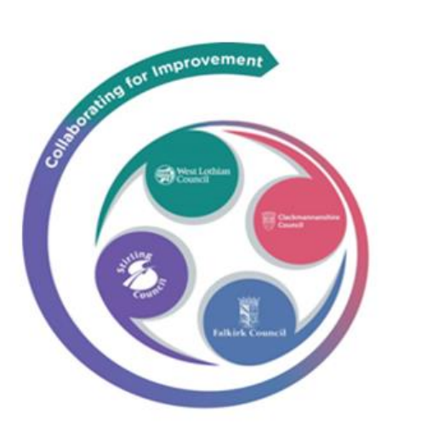




Forth Valley and West Lothian
Regional Journey
The Toolkit approach and accompanying implementation guidance have been developed from the Forth Valley and West Lothian Regional Youth Voice model.
This model demonstrated that meaningful youth voice can be facilitated across a wide range of settings, with the creation of the charter allowing children and young people to outline the principles and methods adults should employ when consulting with them.
Thank you to the children, young people and staff involved in the Forth Valley and West Lothian Regional Youth Voice Development Group.
For Practitioners

Slide 4
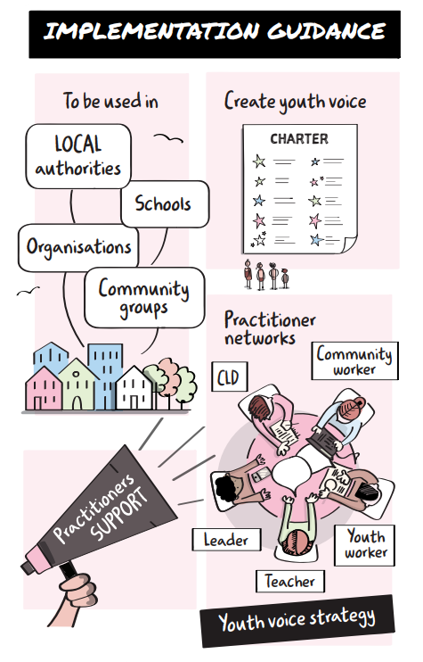
Before getting started…
Please ensure that you are familiar with the Toolkit, and have followed the steps outlined within the Implementation Guidance for the relevant setting
Implementation Guidance
Please also refer to the support materials section to help implement this pack
Support materials
For Practitioners

Slide 5
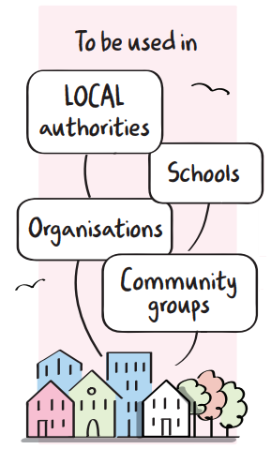
Purpose of this resource
This resource supports practitioners to make youth voice more meaningful and representative across a range of settings.
It empowers children and young people to have their voices heard in schools, youth groups and community settings, and across local authorities and organisations.
This resource can be used with both existing and new youth voice structures, including leadership groups, pupil councils, youth forums, champion boards and ambassador projects.
For Practitioners

Slide 6
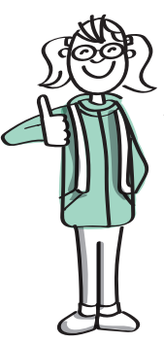
Using this resource
Practitioners can adapt this resource as required, as some slides may not suit all groups. Facilitator guidance and activity notes are included in the notes section of each slide.
This resource supports children and young people to learn about youth voice and children's rights then undertake peer research on any theme.
Themes could include learning and teaching, attendance, outdoor learning, mental health and wellbeing etc.
If the theme is already chosen, please ensure children are well informed to participate fully when it comes to that part of the resource. There is additional guidance on this in the Support Materials.
For Practitioners

Slide 7

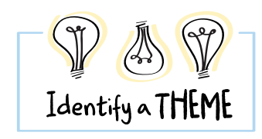
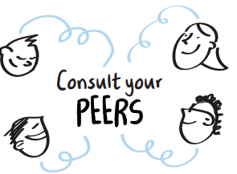
Principles of peer research
Peer research is used to help young people develop skills and confidence in consulting their peers, enabling them to:
Understand the importance of youth voice and children's rights
Develop questions, conduct research and gather peer views on any theme
Work as a group to represent their peers
Learn about key aspects of research including consultation, data, planning and analysis.
For Practitioners

Slide 8

7 Golden Rules for Participation
7 Golden Rules
Understand my rights
A chance to be involved
Remember it’s my choice
Value me
Support me
Work together
Keep in touch
This resource is underpinned by the 7 Golden Rules of Participation from the Children’s Commissioner.
Find out more about the 7 Golden Rules here:
7 Golden Rules
For Practitioners
Notes:
7 Golden Rules Link: https://www.cypcs.org.uk/wpcypcs/wp-content/uploads/2020/03/Golden-Rules-children.pdf
You may also wish to read the Children in Scotland Principles and Guidelines for Meaningful Participation and Engagement of Children and Young People:
https://childreninscotland.org.uk/wp-content/uploads/2022/08/Principles-Guidelines-22_FINAL.pdf

Slide 9

Contents - Part 1
Section 1 – Understanding Youth Voice
Section 2 – Children’s Rights
Section 3 – Working as a Team and becoming Researchers
Part 2 (powerpoint 2)
Section 4 – Identifying a Theme and Research Tools
Section 5 – Undertaking Research
Section 6 – Analysing results and Next steps

Slide 10
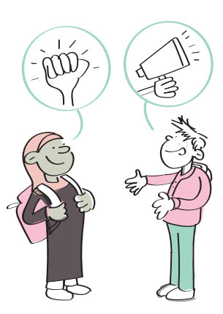
Section 1
Understanding Youth Voice
In this section you will learn about youth voice and why it is important.
Notes:
Section 1: Understanding Youth Voice
This section covers information on the importance of youth voice. You may wish to link this section to any existing youth voice charters or agreements within the setting – such as school or classroom charters or group agreements. If you do not have a pre-existing youth voice charter or agreement, you may wish to use some time in this section to create one with the group.

Slide 11
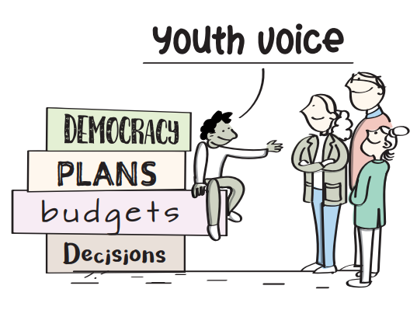
Youth Voice
It is very important that adults listen to children and young people when they are making decisions that affect them.
This is called consultation, and it should happen before any decisions are made.
We know that young people sometimes feel like they are not listened to, and their views are not taken seriously – we want to change this!
Notes:
Facilitator Notes: Youth Voice
Read through above slide, highlighting the importance of youth voice.
You should place emphasis on how consultation with children and young people makes change to happen - when it is done in a genuine, meaningful and representative way.

Slide 12
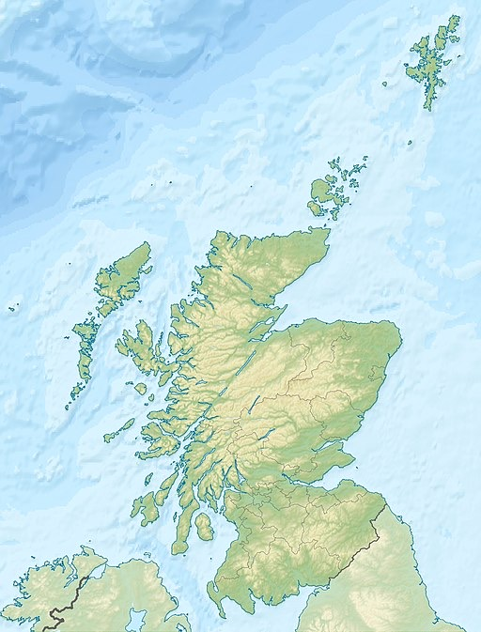
Our Learning Community
Schools and communities across Scotland are very diverse.
Some schools only have a small number of children and young people, and some have over 1,000.
Can you think of some issues that are important to children and young people across Scotland?
Do you think young people across the country feel the same way about these issues?
This Photo by Unknown Author is licensed under CC BY-SA
Notes:
Facilitator Notes: Our Learning Community
This slide is intended to support discussions and connections to place - you may wish to link this to the school learning community.
You may wish to ask young people to locate where they are from, can they find it on this map?
What are the issues that are important to children and young people today?
The slide includes a map of Scotland but you may wish to include more localised information. This slide is intended to encourage conversation about children and young people having similar, different and collective views.
You may wish to ask your group why it’s important to have many views from children and young people on issues that affect them, instead of just having a few.

Slide 13
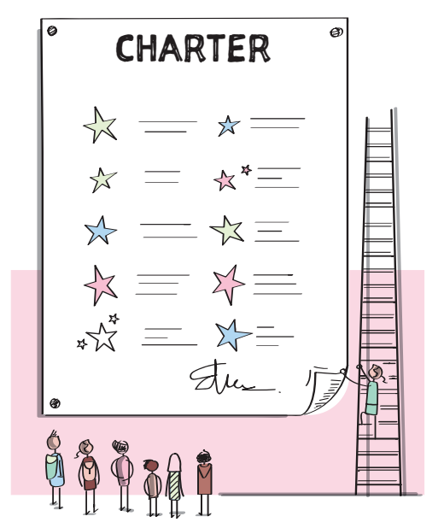
How do we make sure Youth Voice is done correctly?
Children and young people have the right to have their voices heard on issues that are important to them.
One way to make sure this happens properly, is to make a charter that tells adults, how children and young people should be consulted.
An example of a regional charter from Forth Valley & West Lothian is on the next slide.
Notes:
Facilitator Notes: Creating a Youth Voice Charter
As an example, the next slide includes the regional Youth Voice Charter from Forth Valley and West Lothian.
https://blogs.glowscotland.org.uk/glowblogs/fvwlric/youth-voice/

Slide 14
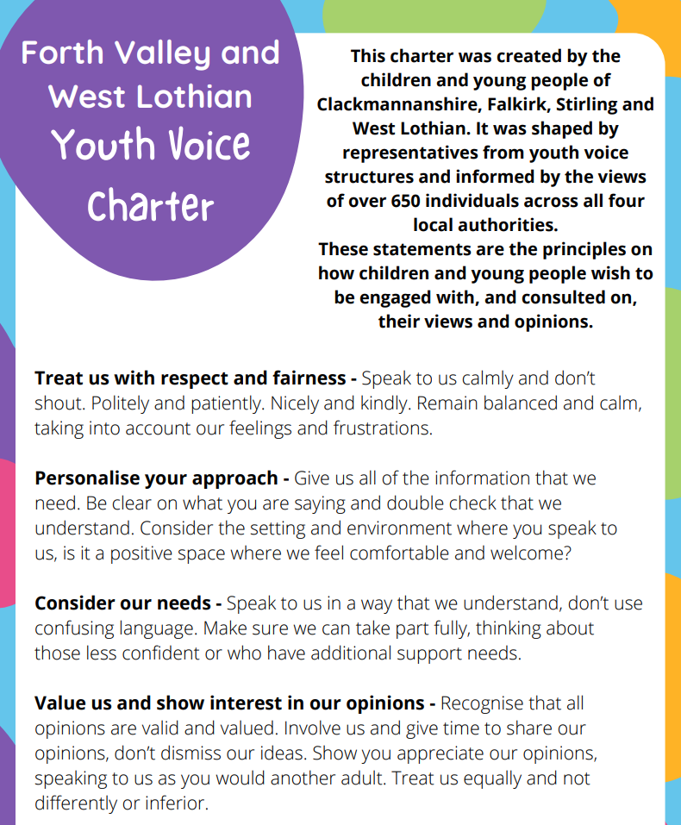
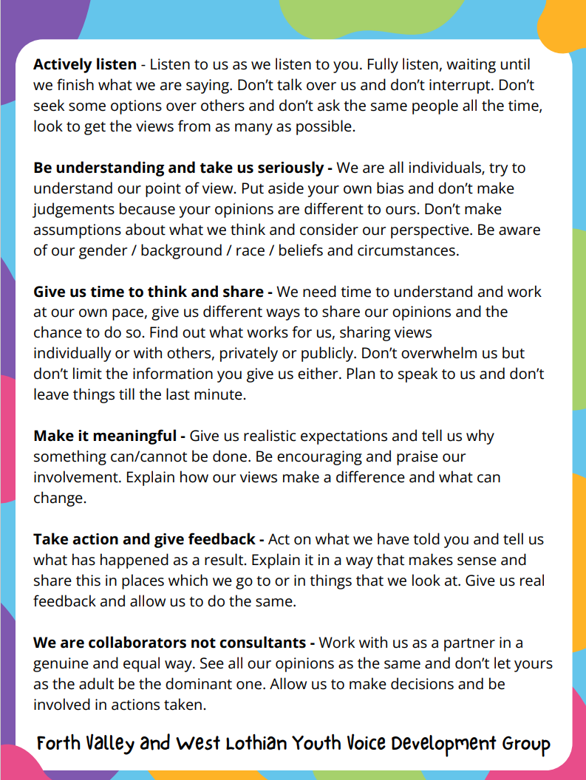
Forth Valley and West Lothian Youth Voice Charter
Notes:
Facilitator Notes: Example Youth Voice Charter
Show the group the charter and read through the statements.
Which statements do the children and young people you work with feel are most important? Is there anything they feel is missing from the charter?
Explain to the group that in Forth Valley & West Lothian, this charter has been agreed across the region and explain that all staff who support youth voice within the 4 local authorities must adhere to these guiding principles.
Additional Information: This charter was created in Spring 2023 based on the views of over 650 children and young people. It was put together by individuals who are involved in youth voice groups (e.g. youth forums, pupil councils, Members of the Scottish Youth Parliament). Young people selected the final visual charter design.

Slide 15
Our Youth Voice Charter
You should have created a youth voice charter for the setting or area and theses are the “rules” of how adults should work with you when they want to hear your views.
Please use this slide to reference to any existing youth voice charters or agreements within the setting – such as classroom, school or community charters or group agreements.
If you do not have an existing youth voice charter – please refer to the steps in the Implementation guidance to create one.
Notes:
Facilitator Notes: Our Youth Voice Charter
You may wish to link this section to any existing youth voice charters within your setting – such as school, classroom or community charters. Any pre-existing charters must present clear guidelines and principles to adults on how they should engage with children and young people when they are looking to consult them.
If you do not have a pre-existing youth voice charter, please refer to the guidance in the Implementation Guide and you may wish to use some time in this section to begin to create one with the group.
If your local authority/organisation already has a youth voice charter you can use this OR you can choose to create your own for your setting.

Slide 16

Having our voice heard
Activity
Discuss, draw, write or make a poster to answer these questions:
Why is it important for adults to listen to children and young people?
Where do children and young people have opportunities to express their views and opinions?
Notes:
Facilitator Notes: Having our voice heard
This activity is intended to gather some baseline data around youth voice and begin conversations about how children and young people can express themselves and be heard.
Discuss why it is important to be heard and ask the group to explain why they think this. You may wish to ask young people for examples when they have felt their voice has (or hasn’t) been heard on a matter that affected them.
For example, a young person may have helped an adult make a decision in school or in the community. School groups, pupil council, eco committees, youth groups and clubs in the community are all ways in which young people can have their voices heard.
Activity: Ask young people discuss, draw, write or make a mind map, illustrative poster or cartoon to answer one or both of these questions:
Why is it important to have your voice heard by adults?
Where do children and young people have opportunities to express their views and opinions?

Slide 17
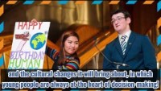
Dear Decision Makers Video…
Video from Scottish Youth Parliament
Notes:
Facilitator Notes: Dear decision makers
Explain to the group that in Scotland, we have members of the Scottish Youth Parliament who are elected by their peers.
Being a member of the Scottish youth parliament is one way to have your voice heard.
They have made this video 'Dear Decision-Makers’ which is a letter to Scotland's Decision-makers.
This video is taken from the Scottish Youth Parliament's 'From Scotland's Young People' manifesto for 2021-2026.
Access Dear Decision Makers Video on Youtube here: https://youtu.be/Qa8rUFGWM1U

Slide 18



Where voice makes a difference
Free Bus travel for under 22’s
Scottish Youth Parliament
Voting at age 16
Notes:
Facilitator Notes: Where voice makes a difference
Use these examples to highlight situations where the views of many children and young people are gathered on particular themes, demonstrating that youth voice can make an extraordinary difference to the lives of children and young people.
Example - Highlight how the voices of children and young people have allowed the creation of free bus travel for anyone aged 11-26 through their Young Scot card and younger through a NEC card.
This happened due to the number of children and young people who highlighted how transport was an increasing barrier. Their voices were listened to and resulted in the creation of this programme.
Example – With continual pressure from the Scottish Youth Parliament, in 2014 the voting age was legally changed from 18 years old to 16 years old.
This allowed all 16 and 17 year olds to vote in Scottish elections and have their views heard for who they believe should govern the country.

Slide 19

Further Resources for Section 1
‘The Right Way’ is a project run by the Scottish Youth Parliament (SYP) and funded by the Scottish Government’s Children’s Rights Unit.
It aims to support and challenge officials and decision-makers, as duty bearers, to work to ensure young people’s Article 12 right is respected.
For Practitioners
Notes:
Facilitator Notes:
This resource can be used to supplement additional learning as part of this section in the resource pack.
The Right Way Resource can be accessed here: https://www.therightway.scot/resources/
Resources — The Right Way

Slide 20

Section 2
Children's Rights
In this section you will spend time learning about Children’s Rights and the UNCRC.

Slide 21
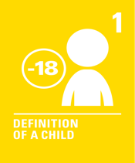






















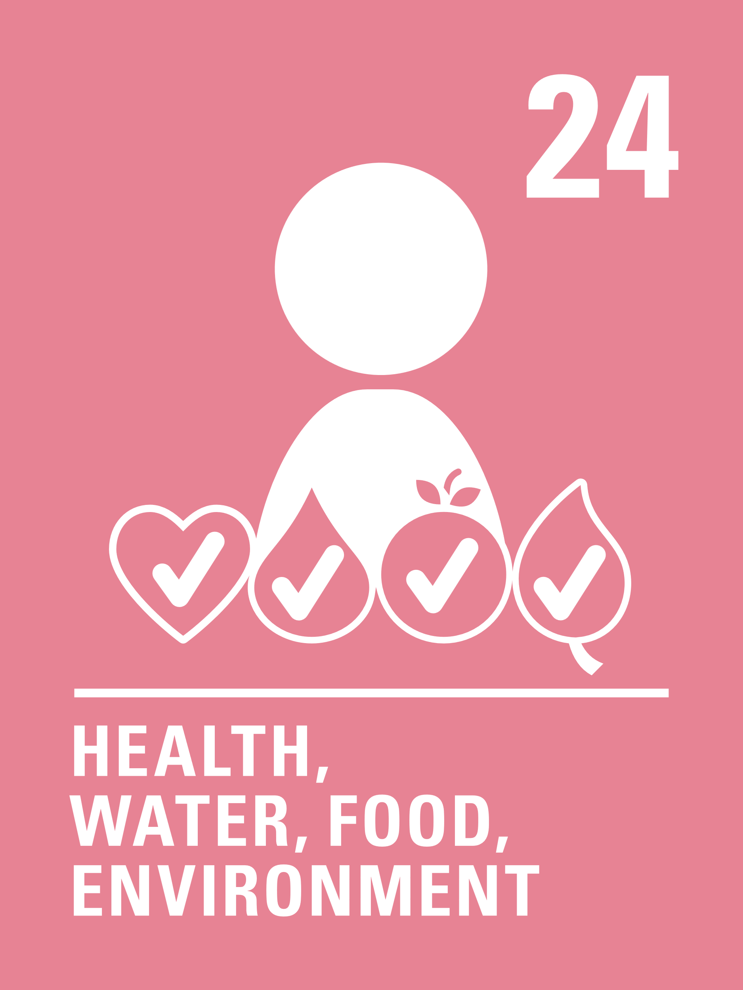


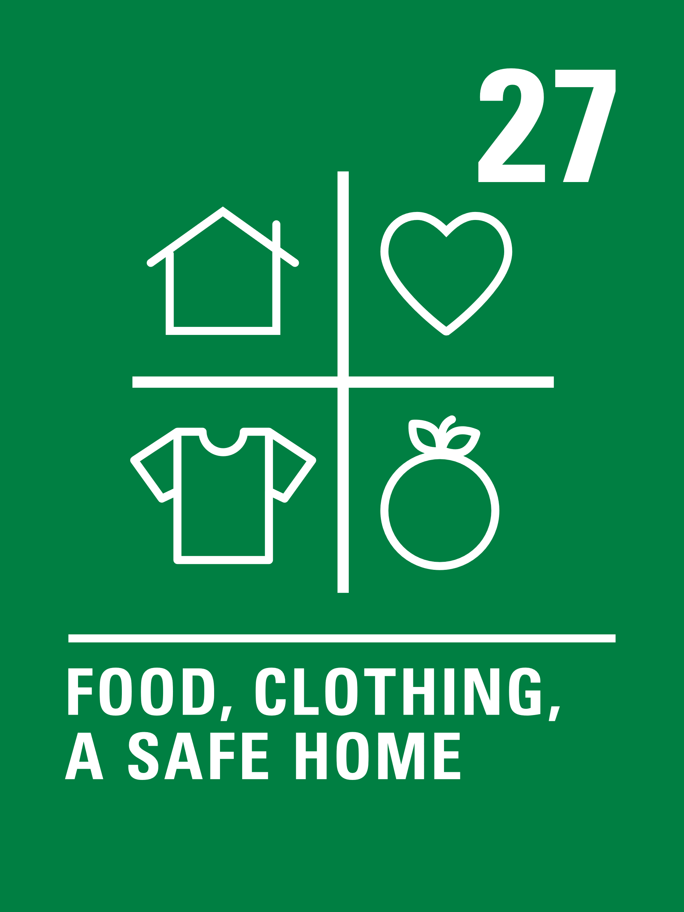

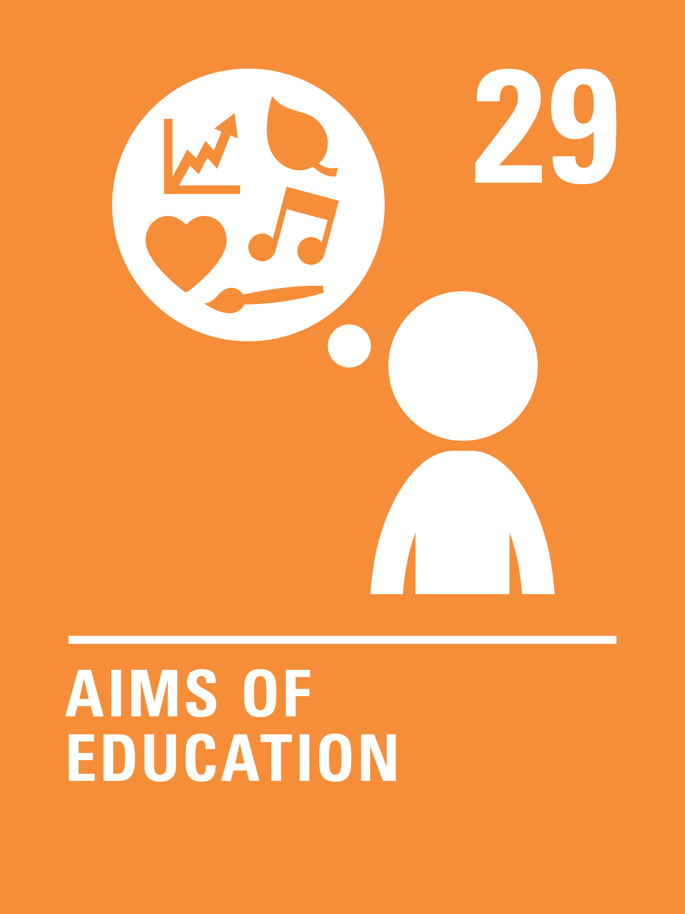





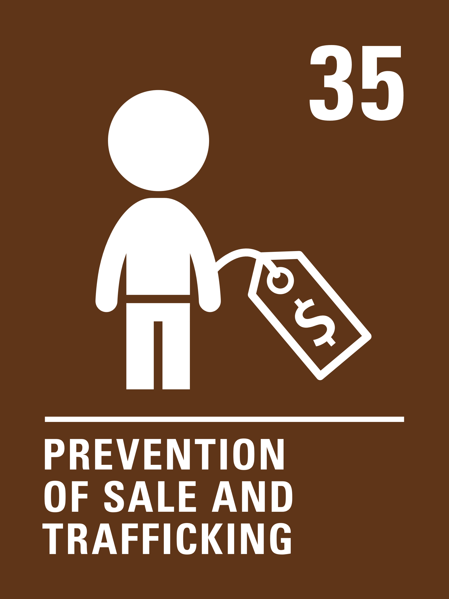



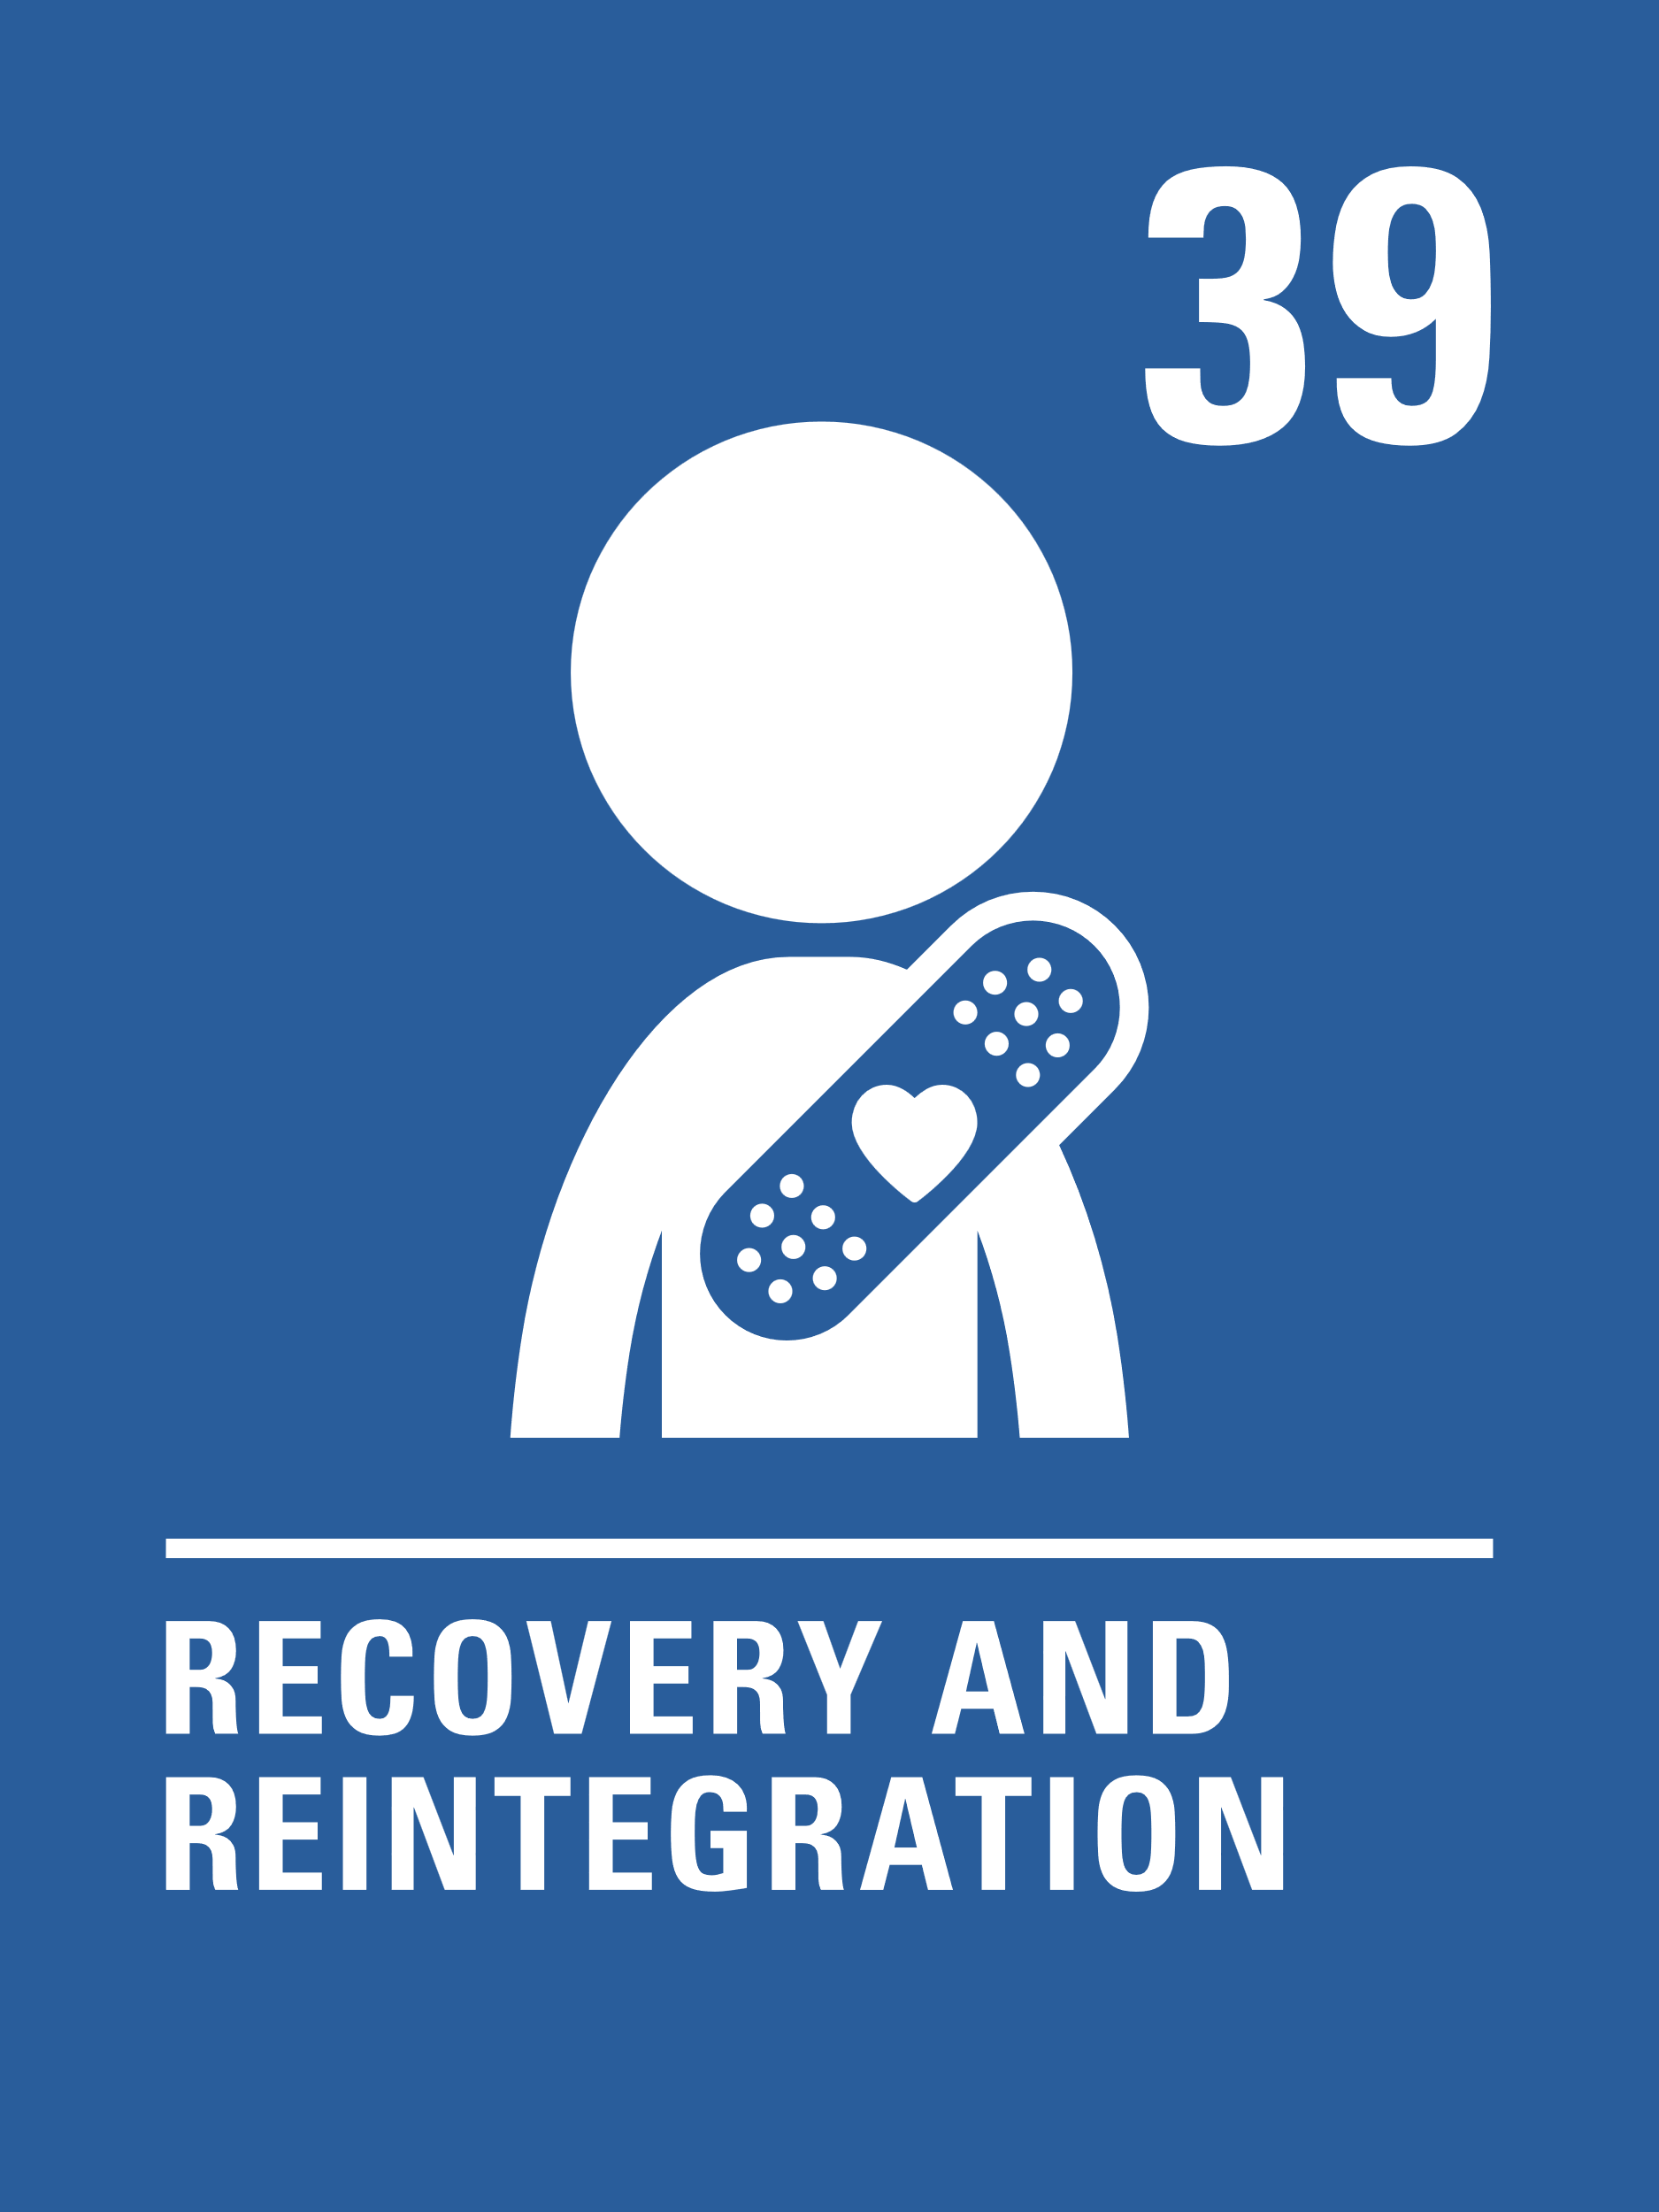




Children’s Rights
Notes:
Facilitator Notes: Children's Rights
The group may already be familiar with the United Nations Convention on the Rights of the Child. It contains 54 articles and all of the articles are equally important.
Discuss what young people already know about their rights, and ensure the young people know they have a right to have their voices heard and listened to (particularly outlined in Article 12).​
Discuss the UNCRC and explain that by using this toolkit and youth voice approach we are:
listening to your views, ​
making sure your views are part of our decision making​
providing you with the information and knowledge to make informed decisions and space to explore what your thoughts are on these subjects.
Images open access and downloadable from:
Child Friendly CRC text and icons - Rights Respecting Schools Award (unicef.org.uk)
https://www.unicef.org.uk/rights-respecting-schools/resources/teaching-resources/guidance-assemblies-lessons/child-friendly-crc-text-and-icons/
There is also a UNCRC poster with symbols here: https://www.cypcs.org.uk/wpcypcs/wp-content/uploads/2020/07/Symbols-Poster.pdf

Slide 22
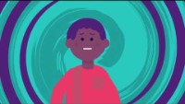
Children’s Rights
We want all adults to make sure that your views and opinions are considered and taken seriously. It is very important that young people are listened to in all matters that affect them – it is your right!
Video from Scottish Government - Children’s Rights and the UNCRC in Scotland
Notes:
Facilitator Notes: Children's Rights
This video introduces the children's rights and reiterates that it is every child’s right be heard and listened to.
This video is from Scottish Government and can be accessed on Youtube here: https://youtu.be/vlakicbEit8
This animation follows four young people on a ‘children’s rights journey’ through their community, interacting with representatives from various public authorities to learn about the practical ways that public authorities can respect children’s rights. Watch the video, discuss the group’s ideas on children’s rights and what is means to them. Also consider why they are important, especially for any specific groups of children?
How can rights help you? – Rights can help us question mistreatment within our society.
Why are rights important? – Rights are important so that children can live a good quality life.
Additional Information:
Link to Education Scotland’s Childrens Rights in Scotland page: https://education.gov.scot/resource-themes/childrens-rights-in-scotland/
Link to Children's Commissioner site for children and young people to learn about their rights - Home - The Children and Young People's Commissioner Scotland (cypcs.org.uk)

Slide 23
Children’s Rights
Discuss
Here are three specific articles from the UNCRC
Article 3
Best interests
of the child
The best interests of the child must be a top priority in all decisions and actions that affect children.
Article 12
Respect for
views of child
Every child has the right to express their views, feelings and wishes in all matters affecting them, and to have their views considered and taken seriously.
Article 13
Freedom of
expression
Every child must be free to express their thoughts and opinions and to access all kinds of information, as long as it is within the law.
Notes:
Facilitator Notes: Children's Rights
Discuss the three specific rights on the slide and explore what these mean with the group.
Ask children and young people to discuss how they feel about these rights, and explain where they feel these rights are respected, protected and fulfilled at school or in the community?​
Explain that this toolkit helps children and young people have many of their rights realised however the main one that it provides for is Article 12

Slide 24

Why are rights important?
Activity
Discuss, draw, write or make a poster to answer this question:
Why are rights important?
Notes:
Facilitator Notes: Why are rights important?
Discuss with young people why it is important to have rights, ask the group to explain why they think this.
Discuss what young people already know about their rights, and ensure the young people know they have a right to have their voices heard and listened to.​
Perhaps consider asking young people to identify where they learn about their rights? Potentially through rights respecting schools if relevant?
If time allows. ask young people to draw, write or make a mind map, illustrative poster or cartoon to answer this question:
Why are rights important?

Slide 25
Focus on Article 12
Discuss
The four things below are important for Article 12. This article says that children and young people have the human right to have their views and opinions heard and taken seriously.
Space
Children and young people must be given safe, inclusive opportunities to form and express their views
Voice
Children and young people must have the chance to express their views
Audience
The views must be listened to
Influence
The views must be acted upon, as appropriate
Lundy Model
Notes:
Facilitator Notes: Focus on Article 12
Within the group, it is important that children and young people to feel secure to share their views.
These 4 elements (space, voice, audience and influence) are a way of ensuring Article 12 is meaningfully protected, respected and fulfilled for every young person.
This is the Lundy model of participation, consider each statement and ask the group to think about what they need in order to feel they have the:​
Space: how can we make sure this feels like a safe space to explore our ideas?​
Voice: how can I help? And how can we help each other to express our ideas?​
Audience: How will you know if your views have been listened to?​
Influence: what will you see if your views are acted upon? How will you feel about this?​
You may wish to ask young people to consider if any of these areas are more important? The answer is that they are all inter-related but it might be interesting to see if one element is more important to your group than others.​
You can find more about the Lundy Model here: https://www.unicef.org.uk/rights-respecting-schools/resources/teaching-resources/guidance-assemblies-lessons/the-lundy-model-article-12-in-practice/

Slide 26
Children’s Rights
Discuss
There are two articles in the UNCRC specifically about education.
Article 28:
Every child has the
right to an education
No matter who they are: regardless of race, gender or disability; if they’re in detention, or if they’re a refugee.
Article 29:
Every child has the
right to an education
Which develops their personality, respect for others’ rights and the environment.
Notes:
Facilitator Notes: Extra articles
Discuss these two specific articles, do the group feel that these rights are respected, protected and fulfilled within their schools/education context?
All articles are listed online here in child friendly language: https://www.cypcs.org.uk/rights/uncrc/articles/
UNCRC Articles Archive - The Children and Young People’s Commissioner Scotland (cypcs.org.uk)

Slide 27
Children and Young People’s Views on Education
“Education helps my personality grow and allows me to get better at things and come out of my comfort zone”
“I think we need to learn more about rights. My family told me things I never learned in school.”
In 2021/2022, children and young people told Children's Parliament, Scottish Youth Parliament, and Together Scotland that:
“I don’t get to show my proper personality at school. At home I would be louder and act different.”
“We are the people that are getting taught, so our voice is important and our feedback.”
Discussion Activity pt. 1
Notes:
Facilitator Notes – Discussion Activity pt 1:
This is a discussion activity using responses from children and young people about education reform.
This activity may link to discussions in the previous slide about how young people feel about Articles 29 and 29.
These are responses from the Children’s Parliament, Scottish Youth Parliament, and Together: https://www.childrensparliament.org.uk/education-reform/
Talk through these statements as a group and use them as prompts to explore what young people agree and disagree with.
Additional Information:
The children's parliament education reform consultation asked children the following statements.
You may wish to use these for form an additional discussion activity with the group:
Do you agree or disagree that you learn about these things when you are at school….
1. My education helps me to develop my personality, talents and abilities to their fullest potential.
2. My education helps me develop respect for human rights and freedoms.
3. My education helps me to develop respect for my parents/carers, my cultural identity and language.
4. My education helps me to develop respect for other countries and peoples.
5. My education prepares me for a responsible life in a free society, in the spirit of understanding, peace and tolerance.
6. My education helps me to develop respect for the natural environment.
7. My education helps me to develop respect for the national values of Scotland.
Then there were another 7 statements. They asked children to think about if they agreed or disagreed with them too.
They were more about whether children like learning and school and whether they have their say about their learning and life at school. In this report, they call these the happy at school and having my say statements. They said:
8. My education meets my needs as a learner.
9. My education will help me to realise my goals.
10. I am involved in making decisions about my learning.
11. The views of children should be taken seriously when schools are inspected.
12. My school is good at using technology to support my learning and assessments.
13. I enjoy learning.
14. I enjoy school.

Slide 28
Children and Young People’s Views on Education
“My friends and teachers encourage me to do things I didn’t think I could.”
“It teaches us what we shouldn’t do to other people to respect their rights. We learn about the rights of the child and create a class charter focusing on different articles.”
In 2021/2022, children and young people told Children's Parliament, Scottish Youth Parliament, and Together Scotland that:
“Some people who like sport in PE show their personality, and who like writing also show their personality. But those who like drawing, dancing, singing, only get to show personality at break.”
“It’s the adults that decide what we learn. That’s why it’s not fun.”
Discussion Activity pt. 2
Notes:
Facilitator Notes – Discussion Activity pt 2:
This is a discussion activity using responses from children and young people about education reform. This activity may link to discussions in the previous slide about how young people feel about Articles 29 and 29.
Talk through these statements as a group and use them as prompts to explore what young people agree and disagree with.
Additional Information (same as previous slide)
The children's parliament education reform consultation asked children the following statements.
You may wish to use these for form an additional discussion activity with the group:
Do you agree or disagree that you learn about these things when you are at school….
1. My education helps me to develop my personality, talents and abilities to their fullest potential.
2. My education helps me develop respect for human rights and freedoms.
3. My education helps me to develop respect for my parents/carers, my cultural identity and language.
4. My education helps me to develop respect for other countries and peoples.
5. My education prepares me for a responsible life in a free society, in the spirit of understanding, peace and tolerance.
6. My education helps me to develop respect for the natural environment.
7. My education helps me to develop respect for the national values of Scotland.
Then there were another 7 statements. They asked children to think about if they agreed or disagreed with them too.
They were more about whether children like learning and school and whether they have their say about their learning and life at school. In this report, they call these the happy at school and having my say statements. They said:
8. My education meets my needs as a learner.
9. My education will help me to realise my goals.
10. I am involved in making decisions about my learning.
11. The views of children should be taken seriously when schools are inspected.
12. My school is good at using technology to support my learning and assessments.
13. I enjoy learning.
14. I enjoy school.

Slide 29
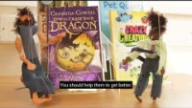
Children's Rights: what (not) to do
Watch this video from Children's Parliament Investigates…
How Professionals Make Rights Real
Notes:
Facilitator Notes: Children’s Rights what not to do
Watch the video and discuss with the group - What do children and young people think of this video?
A tongue-in-cheek puppet show made by the Clackmannanshire Children's Parliament Investigators to help adults who work with children understand how their words and actions impact the children they work with.
Ask the group to think of a situation where a children or young person’s voice isn’t heard?
Can they think of other examples where they see adults making decisions without thinking about children and young peoples views?
You may wish to ask the group to design a cartoon or a poster explaining how the adult could deal with the situation differently by listening to the child / young person.
Video link here – What (Not) To Do - Children's Parliament Investigates How Professionals Make Rights Real (youtube.com)
https://www.youtube.com/watch?v=MHQzlXsrt2U
For more information on How Professionals Make Rights Real: Children's Parliament Investigates - How Professionals make rights real (childrensparliament.org.uk)
Additional resources here: Dignity In School – A home for school-based humans rights practise. (childrensparliament.org.uk)

Slide 30

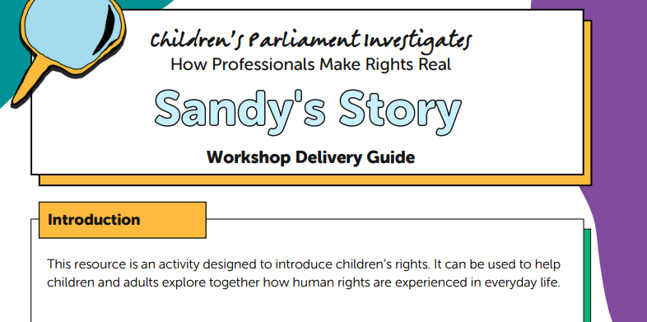
Further Resources for Section 2
For Practitioners
Young Scot
Activate Your Rights Pack
includes Rights Bingo
Childrens Parliament
Sandy’s Story
Notes:
Facilitator Notes: Additional resources
Depending on the group, here are additional activity ideas for section 2
Young Scot: You may wish to use an activity from the Young Scot Activate Your Rights Pack – activities include rights bingo, card games and role play.
Link here: https://static1.squarespace.com/static/5cee5bd0687a1500015b5a9f/t/5f71c92b8bc67827189fc65b/1601292625763/Activate_your_rights_Pack_V4.pdf
Simple rights bingo is on page 19
Advanced rights bingo is on page 72
Activate_your_rights_Pack_V4.pdf (squarespace.com)
Childrens Parliament: Depending on the group, you may wish to use Sandy’s Story here: https://investigates.childrensparliament.org.uk/wp-content/uploads/2022/04/Sandys-Story-1.pdf
It is an activity designed to introduce children’s rights.
By telling Sandy’s Story it can be used to help children and adults explore together how human rights are experienced in everyday life.
This resource was originally written for using with groups of adults and children together but can work well with groups of children/young people of all ages.
Sandy's Story (childrensparliament.org.uk)

Slide 31
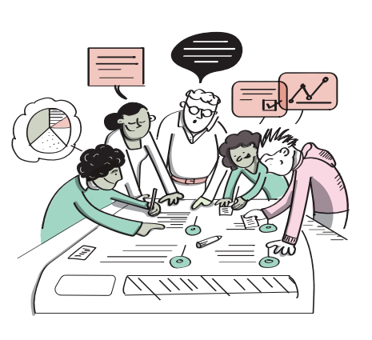
Section 3
Working as a team and becoming researchers!
In this section you will undertake teamwork activities and spend time thinking about becoming researchers.
Notes:
Section 3: Working as a Team
This section covers teamwork and supports young people to develop approaches to working together and an increased ability to work as a team.
This is essential as they will be required to work together when researching and consulting their peers on a particular theme.
There are a few initial activities that can be done however you do not need to do all of them. There may be other teambuilding activities that you would prefer to use than those included in this toolkit.

Slide 32

Count Up!
Activity
As a group, count up to twenty with your eyes closed and without any other communication.
People cannot say more than one number at a time, and if two people speak at the same time, the group must start again!
Notes:
Activity: Count Up
In Count Up, the group have to come together and count up to twenty with their eyes closed (or their eyes can be open can they can’t make any gestures/signals) and without any other communication. People cannot say more than one number at a time, and if two people speak at the same time, the group must start again. Though it seems simple, this team building exercise can really demonstrate the power of effective teamwork.
Facilitator Note: If the group are struggling to reach twenty, adapt the activity and count to ten first.

Slide 33


Would you rather?
Activity
Notes:
Activity: Would you Rather?
Utilise would you rather statements as appropriate with the age group and circumstances of the children and young people you are working with.
Add in different statements as appropriate.
Encourage discussion between team members by asking them to decide what they would rather and why:
Would you rather live the rest of your life without your TV or phone?
Would you rather give up access to Instagram or Snapchat?
Would you rather have a video game come to life or you get trapped inside a video game?
Would you rather watch the same movie on repeat for the rest of your life or listen to the same two songs for the rest of your life?
Would you rather have free Wi-Fi wherever you go or unlimited battery life?
Would you rather have everything you think appear above your head or everything you do be streamed live on YouTube.

Slide 34

Open Fist Activity
Activity
Finding things that we have in common as a group!
Notes:
Activity: Open Fist
Finding things in common with other team members is one of the foundations of good teamwork.
Open Fist is a simple, effective activity, to support young people to share facts about themselves and bond with others in the group.
1. Participants sit in a group. Ask participants to sit in a circle and raise their right fist.
2. Begin the activity. The first player calls out an interesting little known fact about themself. (Examples: I have travelled to London, I like science fiction novels, or I play the guitar.)
3. Ask the other participants to open one finger from their fist if this statement is also true for them.
4. Change players. Ask the first player to point to any other player who will then become the second player.
5. Repeat the process so that everyone has a chance to share a little-known fact or until someone's fist is fully open.
6. Encourage conversation. Allow time for participants to talk and learn more about what they have in common
7. Summary. Highlight how many in the group how have an open first and how this shows that everyone has so much in common
Activity from - Open Fist | SessionLab

Slide 35
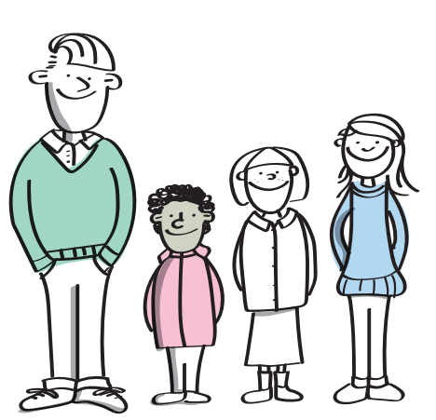
What makes a good team?
Activity
Discuss, draw, write or make a poster to answer these questions:
What makes a good team?
What makes a team work well together?
Notes:
Facilitator Notes: What makes a good team?
Ask the group to think about and discuss what teams they can think of – sports teams, workplace or school teams, community groups, famous teams etc.
Ask the group to discuss, then draw, write or mind map one or both of these questions:
What makes a good team?
What makes a team work well?
Highlight that a good team includes: Trust, good communication, patience, respect, understanding, energy/motivation, supportive teammates, everyone being included, friendly atmosphere,
Highlight that a team works well when everyone treats each other fairly and no one tries to push anyone around, dominate, be mean etc.
It’s also important to note that teams that work well are good at planning who is doing what, and not letting teammates down.

Slide 36



Recycle Towers
Activity
Work in teams to build the tallest tower possible, using only the recycled materials.
Notes:
Activity: Recycle Towers
The purpose of this activity is to build the tallest tower possible using only newspaper and tape, within a given time frame.
If you don’t have any newspapers, this activity could still work with other recycled materials.
The team that builds the tallest tower wins the game, but the challenge can also be judged based on artistic design and creativity for an all-rounded winner.
Divide the main group into teams of 2-4 people.
Give each team an equal pile of newspaper/paper and a roll of tape.
Set a timer for 5-10 minutes and signal when the teams can start building.
Teams must only use newspaper and tape to build their tower.
No other supplies, such as glue or staples, are allowed.
Once the time is up, all teams must stop working on their towers.
The tallest tower made solely of newspaper wins the game.
Any tower that falls over before being judged cannot be repaired or rebuilt.
For a harder game, use less (or no) tape.
Alternatively, you could judge based on a point system that gives credit for artistic designs and creativity as well as the height of the tower.

Slide 37
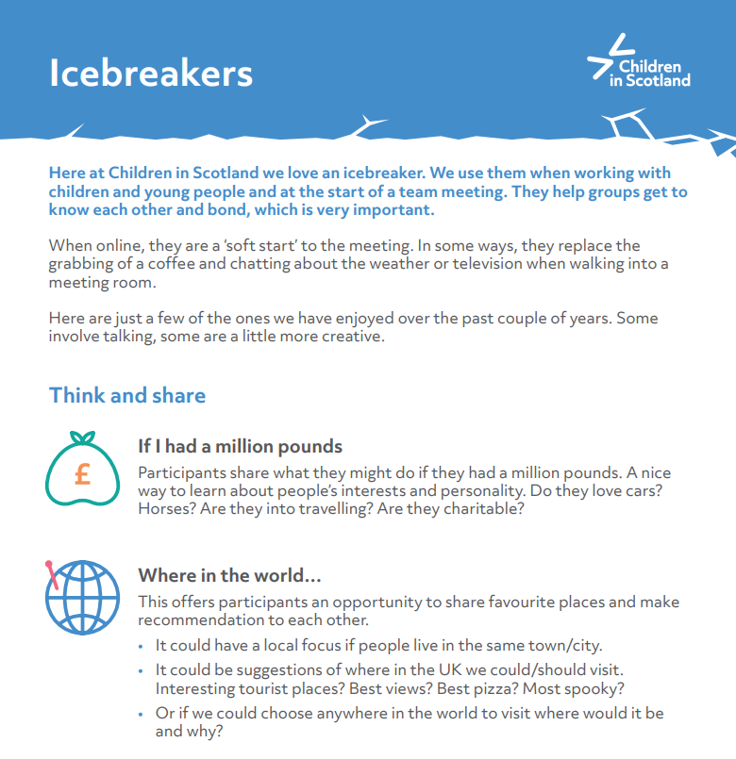
Additional Icebreakers
Children in Scotland have a selection of Icebreaker activities here: Icebreakers
For Practitioners
Notes:
Children in Scotland Additional Icebreakers can be found here: https://childreninscotland.org.uk/wp-content/uploads/2023/06/Iceebreakers_June-23.pdf

Slide 38
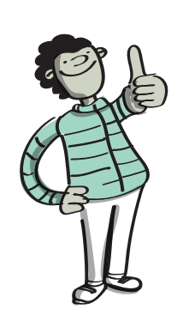
Creating a team plan
Activity
There are many important parts to making a team work.
Think about….
                Who?
                What?
                Why?
                When?
                How?
Notes:
Facilitator Notes: Creating a Team Plan
Depending on the group and context, it may be helpful to make a team plan.
Explain to the group that it would be helpful to have a team plan so that the team are all in agreement about who, what, why, when and how of this project.
You may wish to re-iterate that all answers are valid in this activity and reflect back to earlier discussions about what makes a good team.
Who – Who is in the team, do we all know each other and recognise the skills that we bring?
What – What the team is, and what are we planning to do as a team?
Why – Why is it important? Why is the team doing what it’s doing? What’s the purpose of the group?
When – Timescales of the group, does it have an end-date or will this be a long term project?
How – How are we going to work together? Do the group want to create a group agreement? How the team is going to achieve what it needs to achieve: rules and activities
Continue discussing the Who, What, Why, When and How of the team to get answers from the children and young people.
You may wish to use flipchart paper and post it notes to create a plan or group agreement that you can adapt and refer back to as you move through this toolkit.

Slide 39
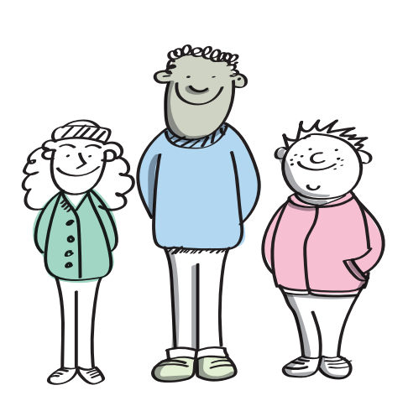
Becoming Researchers
Research is a good way for us to find out about different topics and situations. As a youth voice team can help you find out what is important to other children and young people.
To do a piece of research, you will speak to other children and young people about a certain topic to find out what they think.
This means more children and young people have their voices heard on matters that affect them. Because research asks about personal thoughts and opinions, it has to be approached with the greatest of respect.
Notes:
Facilitator Notes: Becoming a Researcher
Explain to the group that they will be doing research to find out what other children and young people think.
You will be supporting them so that they can undertake a piece of research with their peers.
Research means asking people their personal views and opinions so it must be approached with the greatest of respect.
The next slide will explore in more detail what respect means.

Slide 40

What is respect?
Discuss
What does respect mean?
What does it feel like to be respected?
Notes:
Facilitator Notes: Respect
Ask the group as a whole:
What does respect mean?
What does it feel like to be respected?
You may wish to refer back to the Youth Voice Charter from section 1 to explore the meaning of respect in this context.
Example: You are doing research on school attendance and asked someone why they don’t come to school often. The person told you school was boring – you don’t agree with this, but you want to find out more. What do you do and how do you stay respectful?

Slide 41
What is respect?
“Respect means that you accept someone for who they are, even when they are different from you or you don’t agree with them”
Notes:
Facilitator Notes: Respect
Here is one definition of respect to discuss, do the group agree with this?
“Respect means that you accept someone for who they are, even when they are different from you or you don’t agree with them”

Slide 42
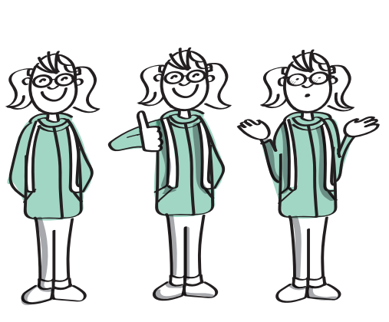
Being a respectful researcher
What does Data mean?
It is information we collect, like numbers, words, pictures or facts, that help us understand things and make decisions
When starting a piece of research, there are a few things to think about...
How will you keep private information safe?
How will you use the information that you collect safely?
Remember, don’t change what the data tells you – even if you don’t agree.
We can’t change the meaning of data!
Notes:
Facilitator Notes: Being a Respectful Research
When starting a piece of research, there are a few things to think about...
How will you keep private information safe?
How will you use the information that you collect safely?
Make sure group members understand what data means using the text at the top of the slide to support this
Reflect on the messages in the previous slide and ask group views on this.
Explore how would they feel if someone shared sensitive information about them?

Slide 43
Trust in research
Trust is important in research because you want people to tell you honestly what they think.
Trust is built in very small moments
Active listening
Taking it seriously
Valuing everyone's views equally
Notes:
Facilitator Note: Trust in Research
It is important to explain the importance of trust in research.
Ask the group to suggest how they could help to build trust when doing a piece of research, ie. – good listening, valuing everyone's views.

Slide 44
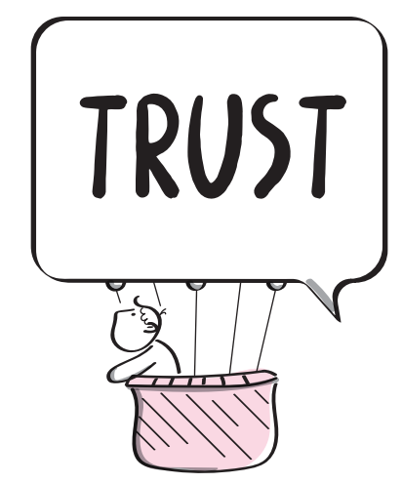
Trust in research
How can trust be lost?
Trust can be lost very quickly
Notes:
Facilitator Note: Trust in Research
Ask the group to identify scenarios where trust can be lost?
It is important to explain the sliding doors analogy to young people (full definition below) – when undertaking research, there is opportunity to gain trust and the opportunity to lose trust.
Reflecting on the discussions from the previous slides, perhaps you may wish to share examples on when/how this could happen.
Sliding door analogy of Trust: Trust is like lots of little doors that open and close every day. Each time you have a choice like whether to listen to a friend, tell the truth, or keep a secret, you’re standing at one of those doors. If you make a choice that shows kindness and honesty, the door opens and trust grows stronger. But if you choose to ignore, lie, or let someone down, the door can close and trust gets weaker. Trust isn’t built in one big moment, but in lots of small choices that show you can be relied on.

Slide 45
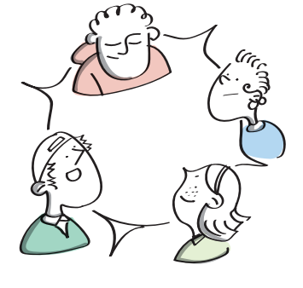
Group Circles
Trust Activity
Activity
Stand in a circle
Put your hands forward with palms facing the roof
Make a fist with your hands
Extend only your index fingers
An object will be placed on your fingers
Lower the object to the ground
Don’t lose contact or drop the object!
Notes:
Facilitator Notes: Group Circles
Have the group stand in a circle – if you have a large group you may wish to split into multiple circles.
Stand in a circle with hands extended in front, parallel to the ground with palms towards the roof.
Ask the group to make fists with their hands and extend only the index finger out.
Gently place an object, like a hula-hoop or book, onto their extended fingers, making sure everyone is included.
Ask the group to lower that object to the ground gently without losing contact with the object or dropping it.
This can be a challenging activity and the group will need to come up with a strategy to make it work.
If the group manage to do the object fairly easily put a more challenging object in the centre to represent different levels of trust

Slide 46

The Marble Jar of Trust
Activity
What would help to build trust?
What would break trust?
Notes:
Facilitator Notes: The Marble Jar of Trust
This activity is based on Brene Brown’s research on trust, she found that trust isn’t an event – it develops incrementally over time.
Please use practitioner judgement with this activity - you will need to consider whether this activity around trust could upset any of the group.
You may wish to draw out marble jars on paper or use a real jar and marbles to illustrate this activity.
Ask the group to think about a time either when someone has gained their trust, or someone has trusted them.
What did they do? Or what did you do? What did you do to make the person feel safe and secure? Or what did they do?
Building trust could include – showing a genuine interest, seeking others input and opinions, give time for conversations, listen with empathy.
Breaking trust could include – dominating conversations, not listening, cancelling, not sharing research findings.
Explain that trust, respect and value are all important to keep filling the marble jar, this is important to consider how children and young people can incorporate trust within the research process.
Further Information: Brene Brown uses the marble jar as a metaphor for teaching that trust is built slowly, over time, and in small moments. This metaphor is based on a story about Brené’s daughter, Ellen, and a difficult experience she had related to trust with her classmates in elementary school. After learning about the marble jar metaphor, young people can start to identify what specific behaviours build trust and what behaviours might break trust or empty the marble jar. There is a short 3 minute video here: The Lesson Brené Brown's Daughter Learned About Trust | SuperSoul Sessions | Oprah Winfrey Network – YouTube
Accessible on Youtube: https://youtu.be/6442YcvEUH8 (copy and paste the link into your browser)

Slide 47
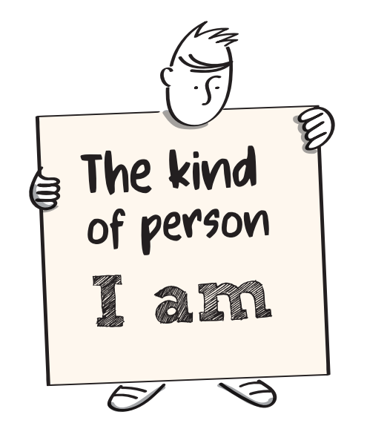

Characteristics of a researcher
Activity
Notes:
Facilitator Note: Activity - Characteristics of a researcher
Using paper to draw it out, or in discussion - ask the young people to identify what are the characteristics of a good researcher?
Is it that they are open-minded, sensitive, compassionate?
Or is it that they have a genuine interest in the topic?
Maybe they like data and studying research?
The key is that anybody can be a researcher – as long as they understand the principles of ethics and understand the research methods.
It is important that researchers put the person at the heart – in this case it is important that the researchers have children and young people’s voices at the heart of their research.

Slide 48


Me as a researcher?
Activity
Think of YOU as a researcher and fill in the boxes below...
Things I would do as a researcher...
Things I would NOT do as a researcher...
Notes:
Facilitator Note: Me as a Researcher
Ask the group to complete this activity, either on paper individually or as a group flipchart activity - to identity characteristics which they will have as researchers and those they will NOT have.

Slide 49
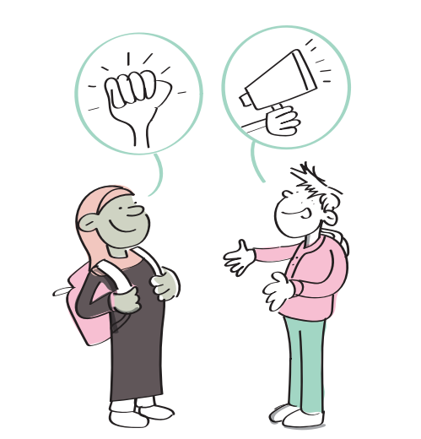
Finished this section?
Well done! You now know the important parts about youth voice, rights, teamwork and being a researcher.
Now move on to Part 2 and get started with your research!
Notes:
Facilitator Note:
When finished Powerpoint 1 – move to Part 2 Powerpoint 2 and get started with the research!

