Slide 1
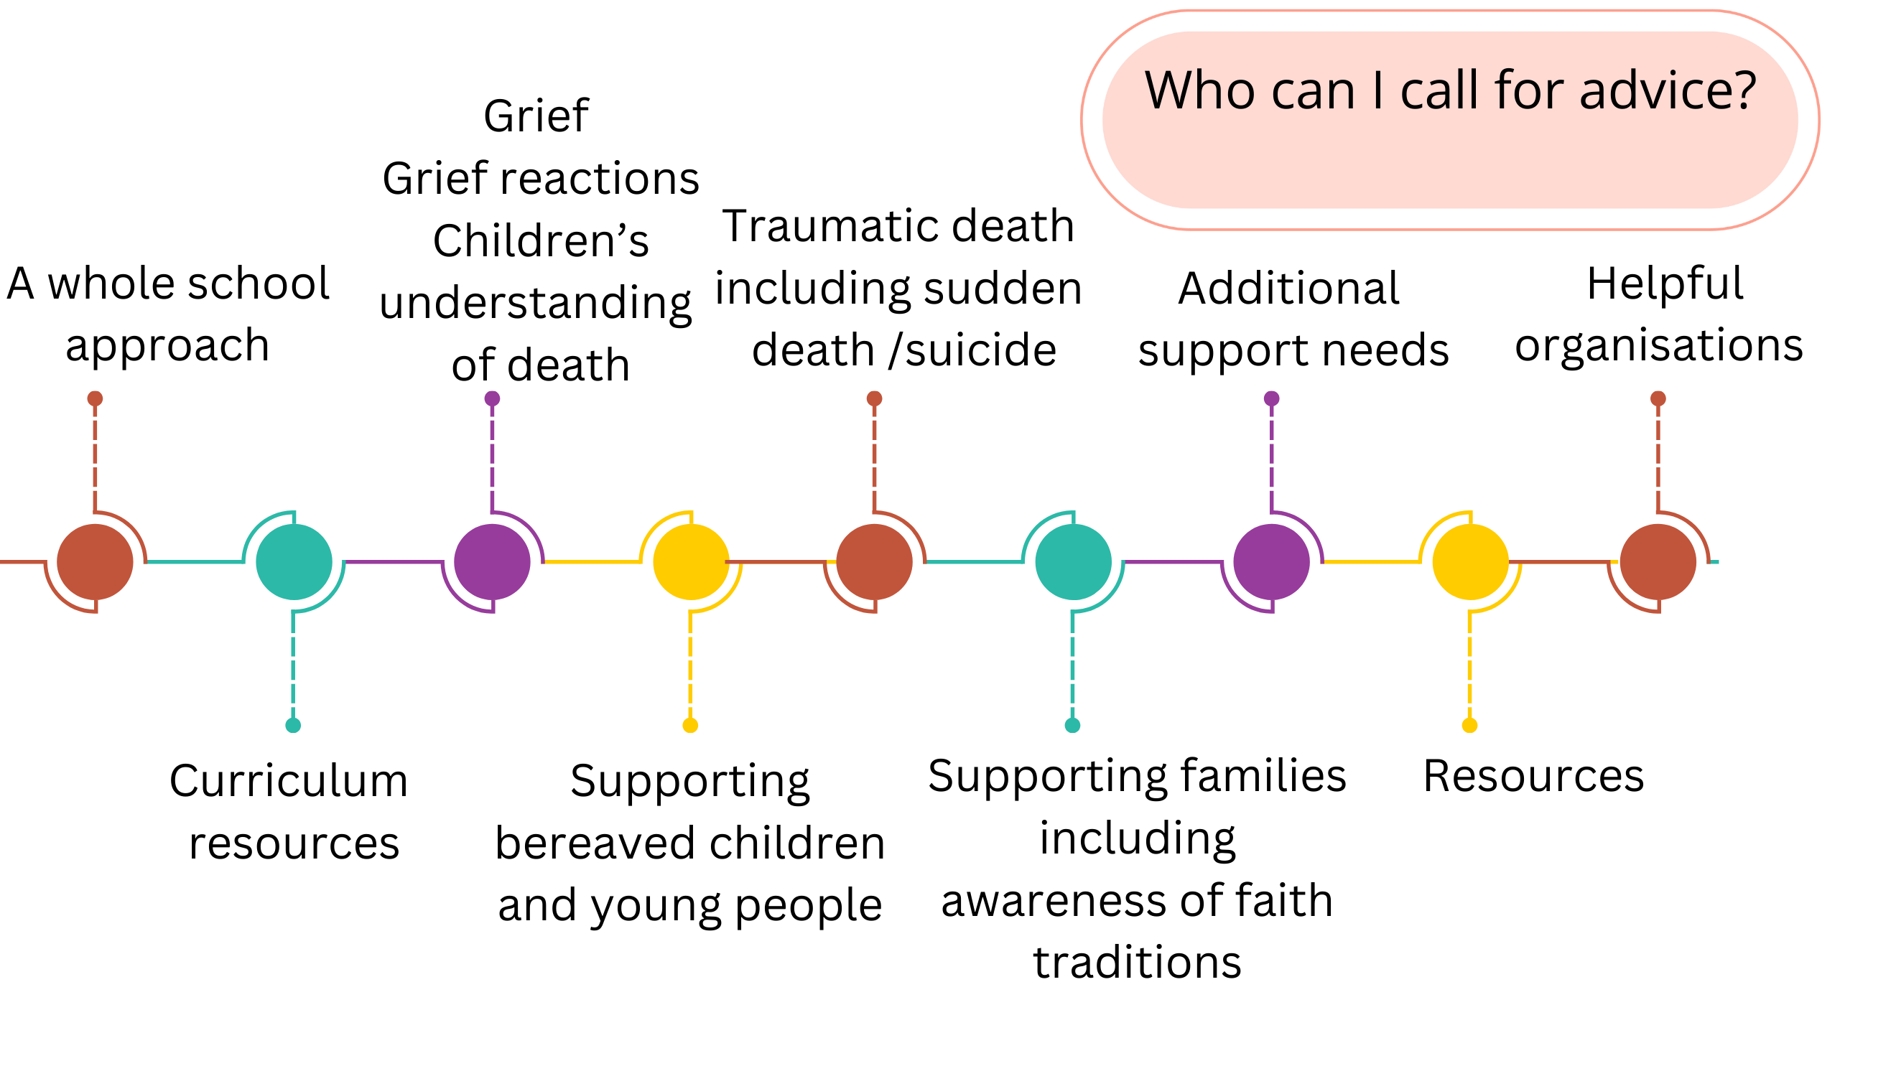
Useful Resources and contacts
For Scotland’s learners with Scotland’s educators

Slide 2



Bereavement: a whole school approach
The Growing in Grief Awareness programme is a whole-school framework, free to primary and secondary, specialist settings and mainstream schools across the UK. It includes a downloadable audit tool and linked action plan.
Being a supportive manager for school leaders
The Cycle of wellbeing draws together a wide range of national guidance and resources published to support the wellbeing of staff and children and young people.
Local Authority publications
Partners in some local authorities have collaborated to develop whole school/community approaches. For example:
A Whole School Approach to Supporting Loss and Bereavement Updated and amended 2016 Glasgow City Council and NHS Greater Glasgow and Clyde 70 pages
A Community Approach to Supporting Bereavement, Loss and Grief East Renfrewshire Council 2024 64 pages

Slide 3
Curriculum Resources 1
East Renfrewshire Bereavement Loss and Grief Team Lesson Plans-resources for P1 to P7
This includes 3 lessons for each primary stage.
The Resilience Project: Educating and Supporting Children around Death, Dying and Bereavement St Francis Xavier’s Primary School, Falkirk
This includes 5 lessons for 2nd level on death, loss and grief.
Having honest conversations about death and grief
This includes a training tool for staff and materials to use in the primary or secondary setting.
There are many opportunities to explore death throughout the curriculum including through biology, literature, art and RMPS.

Slide 4
Curriculum Resources 2
East Renfrewshire Bereavement Loss and Grief Team Lesson Plans-resources for P1 to P7
There are 3 lessons for each primary stage entitled Learn, Explore and Grow.
Learn: this lesson aims to introduce some of the feelings which a loss, change or death can
bring. Stories and film clips are used to generate discussion about how people can manage
these feelings.
Explore: the second lesson explores these themes in more detail. Through group discussions and interactive activities the pupils will consider what death means, what grief is, what people need when they are bereaved and how we can help others.
Grow: the final lesson is focused on building resilience and promoting wellbeing through trying different creative and interactive strategies. This could be related to the themes of loss and grief such as making memory boxes or related to resilience more widely such as practicing gratitude or breathing techniques.
The Resilience Project: Educating and Supporting Children around Death, Dying and Bereavement St Francis Xavier’s Primary School, Falkirk This includes 5 lessons for 2nd level on death, loss and grief.
For Scotland's learners, with Scotland's educators

Slide 5


Grief, grief reactions and children’s understanding of death
What is grief? Child Bereavement UK Animation 2.03s
Puddle jumping Child Bereavement UK Animation 1.12s
Common grief reactions by age and stage
Children’s understanding of death at different ages Child Bereavement UK webpage and video 4.48s
This film explores both understanding of death across the age ranges from baby to teenager and behaviours that are often exhibited.

Slide 6
Bereavement: supporting children and young people
General
Supporting children and young people who are grieving Cruse 7 pages
Explaining death and dying to children Child Bereavement UK
Talking to children who are bereaved NES animation aimed at health professional but suitable for education practitioners. 5m 22s
Early Years
Supporting a bereaved child in an Early Years setting Child Bereavement UK
Supporting bereaved children in the early years ​ a longer webinar by Beck Ferrari Clinical Co-lead at the UK Trauma Council. Starts at 7m 21s and finishes 1h 24m
Primary
Supporting a bereaved pupil in a primary school Child Bereavement UK
Secondary Supporting a bereaved student in secondary school Child Bereavement UK

Slide 7
Supporting families including awareness of faith traditions
Working with bereaved families Child Bereavement Trust
Faiths, beliefs, cultures and communities Child Bereavement UK This explores what we need to be aware of in terms of supporting bereaved families from different faith traditions.
Lasting Post gives practical advice on all the tasks that need to be completed after a death including the funeral etiquette for different faiths.
General
Developing religious literacy in the Rights and Equalities section of the Informed level of the Inclusion, Wellbeing and Equalities Professional Learning Framework.

Slide 8
Resources
Examples of good practice and resources to support children and young people are summarised in these booklets:
A Community Approach to Supporting Bereavement, Loss and Grief East Renfrewshire Council 2024
P.36 Early Learning and Childcare
P.59 Primary school
P.65 Secondary School
A Whole School Approach to Supporting Loss and Bereavement Updated and amended 2016 Glasgow City Council and NHS Greater Glasgow and Clyde
P.39 Early Years and Childcare
P.41 Primary
P. 49 Secondary
CBI_Book_List_Grief.pdf
Books and Resources Child Bereavement UK

Slide 9
Bereavement support following traumatic deaths
Critical Incidents
Managing a sudden death in the school community –including the first 30 minutes, breaking bad news, supporting the bereaved family, supporting school staff, traumatic deaths.
Critical Incidents in Educational Communities – includes guidance, policy framework, lesson plans, inset and meeting with parents UK Trauma Council.
Suicide
Step by Step resources | Samaritans This website gives information on a range of considerations following a suspected suicide.
Help when we needed it most: How to prepare for and respond to a suspected suicide in schools, colleges and other youth settings in the UK The Samaritans. This is a short summary of the information in the Step by Step website.
Explaining to a child that someone has died by suicide Child Bereavement UK 4m 51s
Sudden death/Traumatic Grief
Sudden Unexplained Death in Childhood advice for school staff on death of a sibling
Traumatic Grief is a suite of professional learning resources including animations developed by the UK Trauma Council.

Slide 10
Bereavement and additional support needs
Bereavement as an additional support need
A child or young person has additional support needs if, for any reason, they need extra or different help than others their age to benefit fully from their education. Bereavement can therefore lead to additional support needs.
Learners with existing additional support needs
Additional support needs cover a vast array of needs. The articles below focus on those with learning needs and autistic children and young people.
Bereavement, Loss & Grief - Ways of helping a child or young person with ASN East Lothian Council
Bereavement and pupils with SEND (additional support needs) a landing page leading to coverage of a variety of topics (English education context but universal messages)
Supporting Autistic Learners with Bereavement by NAIT

Slide 11

Who can I call for advice?
You can also find helpful information about supporting bereaved children and young people from:
Child Bereavement UK - Tel 0800 02 88840 Monday to Friday 9am-5pm or for families, young people and professionals, or Live Chat via Child Bereavement UK website.
Grief Encounter - Tel 0808 802 0111 Monday to Friday 9.30am-3pm
Winston's Wish Strategy for schools - Tel 08088 020 021 Monday to Friday 9am-5pm
Petal Support - 01698 324502
Petal is a support service for those affected by murder, culpable homicide, and immediate family members of people who have taken their own life
Cruse National Bereavement Helpline: 0808 802 6161 Mon - Fri 9am - 8pm, weekends 10am - 2pm
SUCD UK Sudden Unexplained Death in Childhood info@sudc.org.uk 07880 350 942
Your local Psychological Services can also offer support and advice.
Survivors of Bereavement by Suicide (SOBS)Support, information, help by email, support groups and a national helpline: 0300 111 5065, 9am-9pm Monday-Friday

Slide 12
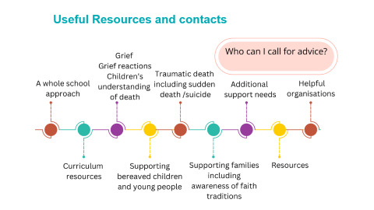

Helpful Organisations
At a Loss provides the UK's bereavement signposting website
Child Bereavement UK works with families and children when a child dies or experiences bereavement and has information for everyone affected.
Winston’s Wish works with children who have been bereaved and has information for everyone affected.
Seasons for Growth (the Notre Dame Centre) - a programme for children, young people or adults who have experienced significant change or loss.
PETAL (People Experiencing Trauma and Loss) provides practical and emotional support to those affected by murder or suicide.
The Samaritans have a Step by Step service to support schools/FE institutes and youth services following a suspected suicide
Cruse Scotland Offers support to adults, children and professionals
LastingPost This gives practical advice on all the tasks that need to be completed after a death including the different funeral etiquette for different faiths.

