Slide 1
Inclusion Wellbeing & Equalities Professional Learning Framework Relational Approaches
Informed Level
@ESInclusionTeam
For Scotland's learners, with Scotland's educators
Do luchd-ionnsachaidh na h-Alba, le luchd-foghlaim Alba
Notes:
Purpose of these Slides
Read title​
This professional learning is pitched at an informed level and suitable for anyone working with children and young people in an educational context.
How to use the slides:
To be used to facilitate professional learning in a group or whole-setting, or as a self-directed learning activity as an individual.
General Guidance
There is a requirement to cover all the slides.
Please do not change the provided slides.
Facilitators are welcome to add slides or activities relevant to your own setting, to support discussion and exploration of the topic. Facilitators will know their participants’ needs best.
Anyone who works in an educational setting can be a facilitator and use these slides.
It is important to establish a safe space which encourages respect and honesty to ensure that everyone is able to participate.

Slide 2
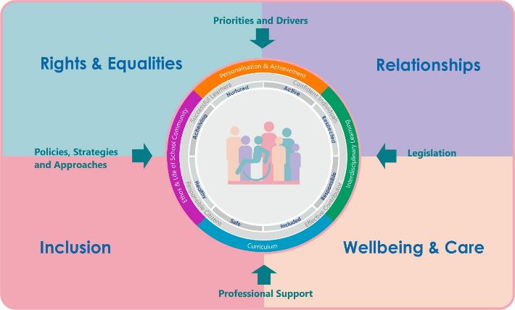
Interconnectivity
Notes:
All of the professional learning in the Framework fits into one of these four themes. The four themes are interconnected and interdependent.​
This activity forms part of the professional learning in the Relationship theme.

Slide 3
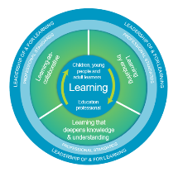
How to use this resource
These slides can be used to facilitate professional learning in a group or
whole-setting, or as a self-directed learning activity as an individual.
Facilitation notes are included at the bottom of each slide.
Please do not remove or change any of the slides included.
Facilitators are welcome to add slides or activities relevant to your own setting, to support discussion and exploration of the topic. Facilitators will know their participants’ needs best.
Anyone who works in an educational setting can be a facilitator and use these slides.
For reflection or discussion activities, it is important to establish a safe space which encourages respect and honesty to ensure that everyone is able to participate.
Notes:
Option to skip slide as these are instructions for facilitators only. No need to read to audience.

Slide 4
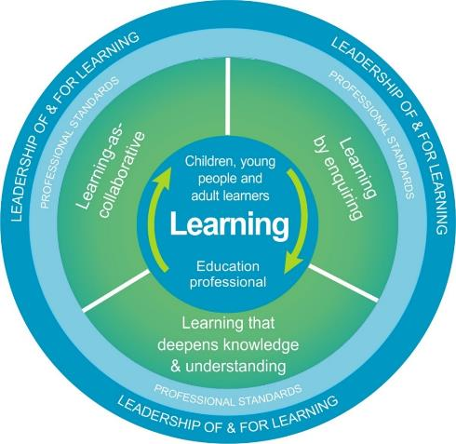
National Model for Professional Learning
This professional learning resource will support you to deepen your knowledge and understanding.
You will have the opportunity to consider how to take this learning forward on your own and with others.
The National Model of Professional Learning (education.gov.scot)
Notes:
This professional learning forms part of the national model for professional learning and is designed to help you gain more knowledge and have a deeper understanding of inclusion, wellbeing and equalities​​
On completion of this professional learning, you will be asked to consider what your next steps will be​​.
Please take some time to consider the reflection questions at the end

Slide 5
Welcome
This session provides an opportunity to:
To explore the importance of ethos, culture, and values-based practice
To explore ethos and culture that promotes strong trusting relationships and positive behaviour
To explore a range of relational approaches used in educational settings
Notes:
Link activity to national model

Slide 6
The Power of Relationships
3: 40 mins
If you are viewing tis as a PDF click the link to access the film https://youtu.be/kzvm1m8zq5g
Notes:
Film 3.08 min

Slide 7
Ethos, Culture, and Values
“A positive school ethos and culture is essential to developing good relationships and positive behaviour in the classroom, playground and wider community.” Policy Guidance 2018
Ethos and culture is created by, and reflect, a learning communities VALUES
Values Behaviour
Drive
Notes:
The quote is from the current Policy Guidance around relationships and behaviour - Developing a positive whole school ethos and culture: relationships, learning and behaviour 2018
we are referring to the Behaviour of ADULTS working with children and young people.
Knowledge often informs and improves practice; however, it is our values and expectations that drive our behaviour.
In other words, our values will determine if we act on the knowledge that we have. For example we may understand about attachment and trauma but do our values drive us to change our practice based on that knowledge.
Our behaviour has a profound impact on the relationships that we form with learners and whether they are positive or not.
Remember that children and young people have told us that they want the support that they receive from all adults to be consistent.
This is why we need to have shared values and demonstrate these values in our behaviour. Values should be shared across a whole learning community – adults (staff and parents) and learners – this can be difficult to achieve.

Slide 8
For example, behaviour driven by values looks like:
listening, with purpose
understanding and responding to behaviour (in a developmentally friendly and holistic way)
showing unconditional positive regard
embracing qualities such as open-mindedness, kindness, empathy, and perseverance
understanding and managing our own emotions (and helping others to do this too)
being proactive in supporting needs – wellbeing, social and emotional, and learning
modelling the behaviour we wish to see
An attitude of caring, acceptance, and support of a person regardless of what the person says or does
Notes:
Relationship-based behaviour that is driven by values.
What does this look like in practice? It involves:
listen, with purpose
understand and respond to behaviour (in a developmentally friendly and holistic way)
show unconditional positive regard – this means we demonstrate an attitude of caring, acceptance, and support of a person regardless of what the person says or does – we wouldn’t allow bias to creep into our attitudes or behaviour
embrace qualities such as open-mindedness, kindness, empathy, and perseverance
understand and manage our emotions (helping others to do this too)
be proactive in supporting needs – wellbeing, social and emotional, and learning
model the behaviour we wish to see

Slide 9
Ethos, Culture, and Values-Based Practice
Everyone in an educational setting contributes towards the ethos and culture
To create an ethos and culture based on VALUES and positive trusting relationships requires:
TIME to discuss and agree on a set of shared values
TIME and opportunity to get to know learners, parents, and colleagues
TIME and opportunity to:
reflect on practice
extend knowledge, understanding and confidence
refine skills - to be more effective in practice
become familiar with practical strategies to support relationships and behaviour, for example, nurturing, restorative, and solution-oriented approaches
Notes:
Everyone in an educational setting contributes towards the ethos and culture
To create an ethos and culture based on VALUES and positive trusting relationships requires:
TIME to discuss and agree on a set of shared values
TIME and opportunity to get to know learners, parents, and colleagues
TIME and opportunity to:
reflect on practice
extend knowledge, understanding and confidence
refine skills - to be more effective in practice
become familiar with practical strategies to support relationships and behaviour, for example, nurturing, restorative, and solution-oriented approaches

Slide 10
Relational Approaches: to improving positive relationships and behaviour
“A whole school approach to positive relationships and behaviour is the most effective way of supporting wellbeing for children and young people. This is supported by a wealth of evidence that links culture and ethos with wellbeing as well as attainment.”
Included, Engaged and Involved part 2: preventing and managing school exclusions, p47
Notes:
The Scottish Government, local authorities, Education Scotland and other agencies, have invested significantly in developing a wide range of approaches which focus on improving positive relationships and behaviour and promoting community safety. These strategies and programmes should help to improve wellbeing, learner attendance and engagement, and reduce the need for exclusion. There is a wealth of evidence that links culture and ethos with attainment.
Relational approaches are most effective when adopted by everyone in the learning community. Relational approaches:
are by default rights respecting and involve more than learning about rights, they involve making rights real in everyday practice
involve learning about emotions, how the brain works, attachment, trauma and adversity, and how these factors have an impact on relationships and behaviour
involve teaching learners, and at times parents, about these things
when translated into practice involve using our understanding and skills to promote positive relationships and behaviour

Slide 11
Relational approaches
Relationships
Trauma-informed approaches
Whole School Nurture
Restorative Approaches
Solution Oriented Schools
Relationships
Relationships
Responsibility of All
PSE and HWB Programmes
Learner Participation
Mentors in Violence Prevention
Recognising and Realising Children’s Rights
Promoting Equality and Equity
Relationships
Notes:
At a whole school (learning community) level we use many different approaches to build and nurture relationships. For example:
Learning through the health and wellbeing aspects of the curriculum
Professional learning around Trauma informed approaches, Nurture, Restorative approaches, Rights and Participation, Equalities, and some of the more specialised programmes such as MVP, and SOS.
No one approach is better than the others and they are not mutually exclusive, in fact they complement each other.
Combining approaches in response to different circumstances, or learners needs, is good relational practice. You can find modules on most of these approaches at either at the informed or skilled level within this Professional Learning Framework. Some professional learning is only available through direct delivery at learning community or authority level or on a train the trainer basis.
Culture and values, however, is key! For any approach to be effective the lived experience of learners, staff, and visitors should be one of kindness, care, and compassion.
Remember it’s the simple things that make a difference and these don’t depend on hours of professional learning but on the values and qualities of the practitioner.
One final comment the approaches adopted by a setting should clearly articulate with, and be explicit in, their Relationships policy, i.e., the behaviour resulting from the approach is consistent with the values and expectations contained within the policy. Remember the goal should be to achieve consistency of approach across a whole learning community.

Slide 12
Being Rights Respecting:
2: 10 mins
means developing a rights respecting ethos and culture
involves more than learning about rights, it involves making rights real in every day practice
involves listening to learners
If you are viewing tis as a PDF click the link to access the film https://youtu.be/1DOPyjKSUxo
Notes:
Means developing a rights respecting ethos and culture
Involves more than learning about rights, it involves making rights real in every day practice
Involves listening to learners and acting on what they say – this is reflected in most Policy Guidance documents for example Developing a positive whole school ethos and culture: relationships, learning and behaviour 2018 a priority action was that ‘Children and young people will be given opportunities to participate actively in policy making and approaches to develop relationships and behaviour within a positive ethos and culture’.

Slide 13
For example this means:
Recognising and realising Article 2 – non-discrimination
Means being aware and pro-active about affinity bias
the increased likelihood that we form closer relationships with people like us
For more information about unconscious bias see the PL modules on Rights and Equalities

Slide 14
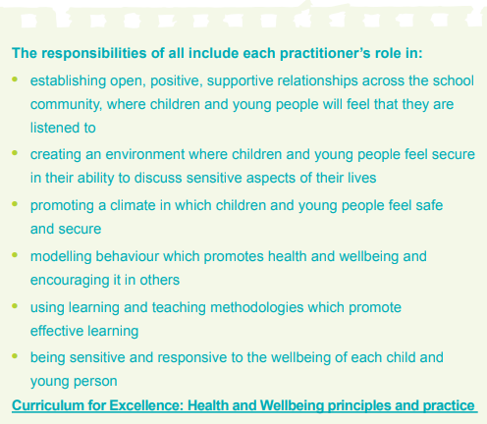
The Curriculum
CfE Health and Wellbeing
Learning in health and wellbeing ensures that children and young people develop the knowledge and understanding, skills, capabilities and attributes which they need for mental, emotional, social and physical wellbeing now and in the future.
Notes:
All learning contexts offer opportunities to build relationships and promote positive behaviour.
Learning through the health and wellbeing aspects of the curriculum reinforces and develops the knowledge and understanding, skills, capabilities and attributes which children need for mental, emotional, social and physical wellbeing now and in the future.
Responsibility of All in particular, focusses on all practitioner's responsibility to build relationships, create that sense of safety that learners need to be able to learn, and model the behaviour we want learners to display

Slide 15
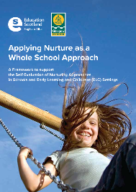
Nurturing Approaches
Learning is understood developmentally
Environment offers a safe Base
All behaviour is communication
Transitions are important in children’s lives
Language is a vital means of communication
Nurture is important for wellbeing
Has experience impacted brain development
Think stage not age
Play is important at all ages
Nurture
Principles
Notes:
Nurturing approaches are based on the theory of attachment which was developed by John Bowlby and Mary Ainsworth and uses the six Nurturing Principles
Marjorie Boxall, using the Nurture principles, developed the concept of Nurture Groups in response to the social and emotional needs of young children. Although Nurture Groups can still be useful as targeted interventions for some young people whereas whole school nurturing approaches can benefit every child and young person in an educational setting and may prevent social, emotional and behavioural issues escalating to a point of crisis for some learners.
Training in Nurture would typically include:
• An understanding of early development and attachment theory and its impact on children and young people;
• An understanding of brain, stress and trauma and how it relates to children and young people’s behaviour and emotional and social development;
• An overview of the Nurture Principles and how they can used in practice
In some instances, nurture can be as simple as adults modelling many of the basic skills which may have been missed in early childhood.

Slide 16
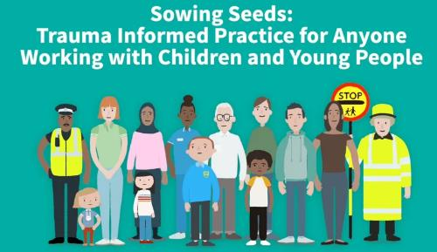
Trauma Informed Practice:
Optional NHS Education Service Film - 2: 10 mins
recognises different types of trauma and acknowledges that trauma is common
recognises the signs of trauma and responses include:
making others feel safe
being someone that can be trusted
offering choices and control in situations when someone feels unsafe
showing compassion and not judgement
working with others to provide holistic help and support
focussing on strengths and not deficits
If you are viewing tis as a PDF click this link to access the film
Nurture and trauma-informed approaches
A summary of supports and resources
Keeping Trauma in Mind
A professional learning programme
Compassionate and Connected Communities
A professional learning activity
Notes:
recognises different types of trauma and acknowledges that trauma is common
recognises the signs of trauma and responses include:
making others feel safe
being someone that can be trusted
offering choices and control in situations when someone feels unsafe
showing compassion and not judgement
working with others to provide holistic help and support
focussing on strengths and not deficits

Slide 17
Restorative Approaches:
recognises that people are the experts of their own solutions and if implemented effectively will promote accountability and maximise personal responsibility
provides a framework of values, thinking and language that is helpful when ‘something’ needs to be restored
can be proactive (relationship building) or responsive (relationship repairing) and can be used at every level from everyday informal interactions to more formal restorative meetings
can be demonstrated by everyone through their values and language
Restorative approaches to support positive relationships and behaviour
Hierarchy of Restorative Approaches
INTENSIVE (Repairing harm)
Restorative: Justice, Conferences, & Meetings
TARGETED (Managing difficulties and disruption)
Restorative conversations: informal and formal
Problem-solving circles
Restorative pedagogy: Social skills learning
Building social confidence and a sense of social responsibility
Identifying and addressing what everyone needs
Restorative values, thinking, and language evident in practice
Focus on relationships and social/community cohesion
UNIVERSAL
(Developing social and emotional capacity)
At Home
In Classrooms and Educational Settings
In Community Settings
Notes:
A restorative approach recognises that people are the experts of their own solutions and if implemented effectively will promote accountability and maximise personal responsibility. A restorative approach provides a framework of values, thinking and language that is helpful when ‘something’ needs to be restored. In different contexts this could be:
effective communication
relationships or friendships
empathy and understanding for another person’s perspective
respect (this could mean a sense of security, self-confidence, self-respect, or dignity)
understanding the impact of our own behaviour on others
repairing or replacing damaged materials or resources
Being restorative can be proactive (relationship building) or responsive (relationship repairing) and can be used at every level from everyday informal interactions to more formal restorative meetings. All practitioners can behave in a restorative way by demonstrating restorative values and using restorative thinking and language.
Training in restorative approaches may include:
• exploration of the key values, skills and practices involved in restorative approaches, e.g. unconditional regard, attunement, active, empathic listening;
• the development of a restorative ethos through activities such as peer support and circle time;
• exploration of the structure of restorative conversations when staff/peer mediators intervene in a situation; and
• the use of restorative meetings and conferences involving all those affected by an incident including families where appropriate (this can be more effective for schools who have already embedded restorative approaches in their practice). Many schools across Scotland have successfully introduced a range of restorative approaches and report improvements in school relationships and behaviour following this.

Slide 18
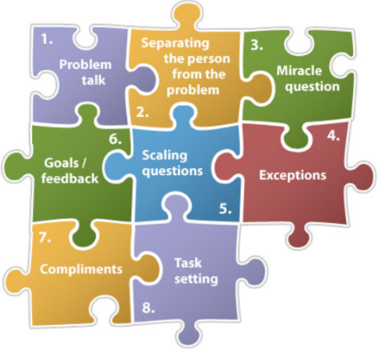
Solution-Oriented Approaches:
develop goals and solutions rather than just exploring problems
focus on the present and the future, rather than the past
strength-based rather than deficit-based to identify the skills, strengths and resources and find their own solutions
build capacity for effective problem solving and reflective practice
contribute to positive relationships, understanding and connections, and recognising what influences behaviour
Source: Solutions Focused Therapy Sfbt Solution Focused
Notes:
Solution oriented approaches are based on the key principles:
People have the necessary resources to make changes
Everyone has their own ways of solving problems
No sign-up, no change
Collaboration enhances change
Language shapes and moulds how we make sense of the world
Training SO practice includes:
• identification of applications in day to day practice, principles & language
• planning and organising a solution-oriented meetings (anything from multi-agency meetings, pre-and post-exclusion meetings to professional development reviews)
Solution oriented approaches can be used effectively to actively support positive relationships and culture at the classroom/universal support level.

Slide 19
Mentor in Violence Prevention (MVP) Programme:
gives young people the opportunity to explore and challenge the attitudes, beliefs and cultural norms that underpin gender-based violence, bullying and other forms of violence
trains Senior pupils to become young leaders who support and mentor younger learners
explores behaviours including bullying, name-calling, sexting, controlling behaviour and harassment
uses the bystander approach to empower both male and female pupils to support and challenge peers and to be active in preventing violence in a safe way
is most effective as a whole school approach helping young people to stay safe and support each other
fits well with Curriculum for Excellence health and wellbeing experiences and outcomes and the national approach to promoting positive relationships and behaviour in educational settings
encourages positive healthy relationships amongst peers
Notes:
The Mentors in Violence Prevention Programme was developed in the US in the 1990’s by Dr Jackson Katz. The Violence Reduction Unit in Scotland has adapted the model for the Scottish context. The MVP Scotland Programme has been developed by the Violence Reduction Unit and is working with Education Scotland and local authorities to engage young people in schools to promote positive healthy relationships for young people across Scotland.
gives young people the opportunity to explore and challenge the attitudes, beliefs and cultural norms that underpin gender-based violence, bullying and other forms of violence
trains Senior pupils to become young leaders who support and mentor younger learners
explores behaviours including bullying, name-calling, sexting, controlling behaviour and harassment
uses the bystander approach to empower both male and female pupils to support and challenge peers and to be active in preventing violence in a safe way
is most effective as a whole school approach helping young people to stay safe and support each other
fits well with Curriculum for Excellence health and wellbeing experiences and outcomes and the national approach to promoting positive relationships and behaviour in educational settings
encourages positive healthy relationships amongst peers

Slide 20
Reflection
From what you have learned so far, think about:
How has this made you feel?
What has this made you think about?
What one action would you like to take forward?
How can you link what you plan to do with others in your setting?
How you will know that this learning has made a difference?
Notes:
Facilitation notes:
You can do this in groups...
Encourage educators to take this forward in an enquiry
Consider impact of the actions / learning

Slide 21
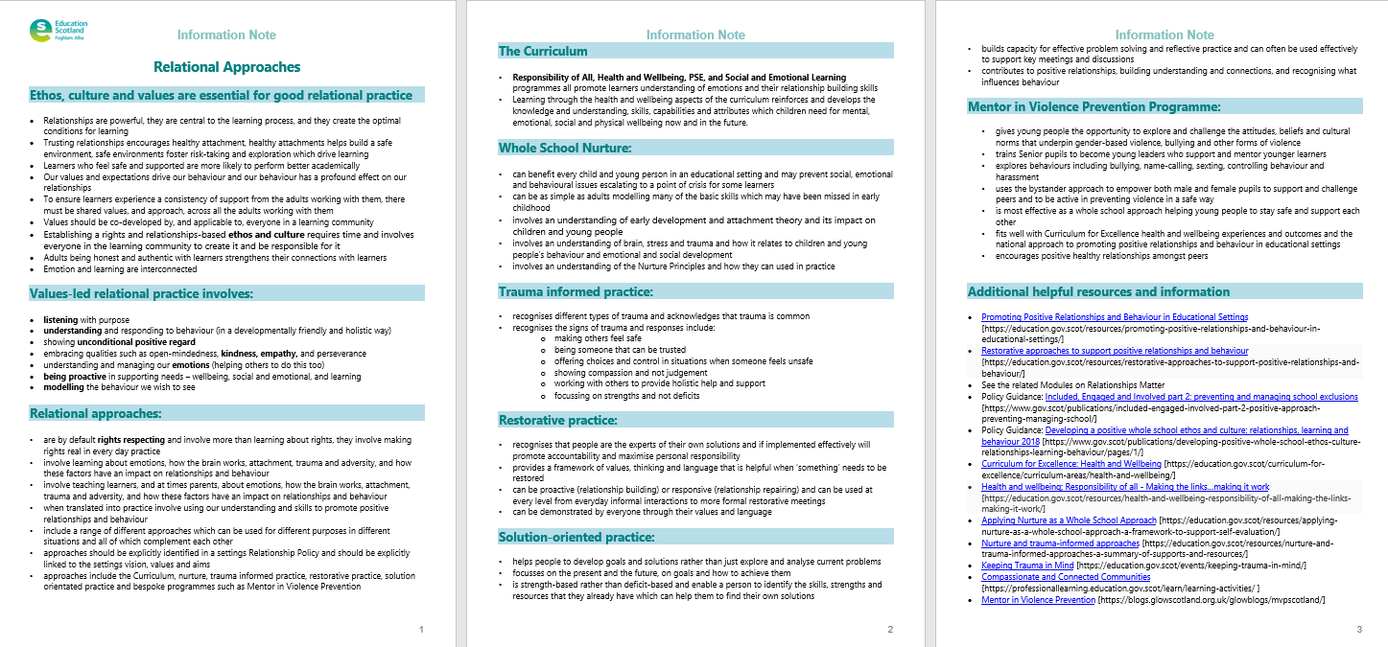
Resources and Information to help

Slide 22
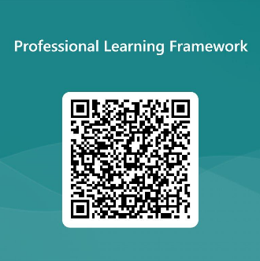
We value your feedback
From now until March 2024 we will be taking feedback on these resources so that we can make changes in advance of a formal launch of the Professional Learning Framework in June 2024
Your feedback could help us improve this resource
Please complete this short form, using the link or QR code, to let us know what you thought of it and any suggestions you have on how it could be improved
LINK: https://forms.office.com/e/b5PCpJJJ3P

Slide 23
For Scotland's learners, with Scotland's educators
Do luchd-ionnsachaidh na h-Alba, le luchd-foghlaim Alba
Education Scotland
Denholm House
Almondvale Business Park
Almondvale Way
Livingston EH54 6GA
T +44 (0)131 244 5000
E enquiries@educationscotland.gsi.gov.uk

