Slide 1
Inclusion Wellbeing & Equalities Professional Learning Framework Introduction to Planning for Learners with Additional Support Needs
Informed Level
@ESInclusionTeam
For Scotland's learners, with Scotland's educators
Do luchd-ionnsachaidh na h-Alba, le luchd-foghlaim Alba
Notes:
Introduction to Planning for Learners with Additional Support Needs
This professional learning is pitched at an informed level and suitable for anyone working with children and young people in an educational context.
This is the first in a serious of presentations focusing on ASN planning.
Purpose of these Slides
Read title
This professional learning is pitched at an informed level and suitable for anyone working with children and young people in an educational context.
How to use the slides:
To be used to facilitate professional learning in a group or whole-setting, or as a self-directed learning activity as an individual.
General Guidance
There is a requirement to cover all the slides.
Please do not change the provided slides.
Facilitators are welcome to add slides or activities relevant to your own setting, to support discussion and exploration of the topic. Facilitators will know their participants’ needs best.
Anyone who works in an educational setting can be a facilitator and use these slides.
It is important to establish a safe space which encourages respect and honesty to ensure that everyone is able to participate.

Slide 2
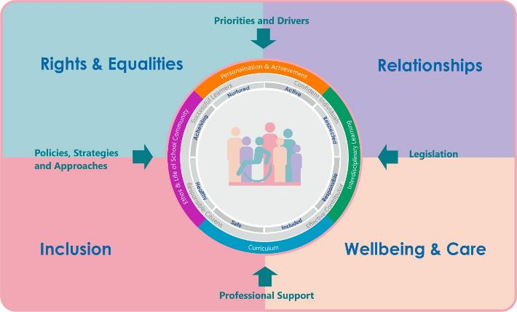
Interconnectivity
Notes:
All of the professional learning in the Framework fits into one of these four themes. The four themes are interconnected and interdependent.​
This session forms part of the professional learning in the Inclusion theme.

Slide 3
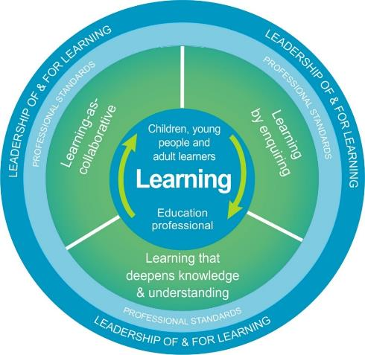
National Model for Professional Learning
This professional learning resource will support you to deepen your knowledge and understanding.
You will have the opportunity to consider how to take this learning forward on your own and with others.
The National Model of Professional Learning (education.gov.scot)
Notes:
This professional learning forms part of the national model for professional learning and is designed to help you gain more knowledge and have a deeper understanding of inclusion, wellbeing and equalities​
On completion of this professional learning, you will be asked to consider what your next steps will be​
Please take some time to consider the reflection questions at the end

Slide 4
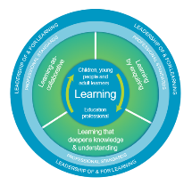
Welcome
This session aims to provide an opportunity to reflect on:
Different roles and legislative duties of all involved within the ASN planning process
Your understanding of the various levels of planning for pupils with Additional Support Needs (ASN)
Notes:
This session is for any practitioner who is involved in the ASN Planning process in any way
It contains a quick introduction to the various levels within the ASN planning process, touching on the different roles within it and contains a quiz for you to use to reflect on your next steps in learning about this sometimes complicated subject.

Slide 5
Why do I need to know this?
We have a collective Legal Duty to provide additional support to children and young people who have an identified additional support need when they need it.
Notes:
You may be a Pupil Support Assistant, Teacher, Early Years Practitioner, Member of Management team, or a member of a partner agency. We all collectively have a duty to provide the additional support for any pupil who needs it within the scottish education system.
The legislation states that we (individually and collectively) must identify and record the barriers to learning, resulting needs of the learner and a plan to meet those needs for any learner who requires additional support to access education, that is addition to what is universally provided for all other pupils of the same age and stage.
Parents/Carers and learners themselves MUST have their views recorded and taken into account within this ASN planning process.
Whilst different Local Authorities may have different names for ASN plans, they should all contain a minimum list of things and be outcome based, focussing on what is planned to be better or different for the learner as a result of what is put in place.
This is all explained in more detail in further training sessions but for now, it is important to understand that this is a legal duty.
There are links at the end of this presentation to the related legislation.

Slide 6
Interconnectivity
Notes:
These themes are all so important in the ASN planning process and indeed are interconnected.
Every learner has the right to an education without barriers. They have the right to be involved and have their voices heard and taken into account when decisions, including plans are made to help them achieve this.
ASN planning, when effective, aims to ensure inclusivity and as much independence for all learners at all levels.
This in turn has an obvious positive impact on the wellbeing of a learner and this should be documented in a learner profile and reviewed as plans are evaluated. Obviously, none of this will be effective if the positive, supportive relationships are not apparent with anyone involved in the processes involved.
Before moving on - think of a learner with Additional Support Needs that you know or currently work with, what elements of this graphic do you provide in your role?
Are you that trusted adult they talk to? Do you advocate for a learner's right with others? Do you plan to make sure that learner is truly included in the totality of the curriculum offered to them?

Slide 7
What the acronyms are…
ASN
(Additional Support Needs)
IEP
(Individual Educational Programme)
CSP
(Co-ordinated Support Plan)
Notes:
As I mentioned, there are a number of different names for the different plans you may come across but these are the plans referred to in the ASL legislation.
You may also come across a number of different plans that may sit alongside or feed into an ASN plan such as a care plan - this maybe in place to support a health colleagues input, intimate care or medical needs, or indeed it maybe be a plan in place for care experienced learners.
A 'Child or Young Person's Plan' can be an ASN plan or often refers to a plan put in place by Social Work Colleagues. The name of this plan comes from the Child and Young person's Bill (2010)
You can see why this is complicated and can get very confusing. Once you have finished this session, if you do not already know what the ASN plans are called in your LA, we advise that this will be your next step

Slide 8
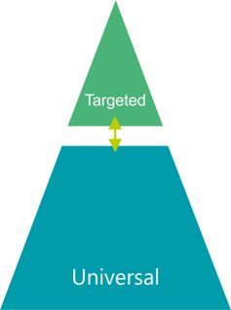
Levels of Intervention and plans
CSP
Possible IEP
ASN Plan at all levels
Notes:
As I mentioned, there are a number of different names for ASN planning but whatever it is called, it will cover the full range of Additional Support Needs that could be identified for a learner at any point in their educational journey.
Many learner's may well have their additional support needs met at a Universal level.
Some may require additional targeted interventions or reasonable adaptations put in place to meet needs,
Where a plan’s outcomes are individual to the child and cannot be planned for with the class or group planning, an IEP may be incorporated into the ASN plan
A small number of plans, which meet the legal criteria may require to also be documented in a CSP.
A CSP is the only statutory level of educational ASN planning, whilst it is intrinsically linked to the whole process.
When and how to use each level of planning is explored in more detail in other sessions however it is important to note at this point that if the criteria is met for any of these different levels of planning – you have a LEGAL DUTY to ensure it is place.

Slide 9
How do our ASN plans all fit together?
Does the learner have ASN?
Class
Group
Personal plans
Resources and strategies
already in place
Assessments
Observations
Chronology
Views
Professional judgements
ASN Profile and Plan
Unmet need?
Yes
No
SMART Outcome:
What is going to be better and different for the learner?
IEP
CSP
Notes:
The basic processes involved in completed an ASN plan are shown here.
The ASN planning process can be initiated by you, by the parent/carer or indeed by the learner themselves. If the parent or child requests an assessment of need, you have a duty to start the process if this is not already started. Equally, even if a parent/carer or learner does not agree an ASN plan should be in place, you, as educators, have a duty to ensure the right level of planning is completed.
Firstly it important to pull together the planning, assessments and information you already have about the learner.
This does not have to be a new assessment, in fact it is important to look at what you already have and utilise your knowledge of the learner before further assessment is considered.
All of this information comes together to form the learner profile. Each element of a learner's profile is a jigsaw piece that, when brought together, helps all involved to see the learner's bigger profile picture of strengths, factors and potential barriers and the resulting needs for that individual.
The profile should always explore the learner's strengths and it usually helpful to have these documented first in a profile. Thinking of a learner with ASN only in a deficit model (i.e. what they are struggling with or can't do) usually results in less engagement from the learner or partners in the plan.
When a profile is complete and the resulting needs of a learner are identified, it is then a case of considering if these needs are already being met?
It may be following the identification of needs, the process may conclude with a plan that identifies that a learner's need are being adequately met within what is universally available within your setting at this time. This can help support or remind learners and parents of what is in place and working already. No further outcomes may be required at this stage.
If there remains unmet need, an outcome (or two) would then be agreed to explore how to meet that need further.
If the actions to meet that outcome meet the criteria for an IEP or a CSP, this should also be explored and put in place. It is important to note here that an IEP or a CSP would contain relevant elements of what is already in an ASN plan. The main ASN plan is the working document that all the others will connect to.
So as you can see, whilst it may be one person's role to write or coordinate an ASN plan (at whatever level) we all have a part to play in keeping ASN plans relevant, reviewed, up to date and effective to ensure that the plan is learner centred.

Slide 10
Test your knowledge?
What do I know about ASN Planning?
Click here to start quiz
Notes:
Now check what you know...
We often here – I don't know what I don't know.. This is an opportunity to explore some challenge questions around the ASN planning process which will hopefully help you to identify your next learning steps.
I will stop talking now and join you again after the quiz.

Slide 11
Question 1
It doesn’t matter what plan you use or what you call it as long as it centres around the learner.
True
False
Could be either
This Photo by Unknown Author is licensed under CC BY

Slide 12
False!...
The legislation states that all educational establishments MUST ensure the correct level of planning is in place to meet the needs of a pupil with identified ASN.
An IEP and/or other ASN plans can be referred to in a CSP.
If the criteria for a CSP is met, this level of planning must be in place as a separate documents (again - stated in legislation).
NB - There should not be anything new in a CSP that is not in a ASN plan. The CSP only contains the outcomes of the ASN plan that require to be coordinated with the relevant agencies outside of education.
This Photo by Unknown Author is licensed under CC BY

Slide 13
Question 2
A care plan is for when a child requires medication.
True
False
Could be either
This Photo by Unknown Author is licensed under CC BY

Slide 14
True!...
The term 'care plan' can indeed be used for an agreed protocol for administration of medication.
The term can also be relating to programs of therapy (such as a physiotherapy routine), personal care (such as toileting) or relating to moving and handling.
The term care plan can also refer to learners who may be care experienced or require a package of care often involving social work input.
All such plans should be related to the profile of a learner and their needs and referenced within ASN planning.
This Photo by Unknown Author is licensed under CC BY

Slide 15
Question 3
If a learner already has an ASN Plan – they don’t need a separate IEP or a CSP as well.
True
False
Could be either

Slide 16
False!...
Question
An IEP can be incorporated into and reviewed within the ASN planning for a learner but a CSP must be a stand alone document due to it being the statutory PART of the plan to support the pupil.
Ideally, what is contained in a CSP is taken directly from the ASN plan in place. It shouldn’t contain anything new.
It is good practice to make sure that whatever level of planning is in place that the pupil has a format of the plan that is accessible to them i.e. visual representation and/or using an understandable form of language.

Slide 17
Question 4
In consultation with all plan partners, a school/EYC decides if an IEP or a CSP is needed (as well as the ASN /CYP planning already in place)
True
False
Could be either

Slide 18
It could be either!...
An IEP is determined at school level
Whether the legal criteria for a CSP is met is usually determined at a Local Authority (LA) level based on the information available from the school and other agencies involved. Check with your LA what their process is for this if you are not sure.

Slide 19
Question 5
If a learner has a behaviour protocol (perhaps containing a risk assessment) they do not require any other ASN planning.
True
False
Could be either

Slide 20
Could be either!...
If the behaviour risk assessment and protocol is based upon and documents a holistic assessment and profile of the learner and the full legal data set of ASN planning, this may be true.
As this is often not the case however, a behaviour risk assessment and protocol can be referenced or embedded within the wider ASN plan to ensure all legal duties are fulfilled.

Slide 21
Question 6
If a parent/carer or pupil asks for a CSP (even if those involved think it is not necessary) further action is required.
True
False
Could be either

Slide 22
True!...
If a CSP is requested by a parent/carer or learner, the LA have a time period of 4 weeks to respond to that request so it is important to follow LA guidance regarding a response as soon as possible.
Discuss the criteria during an ASN meeting with all of the information and hopefully the professionals available to answer the questions present, is helpful to inform that decision.
Even if it is felt that the criteria is not met, the request should be recorded and the request officially replied to – otherwise this can be seen as a deemed refusal and lead to a reference to the ASN tribunal.

Slide 23
Questions 7
A CSP can make sure agencies do what they have agreed to do.
True
False
Could be either

Slide 24
True!...
A CSP is a statutory documents so it can legally ensure that the agreed actions stated within it happen within the timeframe indicated (via a tribunal process if need be).
It will also make sure that all agencies communicate effectively with education so that the plan for the pupil can be co-ordinated well.
BUT a CSP will only contain agreed actions by the relevant agencies for the forthcoming year. It cannot ‘ask or demand’ anything that is not already agreed in an ASN plan by the agency involved.

Slide 25
Question 8
If a CSP is opened for a learner it cannot be closed again
True
False
Could be either

Slide 26
False!...
A CSP can be discontinued for a variety of reasons:
One or more of the criteria are no longer met (usually input from agencies has changed, but can be any of the criteria)
This could be indicated at a planning meeting or by an agency
The child or young person moves to another Local Authority (LA)
The young person leaves education (to be educated at home or as part of a transition to move on from school education)

Slide 27
Question 9
All Care Experienced (LAC) Learners should be considered for a CSP
True
False
Could be either

Slide 28
Could be either!...
It depends.. All care experienced learners are deemed to have ASN unless proven otherwise. If they have ASN the:
An amendment to the ASL legislation (in 2014) states that all care experienced learners, with ASN SHOULD BE CONSIDERED for a CSP.
This does not mean that they will meet the criteria. Some may have less needs as a result of being care experienced.
Most care experienced learners will have some form of plan (GIRFEC Child's Plan - that can be statutory or non-statutory) which is usually involves Social Work input. Exploring how significant this input is/will be, will inform the decision regarding wither the criteria is met or not.

Slide 29
Question 10
If a CSP is not granted, the outcomes within it will not be achieved.
True
False
Could be either

Slide 30
False!...
After it has been established and communicated to all that the legal criteria is not met, the ASN/CYP plan will continue to work towards achieving the outcomes detailed within the CSP and the ASN plan as they should be the same. Parents/YP have the right to appeal to the ASN Tribunal if they are not satisfied with any decision related to a CSP.
The criteria for a CSP can be reconsidered at any time so it is important to continually review the level of planning and to discuss and explore criteria in a meeting where appropriate.
If an agreed action does not take place, there are avenues (other than the ASN Tribunal) available to find a solution focussed approach to resolve this.

Slide 31
Question 11
If a CSP is not granted (or it is discontinued) - that will have an affect on the resources and staffing in the school/EYC?
True
False
Could be either

Slide 32
It could be either!...
Whether a CSP is granted or not, is often dependant on the agreed input from outside agencies - whether that is deemed significant or not.
As the input can fluctuate for a number of different reasons from year to year, this can affect if a CSP remains active or not.
It would therefore be difficult to use the number of CSPs in an establishment as a basis to allocate resources or staffing to schools.
You may need to check your LA's policy on this for clarification. Some may use this as part of formula of allocation.

Slide 33
Question 13
All learners in a specialist setting will need a CSP.
True
False
Could be either

Slide 34
False!...
Whilst the needs of the pupils who attend a specialist school /placement have probably the most complex needs, they may well not all have a CSP.
As the capacity for meeting individual’s needs in this type of setting is high and staff are usually given contextualised training, the input from outside agencies is often on a consultative basis only.
It is often the case that some intensive work or input for a pupil can lead to educational staff being able to maintain support without a significant input from other agencies – this is a good thing!

Slide 35
Question 14
If a relevant agency is stating that their input with the plan will be mainly at a consultative level (with either family or school) with little input with the child – does that meet criteria for a CSP?
True
False
Could be either

Slide 36
It depends!...
Question
Involvement of a single agency at a consultation level only is not normally a significant involvement by a relevant agency, but it would help to explore what that consultation would ‘look like’ with regards to frequency and duration to help inform the decision.
Generally speaking, unless there are a number of agencies involved at a consultative level, the coordination of this can be done just equally well through an ASN plan.

Slide 37
Question 15
If a number of different agencies are involved in supporting an ASN plan but none of them have agreed to a significant amount of intervention, the CSP criteria is not met.
True
False
Could be either

Slide 38
It could be either!...
The criteria in this case could still be met – the LA would have to consider if this requires a CSP to coordinate the input from the agencies cumulatively or whether this can be done within the planning already in place.
At points of transition or after a major trauma has occurred can be when a coordinated approach is required but the levels of intervention are perhaps unknown, require further assessment or simply cannot happen all at once. A CSP in these circumstances may be appropriate or consideration could take place after further assessments have been undertaken.

Slide 39
Question 16
Once a CSP is finalised, it can’t be changed.
True
False
Could be either

Slide 40
False!...
The process of drafting and consultation that takes place to finalise the document by the LA and plan partners should limit the requirement for any changes within the timescale for a review (a year from time of finalising) but as needs of pupils change, the plan around them needs to be reviewed and adapted as necessary and so it maybe necessary to review a CSP earlier than indicated on the finalised version (annual review date).
If the CSP coordinator or the educational placement changes or the plan is dramatically altered (due to an unforeseen event for example) these are all reason for the CSP to be reviewed early.

Slide 41
Question 17
The key person/co-ordinator named on an ASN plan needs to be the Headteacher.
True
False
Could be either

Slide 42
False!...
Quite simply, the key person/co-ordinator of an ASN plan should be the best person placed to coordinate the plan with all involved.
As a CSP is an educational planning documents, it is often a promoted member of a School or EYC that is the key person/co-ordinator. It could equally be a professional from a different relevant agency such as Health or Social Work depending on who is best placed to make sure all that is agreed in the plan is happening and working.

Slide 43
Question 18
If a learner moves, their ASN plan moves with them.
True
False
Could be either

Slide 44
True!...
If a child moves to a different school or different Local authority their ASN plan (including a CSP if applicable) should move with them.
It would then be the responsibility of the receiving school to take over the responsibility for the plan and review once the learner has settled in as often the universal supports or needs could possibly change in a different setting.
If the pupil is in the care system, and remains the responsibility of their home LA, the home LA retains responsibility to maintain the legal duties and ensure the relevant plan is implemented.

Slide 45
Question 19
An IEP needs to be a separate document from the main ASN plan
True
False
Could be either

Slide 46
False!...
An IEP can be incorporated into the main ASN plan.
A CSP must be a separate document as states in the ASL legislation but there should be nothing new in it.
Any plan should be accessible to the learner however and so there may need to be an accessible version of part of it (e.g. the outcomes and actions section) to enable full engagement.

Slide 47
Question 20
The outcomes in an ASN plan (at any level) should state what is going to be better or different for the learner
True
False
Could be either

Slide 48
True!...
The Child and Young Person’s Bill (2010) states that ASN planning should be outcome based.
Outcomes stated in ASN planning (at any level) should be learner centred and should be as SMART as possible.
The actions stated to meet that outcome should state what everyone (including the learner) is planning to do to support that outcome to be achieved.
Generally outcomes should not be ‘ongoing’. Progress should be evident. If after review no progress has been made, the actions or indeed the outcome itself should be amended.

Slide 49
Reflection
How well did you do?
In your role, do you need a better understanding of the legislation around ASN planning?
Are there other plans in your establishment that are not mentioned here?
Click here to return to original training

Slide 50
Please try again…
Click here to return to the question…

Slide 51
What else do I need to know?
More details re ASN Planning
Top Tips for ASN Planning meetings
Writing Outcomes
Gathering the Views of Learners and others
IEPs and CSPs
?
Notes:
Welcome back
We hope that the quiz has helped your thinking around where next to go.
There will more sessions going into some aspects of ASN planning in more depth as noted here. We are continuing to develop these resources.
and will be available very soon if they are not on the site yet..
If you feel that more information on any other areas of ASN planning would be useful, please let us know.
At the end of this presentation are details of how you can feedback to us. We want to make these work for you so ANY feedback is extremely helpful.
I will now leave you again to reflect, feedback and plan your next steps

Slide 52
Reflection
From what you have learned so far and the quiz answers, think about:
How has this made you feel?
What has this made you think about?
What one action would you like to take forward?
How can you link what you plan to do with others in your setting?
How you will know that this learning has made a difference?
Notes:
Facilitation notes:
You can do this in groups...
Encourage educators to take this forward in an enquiry
Consider impact of the actions / learning

Slide 53
Some useful Links
Additional support for learning: statutory guidance 2017 - gov.scot (www.gov.scot)
The Additional Support for Learning Act | Additional support | Parentzone Scotland | Parentzone Scotland (education.gov.scot)
ASL Legislation (2004)
Child and Young Person’s Act (2010)
For Scotland's learners, with Scotland's educators
Do luchd-ionnsachaidh na h-Alba, le luchd-foghlaim Alba

Slide 54
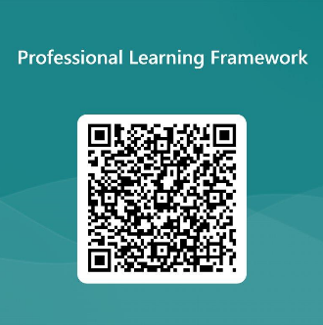
We value your feedback
From now until March 2024 we will be taking feedback on these resources so that we can make changes in advance of a formal launch of the Professional Learning Framework in June 2024
Your feedback could help us improve this resource
Please complete this short form, using the link or QR code, to let us know what you thought of it and any suggestions you have on how it could be improved
LINK: https://forms.office.com/e/b5PCpJJJ3P

Slide 55
For Scotland's learners, with Scotland's educators
Do luchd-ionnsachaidh na h-Alba, le luchd-foghlaim Alba
Education Scotland
Denholm House
Almondvale Business Park
Almondvale Way
Livingston EH54 6GA
T +44 (0)131 244 5000
E enquiries@educationscotland.gsi.gov.uk

