Slide 1







Inclusion Wellbeing and Equalities Professional Learning Framework
Solution-oriented principles
@ESInclusionTeam
Notes:
Purpose of these Slide​:
This professional learning is suitable for anyone working with children and young people in an educational context.
How to use the slides:
There is a requirement to cover all the slides. Please do not change the provided slides.
These slides can be used to facilitate professional learning in a group, whole-setting, or as self-directed learning.
Facilitation notes are included at the bottom of each slide.
Please do not remove or change any of the slides included.
You can add slides or activities relevant to your setting, to support discussion and exploration of the topic.
You will know their participants’ needs best.
Anyone who works in an educational setting can be a facilitator and use these slides.
For reflection or discussion activities, it is important to establish a safe space which encourages respect and honesty to ensure that everyone is able to participate.

Slide 2
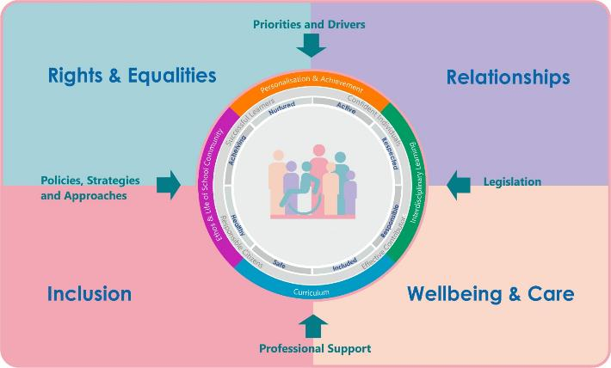





Interconnectivity
Notes:
All aspects of the professional learning framework fit into one of these four themes. The four themes are interconnected and interdependent.​
This activity forms part of the professional learning in the Relationship theme.

Slide 3
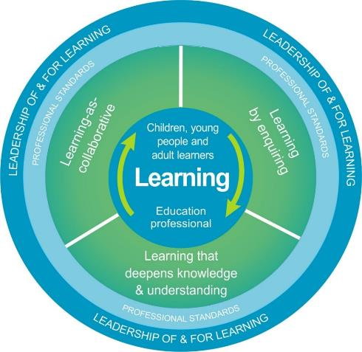
National Model for Professional Learning
This professional learning resource will support you to deepen your knowledge and understanding.
You will have the opportunity to consider how to take this learning forward on your own and with others.
The National Model of Professional Learning (education.gov.scot)
Notes:
This professional learning forms part of the national model for professional learning. It can help you gain more knowledge and have a deeper understanding of inclusion, wellbeing and equalities​​.
On completion of this professional learning, you will be asked to consider what your next steps will be​​.
Please take some time to consider the reflection questions at the end

Slide 4
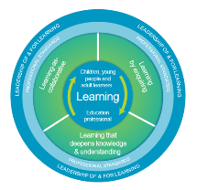
Welcome
This session provides an opportunity to:
To understand what is meant by being solution-oriented
Explore solution-oriented principles

Slide 5

Being solution-oriented means
Focusing on the present and future rather than the past
Creating change by shifting the focus from problems to solutions and from weaknesses to strengths
Using a clear set of principles

Slide 6
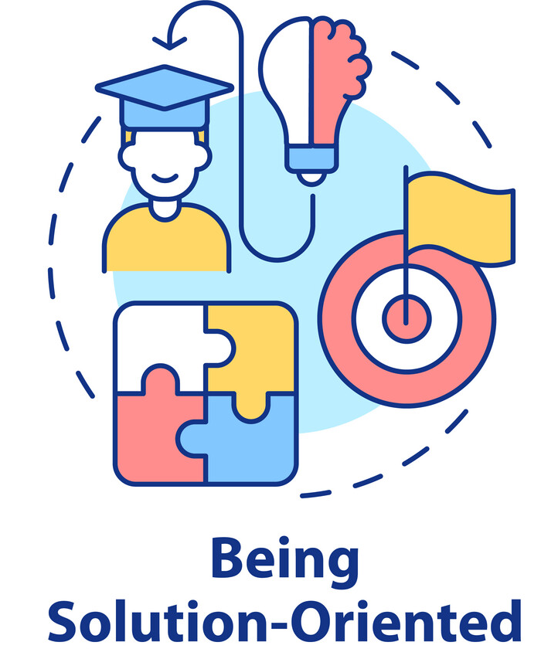
The Solution-Oriented Principles
Listen to the person, hear their story
Everyone has the strengths and resources to make changes
Everyone has their own way of solving problems
No sign up, no change. Collaboration enhances change
Language shapes and molds how we make sense of the world
A focus on future possibilities and solutions enhances change
There are always exceptions to the problem
Small changes can lead to bigger changes
If it works do more of it; if it doesn’t, do something different
The problem is the problem, not the person

Slide 7

1. Listen to the person, hear their story
It is important for people to feel that their concerns have been heard. Listen, acknowledge and validate.
Do not ask follow up questions regarding the problem (unless a safeguarding issue has been raised).

Slide 8

2. Everyone has the strengths and resources to make changes
When we are immersed in a problem, we can lose sight of our existing strengths or the ways we have tackled a similar difficulty in the past.
A solution oriented approach starts from the belief that those strengths and resources exist and a solution oriented conversation can help identify them.

Slide 9

3. Everyone has their own way of solving problems
Everyone has a unique set of experiences, blending with his/her own unique personality.
Because of these differences, a solution that works for one person, will not necessarily work for another, even in a similar situation.
In solution oriented conversations we support people to find their own solution.

Slide 10

4. No sign up, no change
Collaboration enhances change
The person involved is unlikely to sign up for change if they are not involved in identifying their own preferred future and the benefits for them.

Slide 11
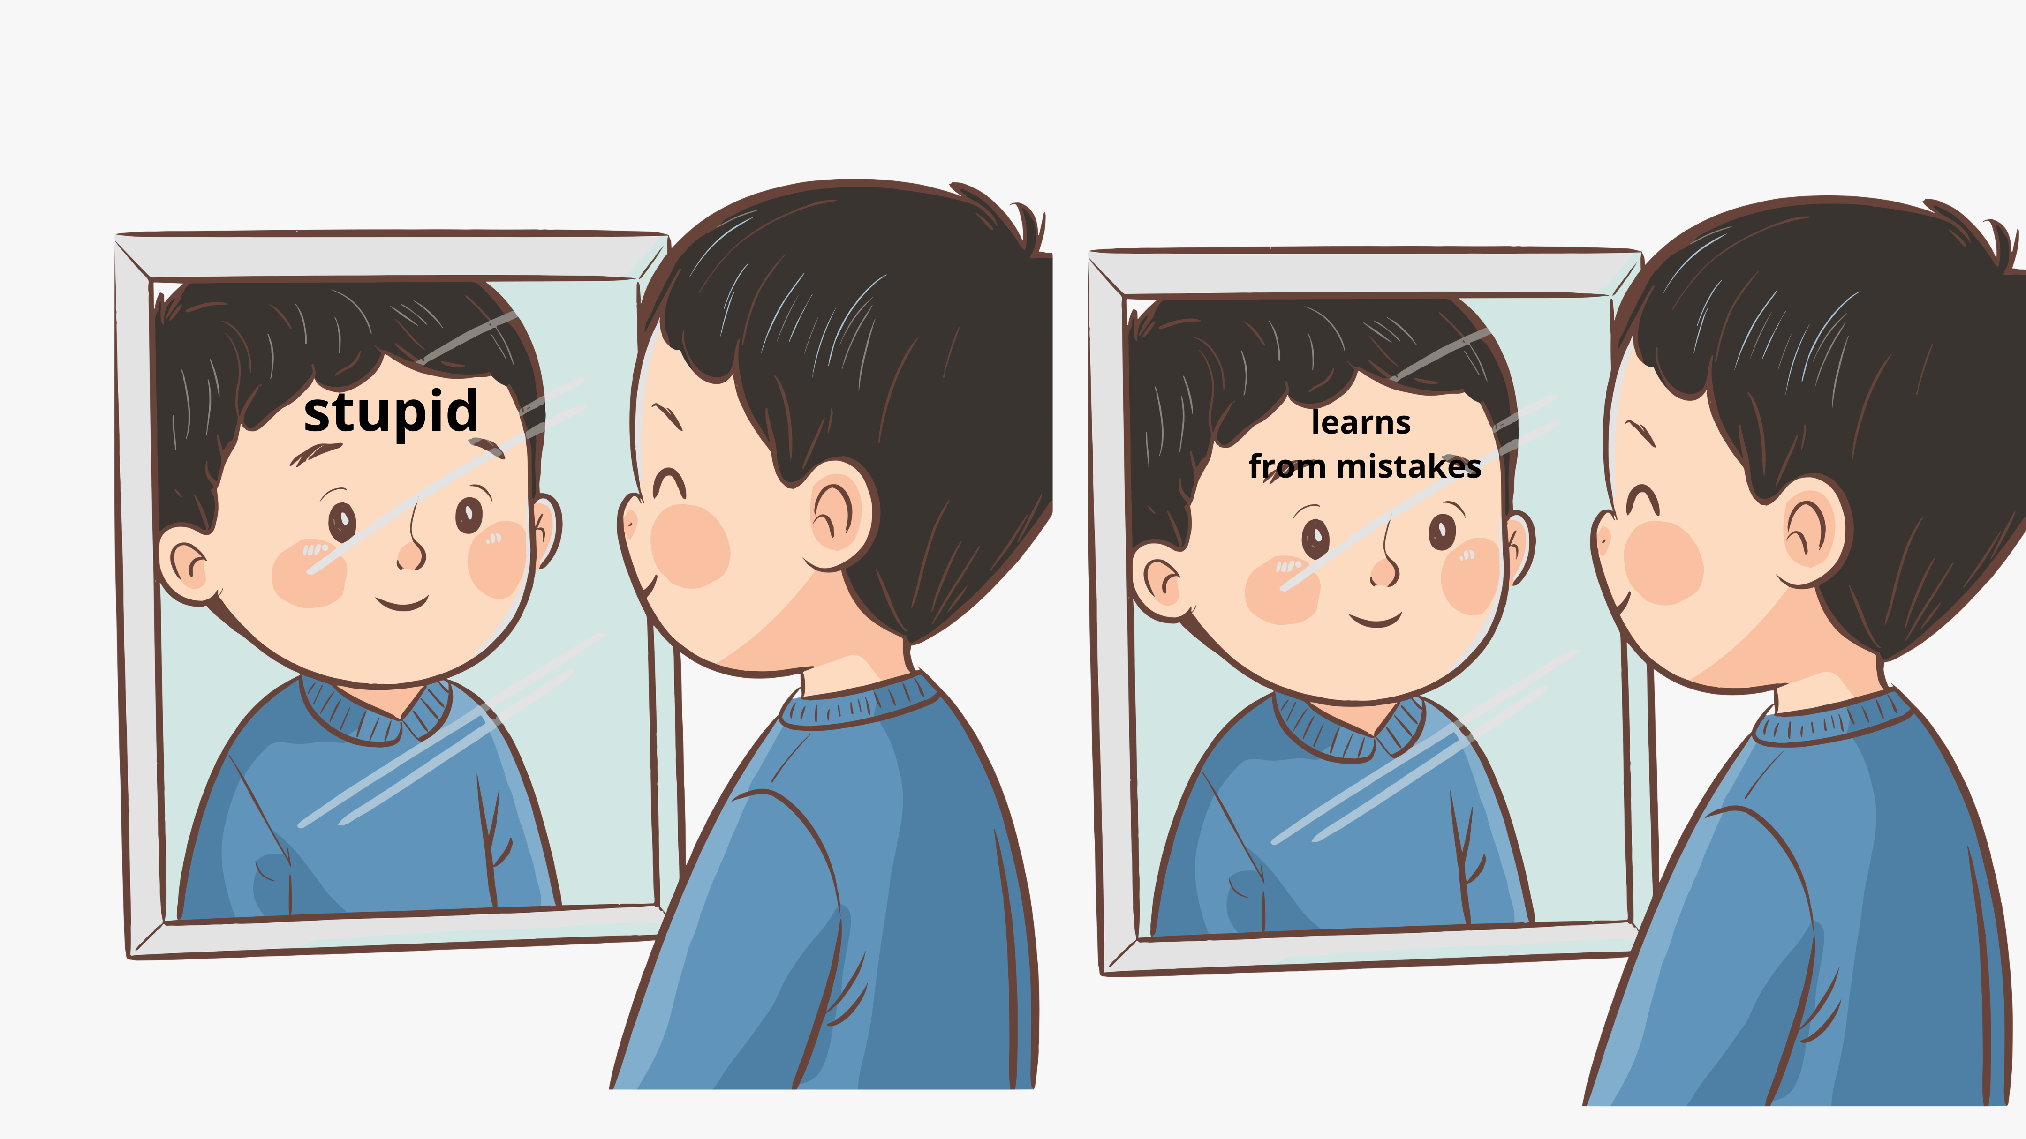
5. Language shapes and molds how we make sense of the world
Words are not neutral and can be used to create meaning and enhance change.
We can help the person ‘construct’ a new perspective, or way of looking at the problematic situation being described.
In this way new possibilities for change can be revealed and we work together to ‘co-create’ a context for change.

Slide 12
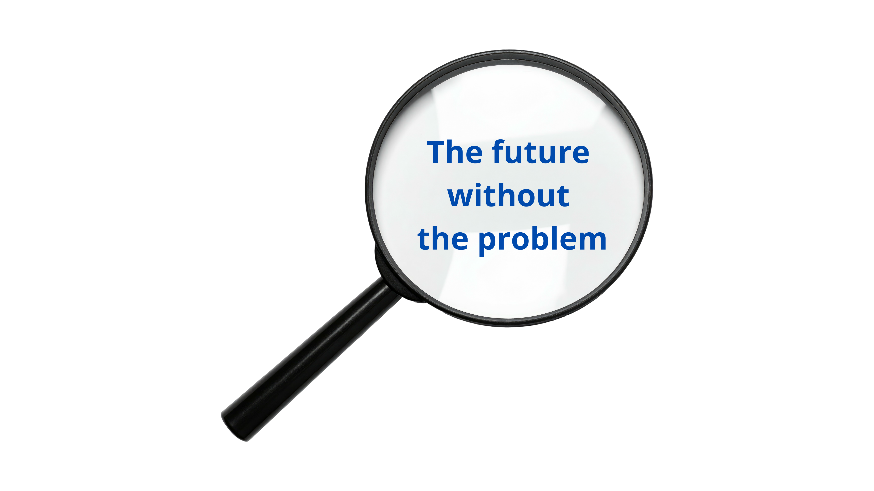
6. A focus on future possibilities and solutions enhances change
Change is more likely when individuals describe the futures they want to build and pay attention to what they are already doing that fits with this future, they start to move towards change.

Slide 13

7. There are always exceptions to the problem
In any situation, no matter how difficult, there will be times when things work some of the time, when things aren’t quite so bad, or when things are just a little bit better.
These times, known as ‘exceptions’ to the problem, are explored in an attempt to identify possible solution pathways, which will be the keys to effective problem resolution.
Once people come to view these exceptions as meaningful, they can begin to change the way they view the problem and themselves.

Slide 14

8. Small changes can lead to bigger changes
Solutions can begin with small changes in behaviour or in a situation that may significantly change the problem pattern, or have a ‘knock on’ effect that will enhance the solution

Slide 15

9. If it works do more of it; if it doesn’t, do something different
By looking for exceptions to the problem we can identify ‘what works’ and try to do more of this rather than continue to engage in activities that are not improving the situation.

Slide 16
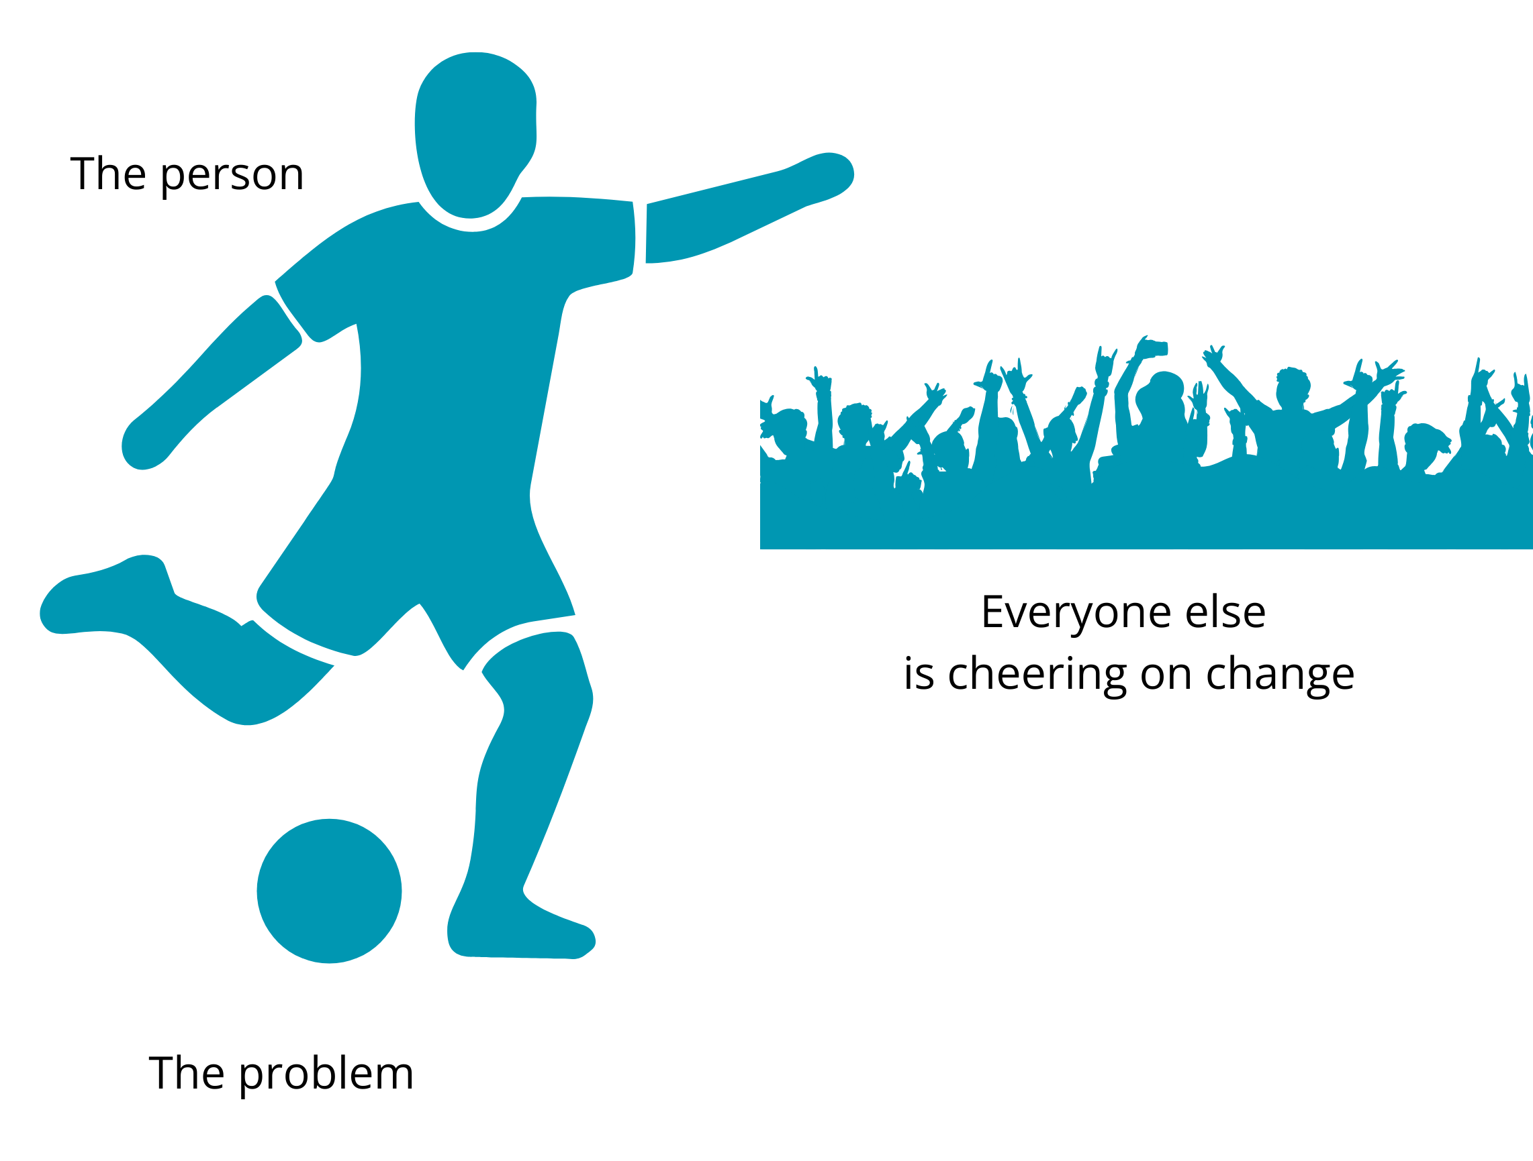
10. The problem is the problem, not the person
By separating the person from the issue the person is less likely to feel judged or experience shame.
This helps everyone work together on solutions.

Slide 17
Basic do’s and don’ts for being solution-oriented
Do:
Acknowledge the problem and validate feelings
Look for fresh perspectives, insights, and ideas
Be willing to explore ideas that may challenge initial assumptions
Don’t:
Dwell on the problem
Get stuck in a loop of negative thinking
Ignore exceptions and recognise when things have positively changed, even partially

Slide 18

Final Reflection
From what you have learned so far, think about:
How has this made you feel?
What has this made you think about?
What one action would you like to take forward?
How can you link what you plan with others in your setting?
How will you know that this learning has made a difference?
Notes:
Facilitation notes:
You can do this in groups...
Encourage educators to take this forward in an enquiry
Consider impact of the actions / learning

Slide 19


We value your feedback
Education Scotland is taking feedback on these resources so that we can continue improving our professional learning resources.
Your feedback could help us improve this resource
Please complete this short form, using the link or QR code, to let us know what you thought of it and any suggestions you have on how it could be improved.
framework feedback form
Notes:
Slide 29: Feedback slide
Education Scotland is taking feedback on these resources so that we can continue improving our professional learning resources.
Your feedback could help us improve this resource
Please complete this short form, using the link or QR code, to let us know what you thought of it and any suggestions you have on how it could be improved

Slide 20

Contact Education Scotland
Denholm House
Almondvale Business Park
Almondvale Way
Livingston EH54 6GA
Telephone: +44 (0)131 244 5000
Email: enquiries@educationscotland.gsi.gov.uk
Website: Inclusion, wellbeing and equalities framework | Education Scotland

