Slide 1

Leadership for Equity
Scottish Learning Festival
September
2016

Slide 2
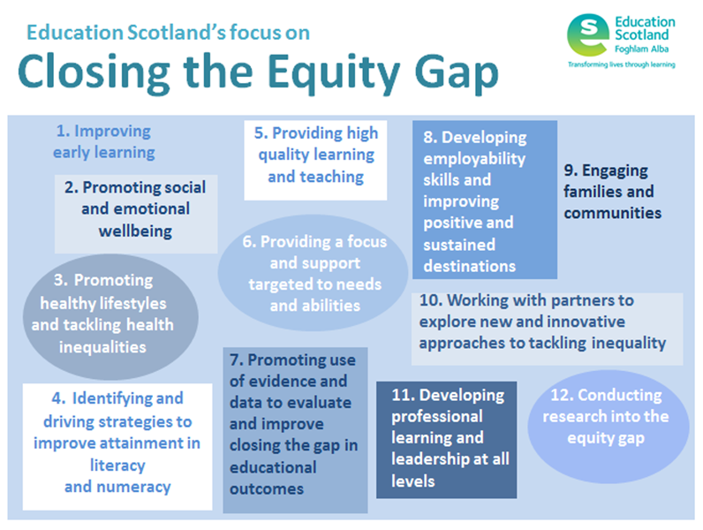


Slide 3

Dundee
Leadership
Learning and Teaching
Families and Communities
Notes:
With the appointment of key staff with varied backgrounds, experiences and skills, schools are beginning to see the benefit of partnerships to support children and families and explore ways of promoting and increasing family engagement in children’s learning.
Schools are more focussed in their Improvements plans on RA and CTG. HTs and teachers are more confident in the use of data to target interventions.
Speech and language therapists are beginning to work with families in our nurseries to support the development of early literacy. This is a new approach to working with our colleagues from NHS and we are planning action research to report on this locally and nationally to inform the way forward.
The Attainment challenge fund has supported the appointment of a SFW for all AC schools.. This would not be possible otherwise. In the past primary schools have had a very small input from this service, usually shared across the secondary and cluster primaries. HTs and schools have very high expectations that this will have a significant impact on engagement with families.
Schools have plans in place to support targeted families and in the Strathmartine ward and associated primary schools. Their first priority has been to target families for the holiday provision organised for the forthcoming Easter Holiday.
Overall improvements made as a result of our involvement in the Scottish Attainment Challenge in the following areas:
1) Leadership
There are clear messages re the SAC, objectives and goals set from the governance groups, the Project Leader and the Attainment Advisor
This translates into clear leadership at establishment level
HTs and teachers are focussed on this agenda
Leadership for all workstreams to support staff in establishments, eg literacy staff tutor, maths staff tutor, HWB, Educational Psychology
2) Learning and Teaching
Focus on Early Learning and Early interventions to close the gap earlier in a child’s learning journey
Focus on pedagogy and research to up-skill teachers and educators
Encouraging and facilitating professional dialogue around improving outcomes for learners through development of networks of staff and professional learning communities
Building capacity in nursery and school staff through opportunities to work with NHS allied professionals – Speech and Language Therapy
3) Families and Communities
Programmes to support families with their children’s learning such as SLT interventions in nursery and holiday programmes
Working closely with the LA parental engagement officer to develop support for parents, communications strategy and approaches to engaging parents through digital media.
The appointment of a SFW for every school and nursery
The approach to improving HWB through Growth Mindset and ASPIRE is through community engagement, not just schools.

Slide 4

Closing the Poverty Related Attainment Gap in Dundee
In February 2016, we held a seminar and workshop for our Attainment Challenge Head Teachers in Dundee on ‘Leadership for Equity’ :
Very well received
Feedback indicated that HTs would welcome further support
Confidence and skills to lead the attainment challenge in their schools
Develop coaching and mentoring skills to support their staff in the challenge
Develop as systems’ leaders

Slide 5
Leadership for Equity
National Context / Dundee Context
February 2016

Slide 6
What is Leadership for Equity?

Slide 7
Closing the Poverty Related Attainment Gap - National context
Everyone who works for Education in Scotland has a role to play in the Scottish Attainment Challenge.
Launched in 2015 by the First Minister, the Challenge aims to raise the attainment of children and young people living in deprived areas in order to close the equity gap, and to increase attainment overall.
Education Scotland is working with colleagues in Scottish Government to take forward the Scottish Attainment Challenge.

Slide 8
Closing the Poverty Related Attainment Gap - Dundee
1.6 Leadership
Strong and effective leadership permeates all our plans for raising attainment. The plans identify the importance of lead professionals:
to deliver professional development
to work with Head Teachers and staff in schools to analyse their data rigorously
to facilitate and support Professional Learning Communities and Alliance models
to evaluate, analyse and review the impact of initiatives
offer coaching and mentoring support
to continue to develop high quality leadership

Slide 9
Closing the Poverty Related Attainment Gap - Dundee
The plans also recognised the importance of Head Teachers and school staff to develop leadership to:
know how pupils are progressing through rigorous analysis of data
deliver outcomes and evaluate impact
engage in professional learning
engage in Action Learning Sets/Research and Professional Learning Communities
link intervention to research

Slide 10
Closing the Poverty Related Attainment Gap - GTCS
Standards for Leadership and Management Dec 2012 Leadership and Management Leadership is central to educational quality. Leadership is the ability to:
develop a vision for change, which leads to improvements in outcomes for learners and is based on shared values and robust evaluation of evidence of current practice and outcomes;
mobilise, enable and support others to develop and follow through on strategies for achieving that change;

Slide 11
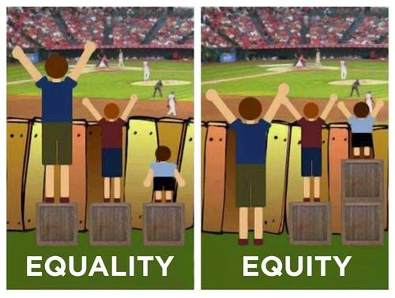
Closing the Poverty related Attainment Gap

Slide 12
OECD December 2015
Equity and closing the gap

Slide 13
Our recommendations
Be rigorous about the gaps to be closed and pursue relentlessly “closing the gap” and “raising the bar” simultaneously.
Ensure a consolidated and evidence-informed strategic approach to equity policies.

Slide 14
Building on ‘Improving Schools in Scotland: An OECD Perspective’, December 2015
Quality and Equity
  be rigorous about the gaps to be closed
  develop metrics that do justice to the full range of CfE capacities
  take a consolidated and evidence-informed approach to equity
Decision-making and governance
  create a new narrative for CfE
  strengthen professional leadership and ‘the middle’
  simplify and clarify core guidance
Schooling, teachers and leadership
  focus on quality of implementation in schools
  develop targeted, networked, evaluated innovation in secondary school
  develop coherent strategy for building social capital
Assessment and evaluation
  develop integrating framework for assessment and evaluation at all levels
  strike more even balance between formative assessment and evidence base
  strengthen evaluation & research
Notes:
You can see here how the OECD report echo's what the National Improvement Framework has focused on and how the two are linked .
These are the 12 recommendations from the Improving Schools in Scotland :An OECD Perspective report

Slide 15
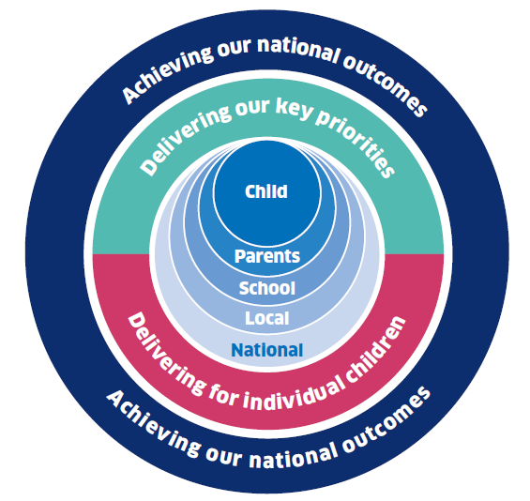
The National Improvement Framework - vision
Excellence through raising attainment: ensuring that every child achieves the highest standards in literacy and numeracy and the right range of skills, qualifications and achievements to allow them to succeed; and
Achieving equity: ensuring every child has the same opportunity to succeed. The Scottish Attainment Challenge will help to focus our efforts and deliver this ambition.
“Be rigorous about the gaps to be closed and pursue relentlessly “ closing the gap” and “raising the bar simultaneously” Improving Schools in Scotland: An OECD Perspective 2015
Notes:
Scottish Government vision for education is….
Having a clear, shared vision for education in Scotland was seen as a key benefit of the Framework. This vision is consistent with the 2020 ADES vision and provides clarity about working together on the priorities at all levels within and across the education system.

Slide 16
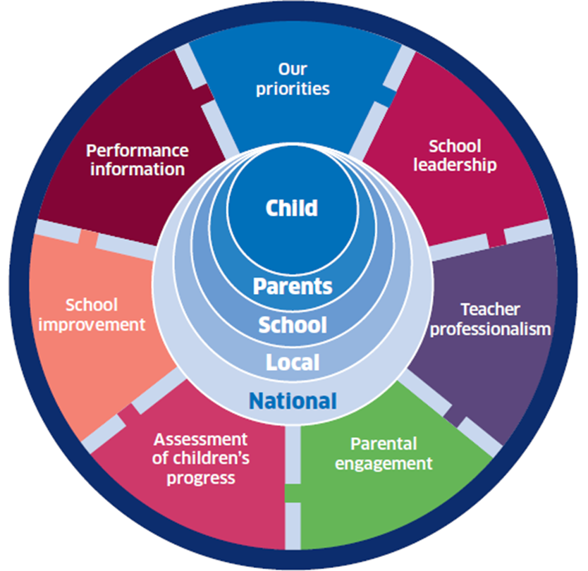
National Improvement Framework
Our Priorities
Improvement in attainment, particularly in literacy and numeracy;
Closing the attainment gap between the most and least disadvantaged children;
Improvement in children and young people’s health and wellbeing; and
Improvement in employability skills and sustained, positive school leaver destinations for all young people.
Notes:
The 6 key drivers for improvement will be instrumental to achieving our key priorities , currently described as:
Improvement in attainment, particularly in literacy and numeracy;
• Closing the attainment gap between the most and least disadvantaged children;
• Improvement in children and young people’s health and wellbeing; and
• Improvement in employability skills and sustained, positive school leaver destinations
for all young people;
Everyone working in Scottish education should be clear about what they are seeking to achieve in making their contribution to addressing these priorities. There may be further improvement priorities at school level, based on local needs and self-evaluation.
The priorities may change over time, depending on what the evidence is telling us. Indeed,
we expect they will as issues are addressed successfully and new priorities emerge.

Slide 17
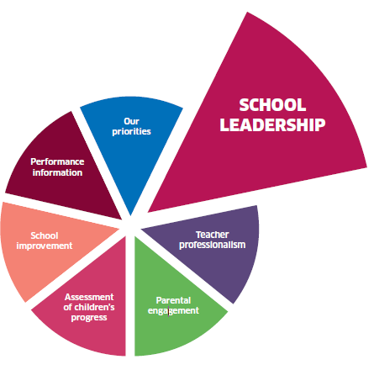
Driver of improvement : School leadership
What is this?
The quality and impact of leadership within schools and at all levels – including members of staff
Notes:
Why is this important?
Leadership is recognised as one of the most important aspects of the success of any school. Headteachers and teachers who are empowered, and who empower others to take ownership of their own learning, have a strong track record of ensuring the highest quality of learning and teaching. This in turn helps to ensure that all children achieve the best possible outcomes. Gathering evidence on the quality of school leadership will help us to identify and share what works and provide support and intervention where leadership needs to improve.
How will this help to achieve excellence and equity for all children?
Leadership is key to ensuring the highest possible standards and expectations are shared across a school to achieve excellence for all. Through evaluating leadership and, crucially, leadership of change, we will be able to focus on where leadership action is delivering excellent outcomes for all children and closing the attainment gap through targeted intervention. We will also have evidence on the extent to which professional skills and competences of headteachers are being developed and maintained.

Slide 18
School leadership
Evidence we will gather
Through school inspection, percentage of schools graded as “good” or better for leadership of change
Number of new headteachers who meet the standard for Headship, and numbers of experienced headteachers who continue to meet Standard for Leadership and Management
Local authority self-evaluation reports on leadership of change
Notes:
What will this tell us
how good planning for improvement is and the impact of improvements and changes. It will focus on leadership at all levels within a school.
about the qualifications achieved and standards met by our headteachers.
how well leadership is improving based on school and local authority self-evaluation and quality assurance activities.

Slide 19


A passionate commitment to ensuring social justice, children’s rights, learning for sustainability and equality are important prerequisites for all who deliver Scottish education. (How good is our school? 4th edition p.6)
Notes:
From the charter:
Charter:
Promotion of social justice and opportunities for all.
Commitment to uphold the moral teaching of the Church

Slide 20
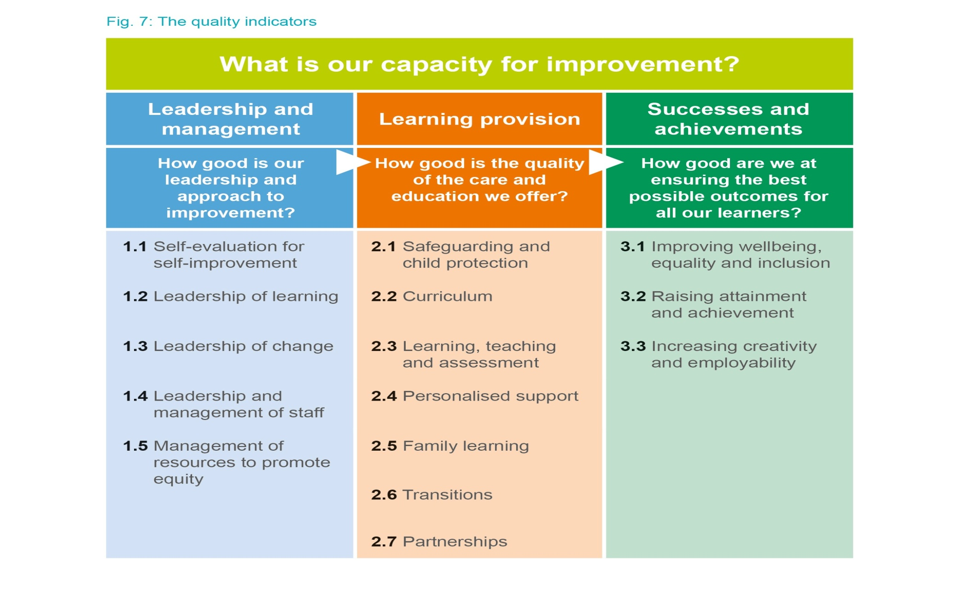
The Framework:
p15
Notes:
The new HGIOS framework is a bit different from the previous version.
15 Qis – more streamlined – we hope this will encourage schools to reconsider approaches to self-evaluation and move away from the current approach in many schools ie on ly looking at the five “inspection” Qis.
Each divided into themes
Highlight a few of the QIs and interesting themes:
self-evaluation for self-improvement
Leadership of learning
Learning, teaching and assessment
Family learning
Transitions
Partnerships
3 outcome QIs – demonstrate our commitment to securing a range of outcomes for Scotland’s children and young people
The arrows and the order of the framework are significant – TSF Leadership is significant factor in quality of school improvement.
1.1 self-evaluation – first QI in the framework – makes it key to school improvement – starting point is to know where you are at.

Slide 21
Leadership and management
How good is our leadership and approach to improvement?
Quality Indicator | Themes:
1.1 Self-evaluation for self-improvement | Collaborative approaches to self-evaluation Analysis and evaluation of intelligence and data Ensuring impact on learners’ successes and achievements
1.2 Leadership of learning | Professional engagement and collegiate working Impact of career-long professional learning Children and young people leading learning
1.3 Leadership of change | Developing a shared vision, values and aims relevant to the school and its community Strategic planning for continuous improvement Implementing improvement and change
1.4 Leadership and management of staff | Governance framework Building and sustaining a professional staff team Staff wellbeing and pastoral support
1.5 Management of resources to promote equity | Management of finance for learning Management of resources and environment for learning
P.16
Notes:
there are 5 other Qis in the Leadership and Management suite.
These Qis have been developed very much in line with the GTCS professional standards. You should see similar language and that should mean that you are able to use these Qis to help you reflect on your individual leadership style and to link this with Professional Update, PRD and defining your CLPL needs.
Across these Qis there is a strong focus on
Collegiate working
Importance of strengthening leadership at all levels and across the entire school community
Ensuring impact from career long professional learning
Need for strong strategic leadership which takes good account of key national priorities – eg. Learning for sustainability, developing the young workforce, ensuring equity and inclusion.
The need to ensure children and young people play a part in leading learning and school improvement
Importance of a strong relationship and shared understanding of school governance structures and lines of accountabiltiy

Slide 22
High Leverage Leadership
Management | Organising: problem solving, creating order & providing consistency | Analysis: using data and other information to create a high definition picture of how issues manifest themselves locally
 |  | Action: emphasising priorities and ensuring that change is explicit, funded and managed.
 |  | Application: Relentless focus, in particular ensuring that the quality of teaching and learning -the core business– is first class.

Slide 23
High Leverage Leadership
Navigation | Securing the vision: setting a direction & promoting change | Awareness: recognising and prioritising issues the organisation will need to address
 |  | Acceptance: understanding that current practice may be a barrier while believing that improvement is possible
 |  | Advocacy: creating a ‘living vision’ and participating in focussed work force development to introduce sustainable change

Slide 24
High Leverage Leadership
Partnership | Modelling Partnership: treating partners with equal esteem and deep respect | Association: being socially aware, nurturing the school as a community in its own right, as a member of its neighbourhood community and as a unit in a wider professional community
 |  | Alignment: improving the alignment of the students’ home and school experiences – without prejudice to what changes and where.
 |  | Area focus: engaging with the wider community in a partnership role because for young people there is no ‘one size fits all’.

Slide 25
Closing the Poverty Related Attainment Gap
Values / Vision / Attitudes / Behaviours
What do we model?

Slide 26

‘Our task is not to put the greatness back into humanity, but to elicit it for the greatness is there already.’
John Buchan

Slide 27
The Columban Code – the essence of leadership
awareness
integrity
perseverance
focus
creativity
service

Slide 28
Closing the Poverty Related Attainment Gap
What are the:
Risks / Challenges / Assumptions
for the Scottish Attainment Challenge (in Dundee)?

Slide 29
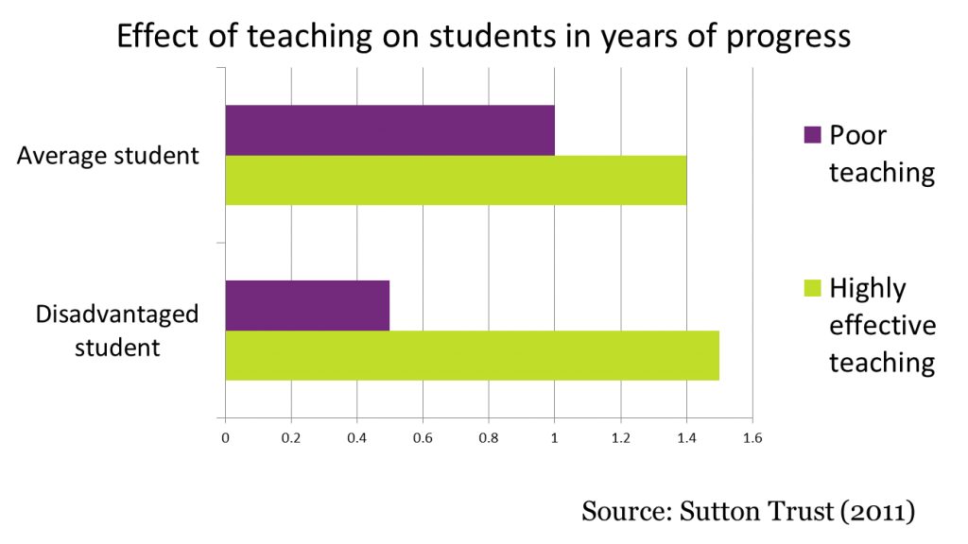


Slide 30

The importance of learning and teaching
“The major source of student
variance lies within the person
who gently closes the door
of the classroom door and
performs the teaching act.”
“The remarkable feature of the
(research) evidence is that the
biggest effects on student learning
occur when teachers become
learners of their own teaching.”
John Hattie “Visible Learning”

Slide 31
The importance of TEACHERS
“Sustainable development can never be done to or even for teachers. It can only ever be achieved by and with them.”
Hargreaves and Fullan (2012)
“The quality of an educational system cannot outperform the quality of its teachers. The only way to improve outcomes is to improve learning and teaching.”
McKinsey

Slide 32
Challenge limiting beliefs and casual assumptions which kill aspiration
  ‘We’ve tried that…’
  ‘We already do that…’
  ‘I’d love to do that but…’
  ‘It won’t work …’
  ‘It won’t work with our children…’
  ‘It won’t work with these children…’

Slide 33
Closing the Poverty Related Attainment Gap
Key questions:
Are we poverty proofing our schools?
Are we developing a curriculum that is designed to tackle inequality, reduce the impact of deprivation and address inequity?

Slide 34
Closing the Poverty Related Attainment Gap
Key questions:
Does your school provide opportunities for staff to share expertise?
Does your school collaborate with other schools in exploring ways of promoting the learning of vulnerable groups?
Is your school active in involving the wider community and partners in supporting its work?

Slide 35
Closing the Poverty Related Attainment Gap- partnerships
‘It takes a whole village to raise a child…….’
African Proverb

Slide 36
Closing the Poverty Related Attainment Gap – The London Challenge
Four key school improvement interventions provided the impetus for improvement - London Challenge, Teach First, the Academies Programme and improved support from local authorities. The research identifies common features that link together all of these interventions:
a focus on data and data literacy
the need for a culture of accountability
the creation of a more professional working culture
a collective sense of possibility and highly effective practitioner led professional development
improvement also depended upon effective leadership at every level of the system
How might Dundee take this learning forward for our Attainment Challenge?

Slide 37
Closing the Poverty Related Attainment Gap in Dundee – Year 2
Feedback from the seminar has resulted in:
3 programmes of CLPL to support the development of leadership for our Head Teachers in the Attainment Challenge schools in Dundee
designed to help develop our HT’s understanding of the importance of their role in delivering the outcomes of the SAC

Slide 38
Closing the Poverty Related Attainment Gap in Dundee – Year 2
The focus of our bespoke programmes is ‘Leadership for Equity’ and will also help develop our Head Teachers as Systems’ Leaders.
The programmes will be delivered through partnerships with Columba 1400, School Leaders Scotland and The Mudd Partnership.
The programmes will take a collaborative and coaching approach.

Slide 39
Closing the Poverty Related Attainment Gap in Dundee – Year 2
This support for HTs will help to improve their confidence as leaders of learning in their own establishment and keep them focussed on excellence and equity.
It will also build capacity across the local authority as we provide opportunities and support to help our HTs become Systems’ Leaders:
Columba 1400 Head Teacher Leadership Academy / SCEL accreditation
Coaching programme
System Leaders’ programme

Slide 40
Closing the Poverty Related Attainment Gap
‘Poverty need not mean destiny’
Nelson Mandela:
‘Education is the most powerful weapon which you can use to change the world’

Slide 41
Closing the Poverty Related Attainment Gap
‘Poverty need not mean destiny’
“the principal’s role is to lead the school’s teachers in a process of learning to improve their teaching, while learning alongside them about what works and what doesn’t.” - Michael Fullan
‘(We need) leadership that is tough enough to demand a great deal from everyone, and leadership that is tender enough to encourage the heart.’ - Thomas J Sergiovanni

Slide 42
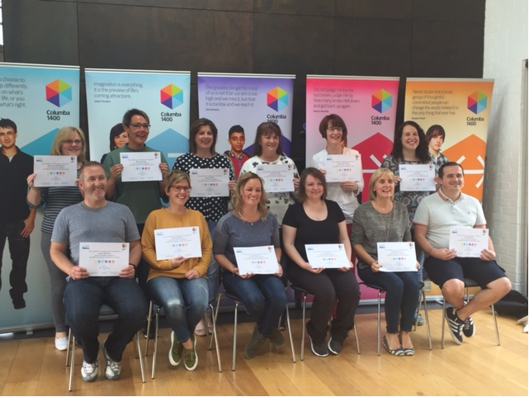
Some first steps……

Slide 43

What will outstanding school leaders in Dundee focus on in Year 2 of the SAC?
Proportionate approach to monitoring and evaluation
Collaborate: essential for excellence
Clear learning and teaching strategies in place to reduce the impact of poverty on progress and achievement
Highest levels of confidence and consistency in teacher judgement of CfE levels
Consider national improvement framework priorities and drivers in your school improvement planning 2016/17
Generic and targeted elements to improvement plan priorities
Moving from parental involvement to family learning offer/ programme

Slide 44
What will outstanding school leaders in Dundee focus on in Year 2 of the SAC?
Increase our focus on Leadership development at all levels – coaching programme, systems’ leaders and Columba 1400
Focussed Self-evaluation / SIP – HGIOS 4 and the NIF
Focussed CLPL for staff in AC nurseries / schools
Moderation, moderation, moderation…
DEPS developments – CAR, toolkit…..
Research / Data / Evidence / GL Assessments
Learning in context visits / sharing NI Hub
Partnerships / parents and families / communities

Slide 45

Every school is thinking about their gaps…..
Which ‘gaps’ exist in your school?
How are they measured?
How will they be reduced?
How will you know?
“Be rigorous about the gaps to be closed and pursue relentlessly “ closing the gap” and “raising the bar simultaneously”
Improving Schools in Scotland: An OECD Perspective, 2015

Slide 46
Audrey.May@educationscotland.gsi.gov.uk
www.educationscotland.gov.uk
http://bit.ly/saccommunity
Twitter - @EdsAttaindundee

