Slide 1
Scottish Local Authorities and the Syrian Vulnerable Person Resettlement Scheme Teaching ESOL to Refugees Event Glasgow Monday 29 February 2016

Slide 2
About COSLA
COSLA is the representative voice of Scottish local government – 28 of 32 local authorities are members
We host the Home Office funded Strategic Migration Partnership for Scotland
Our migration work is also funded by Scottish Government
In the Syrian VPR Scheme we provide a supporting and coordinating role to all 32 local authorities in Scotland

Slide 3
The Syrian Vulnerable Person Resettlement (VPR) Scheme
Established by the UK Government in January 2014 – commitment to ‘several hundred’ people over 3 years
Significantly enlarged in September 2015 – Cameron commits to 20,000 refugees being resettled to the UK over five years
A local authority led scheme with a five year funding package
Scottish Government commitment to take 10% or 2,000 people
Unprecedented support from Scottish local authorities
£1m additional funding provided by Scottish Government

Slide 4
Syrian VPR Process Map
Home Office Map

Slide 5
‘Vulnerability Criteria’
Women and girls at risk;
Survivors of violence and/or torture;
Refugees with legal and/or physical protection needs;
Refugees with medical needs or disabilities
Children and adolescents at risk;
Persons at risk due to their sexual orientation or gender identity; and
Refugees with family links in resettlement countries.

Slide 6
Syrian Resettlement to Scotland
By Christmas 2015 half of Scottish local authorities had received refugees from Syria
400 people hosted by sixteen local authorities
Mostly families with small children
Initial reports indicate that people are settling in well
Expecting at least a further 8 local authorities will receive refugees between January and March 2016
Expectation that Scotland will receive 2,000 people by 2020 with the majority of Scottish local authorities involved

Slide 7
What underpins our approach?
New Scots: Integrating Refugees in Scotland’s Communities
The vision behind the strategy is: for a Scotland where refugees are able to build a new life from the day they arrive in Scotland and to realise their full potential with the support of mainstream services; and where they become active members of our communities with strong social relationships.

Slide 8
The Indicators of Integration

Slide 9
Resettlement Planning
Housing
Health
Employment/Benefits
Education
Social Connections
Pre Arrival | Point of Arrival | First Month | First Year
Establish multi-agency approach and meet regularly Community walk-around: Identify suitable location with available housing, school places, ESOL provision and other wrap-around services Identify and prepare housing Establish appropriate health services are in place Arrange interpreting and translation services Provide staff briefing/training Prepare welcome and orientation information Agree and implement communication strategy Undertake community engagement Arrange transport from the airport Set up payments Undertake gap analysis | Welcome Biometrics gathering NINO allocation Benefits application Transportation to new home Introduction to new home GP registration Establish means of keeping in touch (mobile phones?) | Orientation in the local area Identifying individual integration needs & establishing plan Support ‘normalisation’ School/college registration Starting ESOL classes Dentist registration Hospital appointments Meeting with Job Centre Plus Opportunities to build social connections Help to make links to faith groups Set-up bank or post-office account Manage volunteer input Money management support Familiarisation with police/law Identify cultural issues | Tenancy support Reviewing integration needs progress Language Opportunities to build social connections Possibility of Syrian community meeting up across Scotland Collaboration between neighbouring areas Support employability/qualifications recognition/personal profiles for skills matching

Slide 10
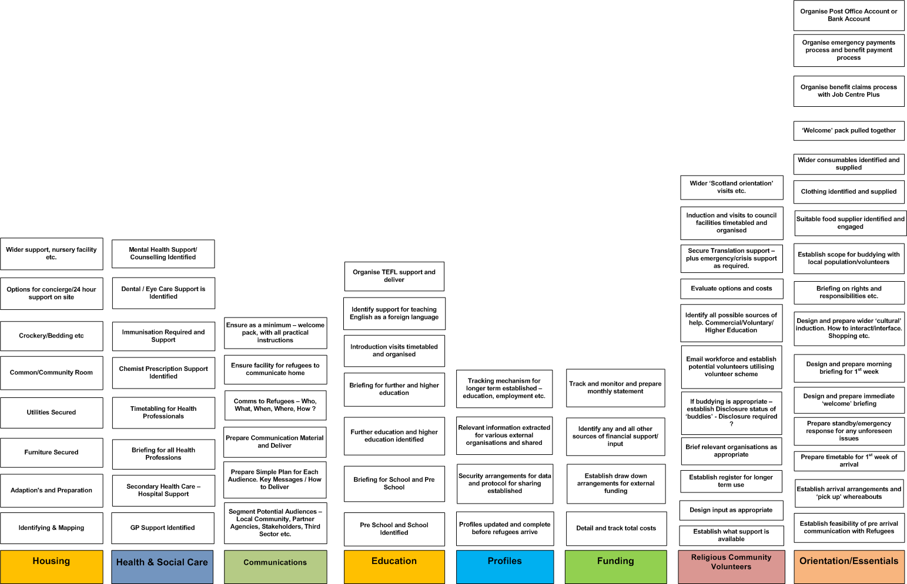
Bringing Refugees to Renfrewshire
Immediate Workstreams

Slide 11
Housing
Employability and Welfare Benefits
Health
Communities and Social Connection
Taskforce
Chaired by Humza Yousaf MSP
Education
Scottish Coordination Structures
Integration Forum
Weekly Tripartite Phonecalls
COSLA – SG – Home Office
Cabinet Office /
Home Office /
Health / LGAs meetings
New Scots Core Group
COSLA VPR Officer Group

Slide 12
ESOL Provision
The Home Office ‘statement of requirements’ say ESOL:
Must be provided within one month of arrival;
At an appropriate level determined by an assessment;
Delivered by an accredited provider; and
Available for 12 months or until mainstream provision becomes available
Recognition that English language acquisition is a key to integration
Provided in a number of ways – CLD Workers, local colleges, voluntary sector partners depends upon local circumstances.
Development of peer education pilot to build on existing efforts to use volunteers to support learning

Slide 13
Conclusion
This is a local authority led scheme – contact yours to find out what is happening in your area
ESOL is a key mechanism to support integration – there is an important role for ESOL practitioners in this scheme
Consider opportunities for peer support and practice development drawing on previous experience of supporting refugees, asylum seekers and other migrants across Scotland
To find out more about our work visit: www.migrationscotland.org.uk

