Slide 1

Developing the Young Workforce
Learning Resource 2: Introduction to Labour Market Information - Stimulus
Notes:
This is a front cover page and can only be used once. Use the corresponding blue internal and back pages if you are using this page. You may add a title and a subtitle if needed only. Do not add anything else or move elements around.

Slide 2
Youth unemployment
Be one of the top five performing countries in the EU for youth unemployment by reducing the youth unemployment rate to match the fifth best country in the EU by 2021
2014
19.0%
The rate of the fifth best country in the EU was 14.7%
2017
8.9%
The rate of the fifth best country in the EU was about 5%

Slide 3
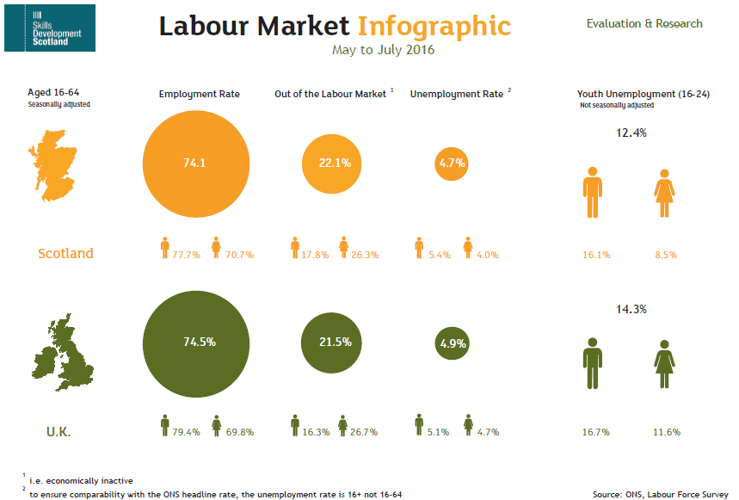
Scotland Vs UK

Slide 4
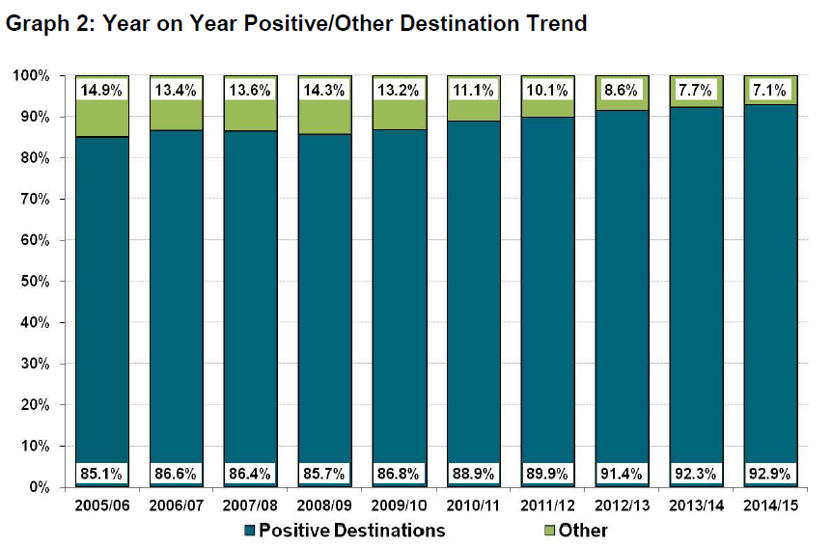
Destinations
Main Findings
Overall the percentage of leavers entering a positive destination is 92.9% - highest since comparable records began
The majority of school leavers ....... within Higher or Further Education 66.1% - highest level since comparable records began.
The percentage of leavers who are unemployed seeking is 5.4% lowest level since comparable records began

Slide 5
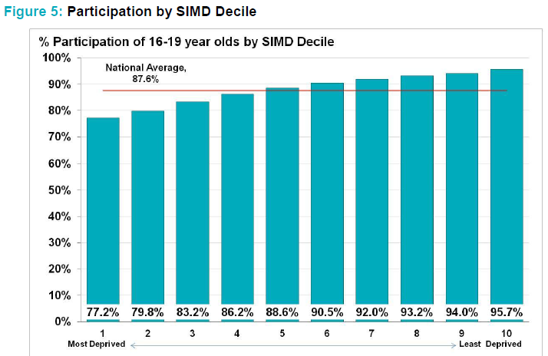
Your postcode is your future?

Slide 6
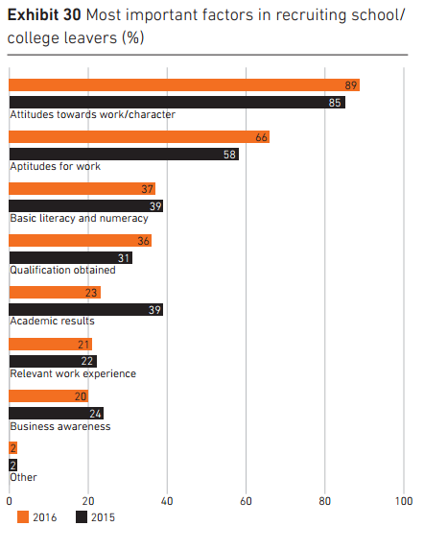
What are employers looking for?
“Businesses are clear that first and foremost they want to recruit young people with attitudes and attributes such as resilience, enthusiasm and creativity. They are
not selecting simply on the basis of academic ability.”
“Less than one business in five(19%) prefers just academic qualifications “
The right combination, CBI (2016)

Slide 7
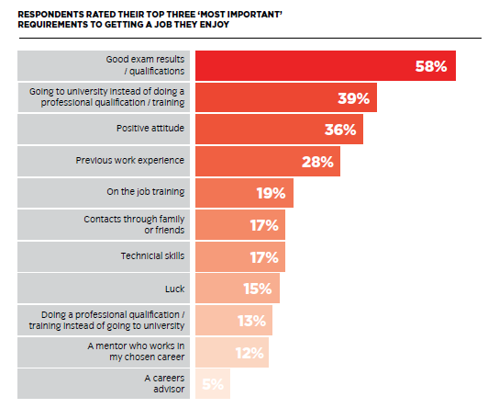
What do young people think employers want?
Qualifications matter most
How do we address the mismatch between young people’s and employers’ views?
Great expectations, City and Guilds 2015

Slide 8
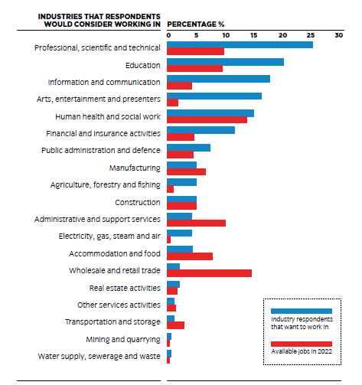
Aspirations Vs Reality
“....the jobs most frequently chosen are ones that young people would commonly be exposed to (ie: secondary school teacher, police officer, doctor) or ones that they may have seen in media representations.”
Great expectations,
City and Guilds 2015
How do we collectively ensure young people are more aware of the realities of the future job market?

Slide 9
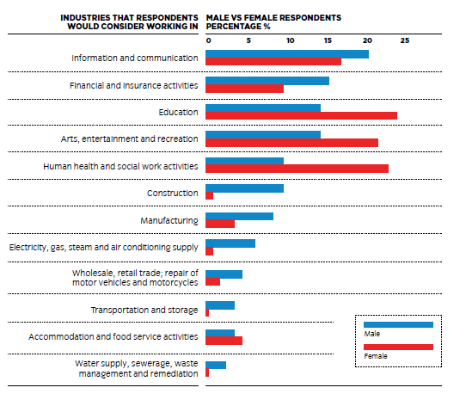
Jobs for the boys
“Good careers advice and giving young people access to role models working in gender biased industries who counter the stereotypes will be essential in getting young people to consider careers in areas not generally thought of as being ‘for them’.... we must also address the gender bias that currently exists in school and even within the family”.
Great expectations, City and Guilds 2015

Slide 10

There’s more than one path to success
“... there is a widespread belief that studying for a degree will lead to a well-paid job and fulfilling professional career and whilst in many cases this is true it isn’t always the case”.
Great Expectations, City and Guilds 2015

Slide 11

Work Based Learning
“.... our findings show that apprenticeships continue to suffer from an image problem compared to Higher Education”.
Parental preferences:
- higher education 51% , UK (56%, Scotland)
apprenticeship 20%, UK (19%, Scotland)
Young people’s preferences
“Only 7% of people aged 18-24 considered
apprenticeships as the best way forward”.
“It’s not about what kids do at 16, 17 and 18, it’s what they do at 6, 7 and 8”

