Slide 1
Enterprise and Employability

Slide 2
What are Enterprise and Employability?
Developing skills we can use in life, learning and work.
Learning by doing – hands on!
Real world experience– e.g. managing money, taking on roles.
Leadership and teamwork.
Determination and success.
Dealing with failure – resilience!

Slide 3
What enterprise goes on in Bonhill?
Pupil Council
Eco
Committee
Library Committee
JRSO
Enterprise
Company
Work Experience
RRS Committee

Slide 4
What enterprise goes on in Bonhill?
Water
Tartan
Chickens
Playleaders
Credit Union
Uniform Recycling
Stationery
Fairtrade

Slide 5
Pupil Council
Run stationery and Fairtrade stall.
Art show in previous years.
Pupil Voice – represent each class.
Democratic.
Hold meetings regularly.
Take on roles such as Chairperson, Secretary, Treasurer.
Lots of skills developed.

Slide 6
Stationery
Pupil Council realised lots of people were asking to borrow stationery.
Ordered in stationery supplies.
Run stalls 3 times a week in each of the playgrounds.
Everything is 20p.
Rota established and the children are in charge of the money.

Slide 7
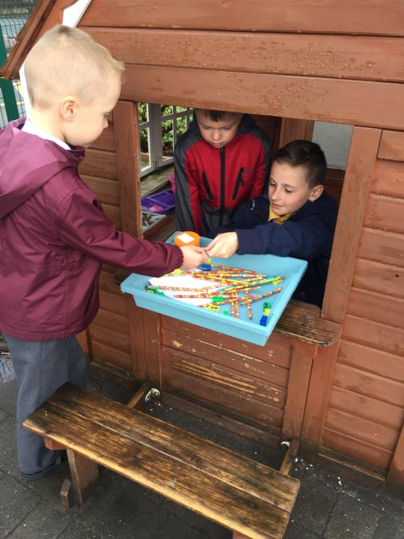

Slide 8
Fairtrade
Fairtrade tuck shop for after school clubs.
Rota in place for who is running the stall and managing the money.
Stall also runs at parent café and keep fit.
Fairtrade rice which is sold for £3. Social Enterprise – sending a child in Malawi to school. Award for this in 2013.
Fairtrade quiz to raise funds to purchase Fairtrade footballs for our playground.

Slide 10
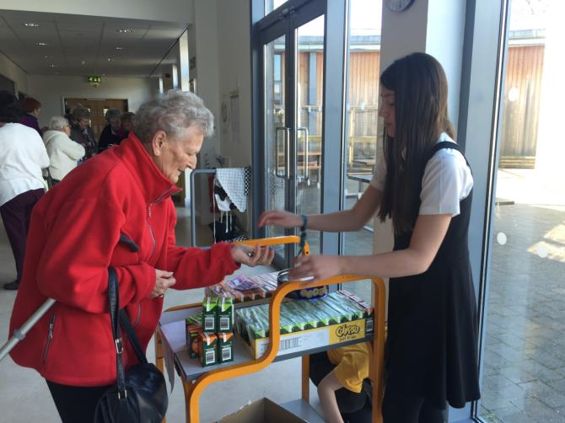

Slide 11
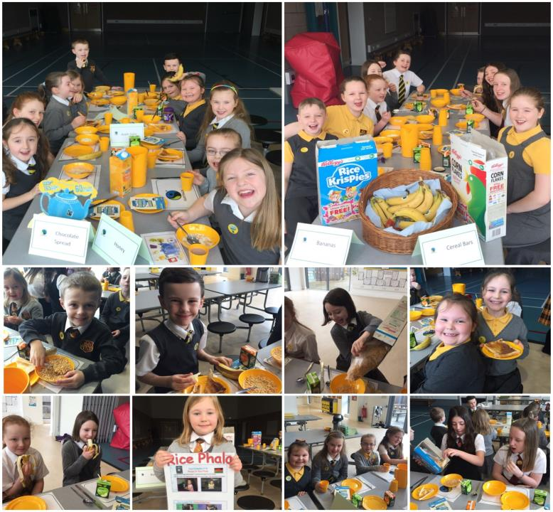

Slide 12
Enterprise Company
Roles including Chairperson and Secretary.
Established to launch school tartan.
Visited garment factory and put forward ideas for tartan items.
Held very successful fashion show – doubled as models.
Carried out market research to see what items people would buy.
Lots of skills developed.

Slide 13
German Markets
Linked Enterprise to 1+2 languages programme, developing our awareness of German culture
Made Santa’s glasses, Wordles in frames
Upper school classes made German biscuits.
Sold outside at Christmas fair.
Choir sang German songs.
Took orders and completed these in following weeks.

Slide 14
Frohe Weihnachten!

Slide 15
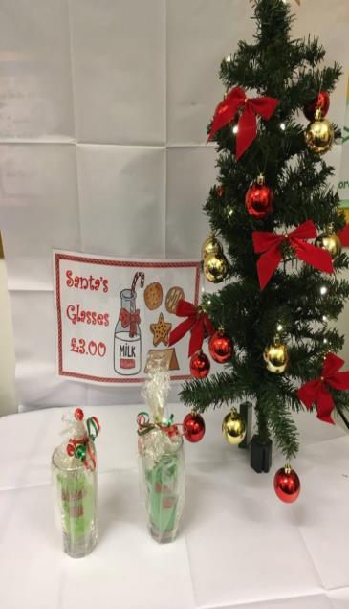
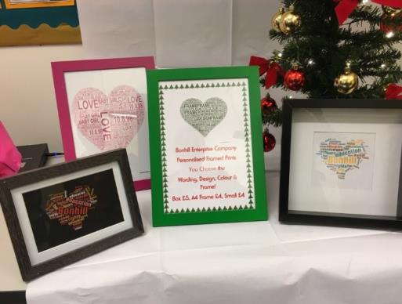

Slide 16
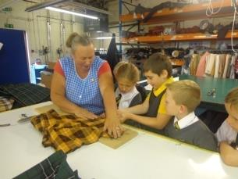
Tartan
Tartan designed and registered.
Woven into fabric.
Visit to garment factory.
Held a fashion show.
Carried out market research.
Order forms.
Developed links with local businesses, such as G&D garments.

Slide 17
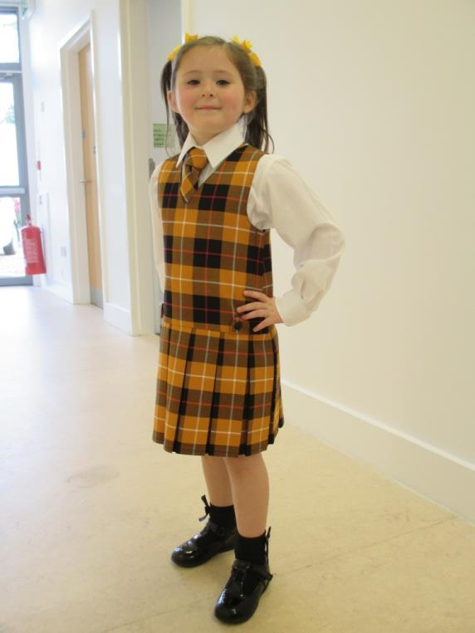
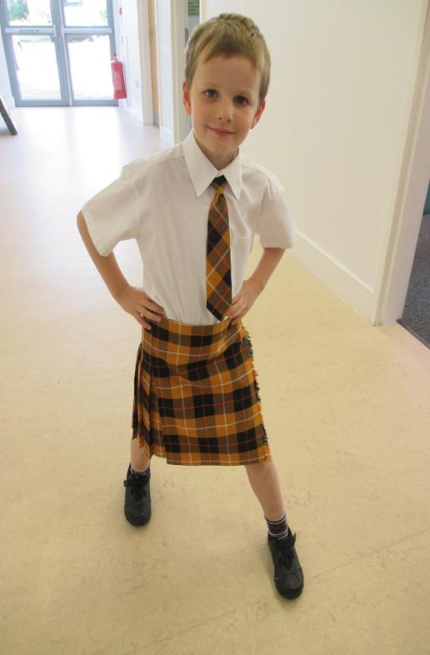

Slide 18
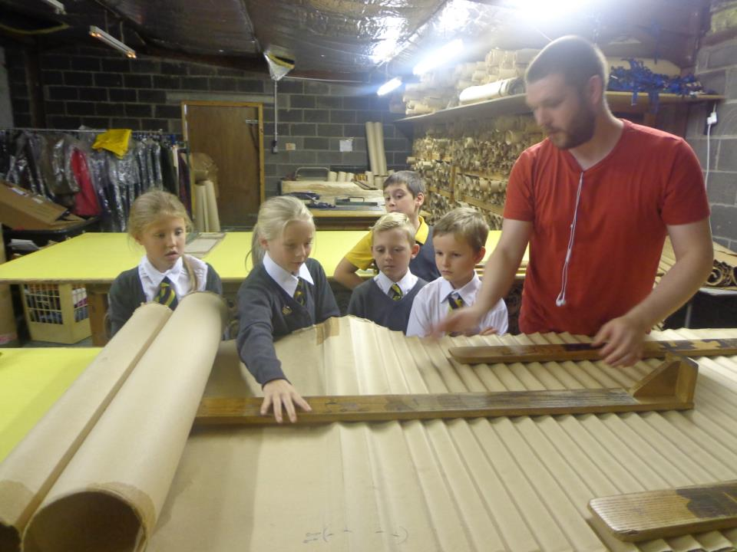

Slide 19
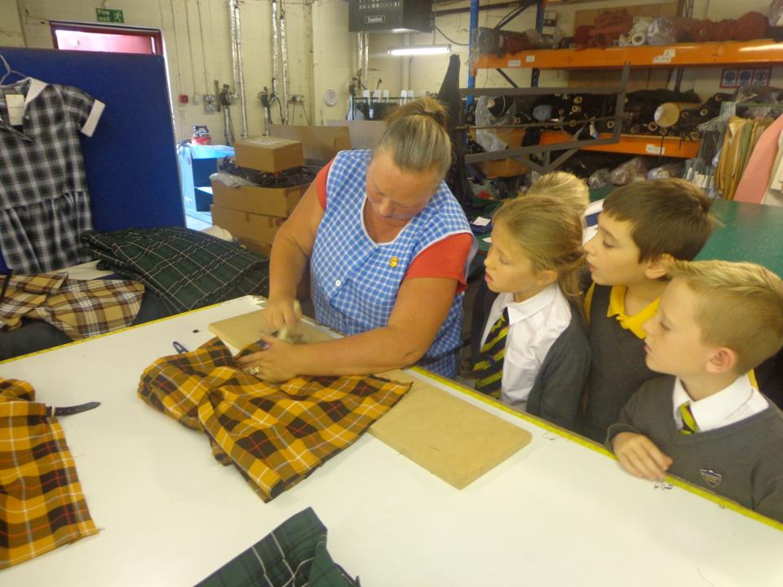

Slide 20
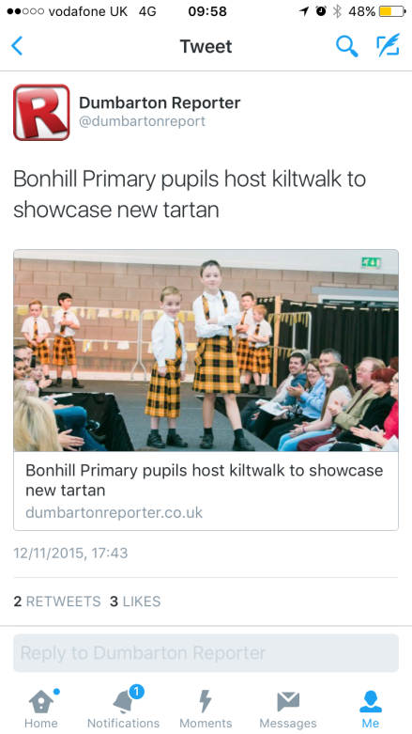

Slide 21
Enterprise Conference
Asked by Young Enterprise to attend a conference to showcase our Enterprise projects.
Got to Network and meet real entrepreneurs!
Met the MSP Annabelle Ewing to tell her about our work.
Geoff Leask, Chief Executive of YES, called us the most enterprising school in Scotland.

Slide 23
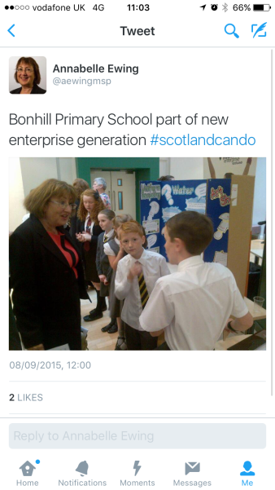
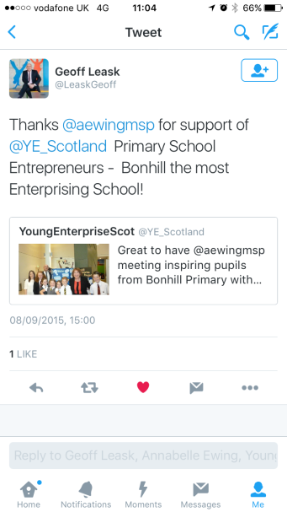
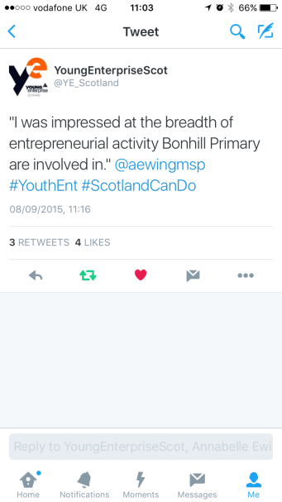
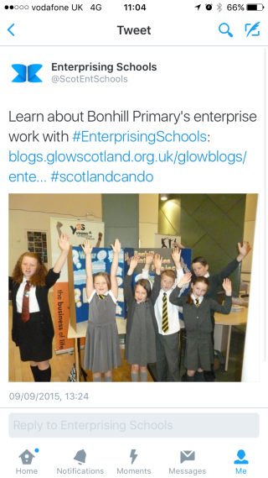

Slide 24
Eco Committee
Ongoing successful Social Enterprise – Uniform recycling – award gained in 2015.
Pupil Voice – represent each class.
Shoe box appeal.
Rag bag collection.
Gardening club.
Presented at school assembly.
Lots of skills developed.

Slide 25
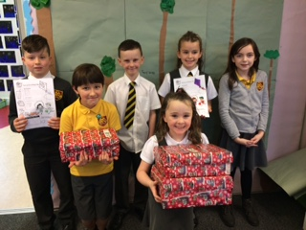
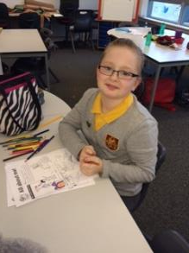
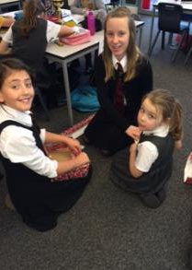
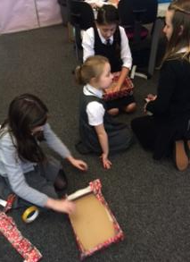
Shoebox Appeal
Run by Samaritan’s Purse to provide less fortunate children around the world with a Christmas gift.
An example of social enterprise as we worked in a team to help others.

Slide 26
Shoebox Appeal
We received a letter telling us the shoeboxes were sent to Belarus.
“Thank you for sending a shoebox gift with Operation Christmas Child. Because of you, a child in Belarus received a gift to remember. Your gift was one of 77,904 shoeboxes sent from the UK to Belarus and 11.2 million packed globally.”

Slide 27
Uniform Recycling
Social Enterpise Award in 2015.
2nd Time Around.
Collect uniform donations across the school.
Wash and dry all donated clothes.
Organise donated uniform into age sizes.
Sell recycled uniform every Thursday afternoon.
Uniforms are sold for a small donation.

Slide 28
Chickens
Isa, Cookie, Susie and Bluebell.
Cluckingham Palace.
4 eggs a day.
Cleaned by Primary 6’s.
Eggs collected by Primary 3.
6 Eggs for £1.50.
Egg carton designed by Euan and Luke Byron
Radio Clyde visit to make jingle.

Slide 29
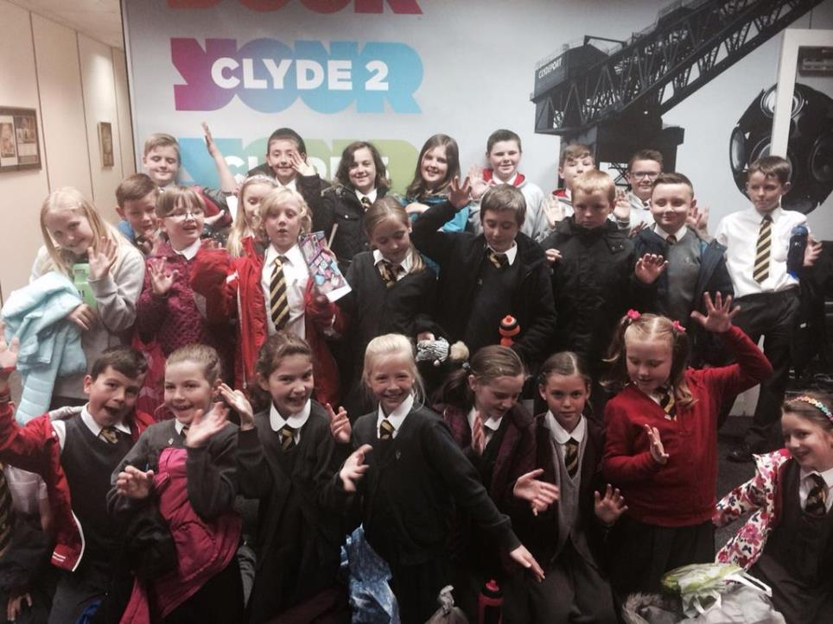

Slide 30
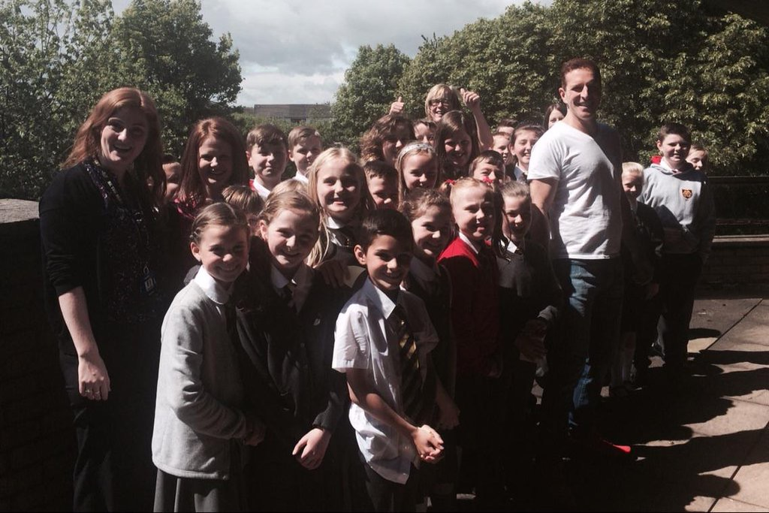

Slide 31
Radio Clyde Visit Sound Clip

Slide 32
Library Committee
Represent each class – Pupil Voice.
Attend regular meetings.
Take on roles such as Secretary and Treasurer.
Run book fair and stationery stall at fair.
Manage money.
Savings scheme.
Run regular competitions.
Lots of skills developed.

Slide 33
RRS Committee
Pupil Voice.
Attend regular meetings.
Roles such as Chairperson and Secretary.
Organise and manage events such as the Day for Change.
Organise initiatives such as Change in a Jar.
Encourage fairness and equality.

Slide 34
Water
Children were asking the office for cups.
This was not eco friendly and water would often spill.
Primary 7 sell water bottles for 30p.
Bottles can be re-used.
Rota for who is selling and in charge of money.
Money is recorded daily.

Slide 35
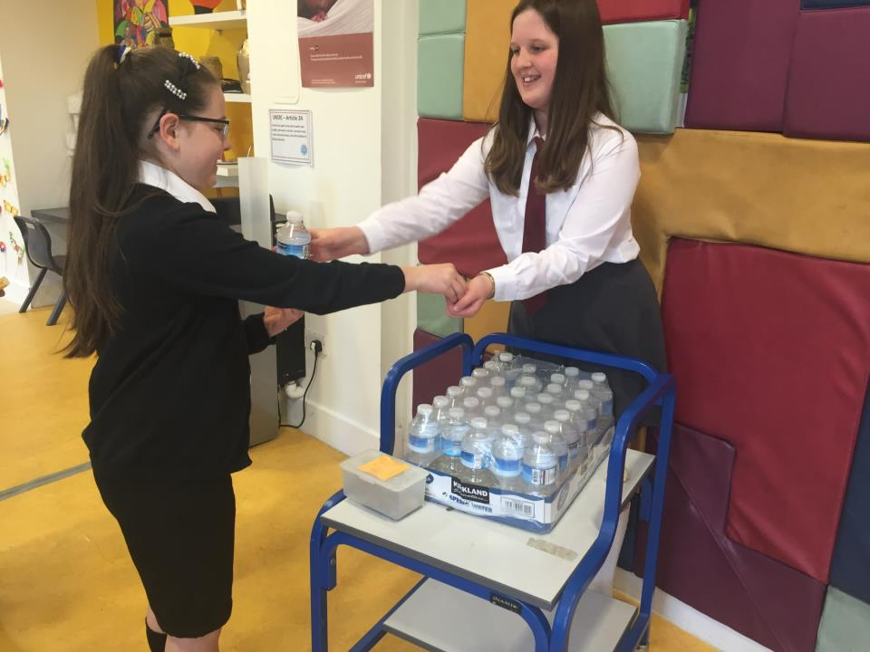

Slide 36
JRSO
Represent the school.
Trained by West Dunbartonshire Council.
Attend regular meetings.
Carry out surveys.
Liaise with West Dunbartonshire Council about safe parking outside school grounds.
Encourage green travel to school.

Slide 37
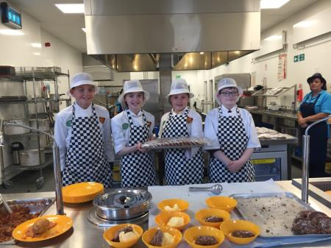
Work Experience
Pupils issued with log book which must be updated regularly.
Wear uniform in kitchen.
Undertake tasks such as preparing vegetables, icing cakes, making pizzas and washing up.
Teamwork.
Real life experience.
Customer service when serving food.
Time management.
Employability skills.

Slide 38
Credit Union
Filled out an application form to highlight skills and experience.
Interviewed for the post by Mr Bance, our Depute Head and Primary 7 pupils.
Take on roles such as tellers and cashiers.
Tellers fill out paperwork for people saving with the Credit Union.
Cashiers count the money and bank this and record it.

Slide 39
Play Leaders
All trained by Active Schools and the P.E Co-ordinator.
Volunteer to participate.
Work together to plan and deliver activities for younger children.
Organise resources and create safe areas to play.
Runs at playtime and lunchtime, two times a week.
Rota in place.
High level of teamwork.

Slide 40
Thank you for listening!

