Slide 1
Catrina Milne, Skills for Work Co-ordinator
Lesley Watson, Business Liaison Officer
Children and Learning

Slide 2
Angus Council’s Commitment to Work Placements
Promoting meaningful and sustainable partnerships between employers and our schools
Council is the largest employer in Angus
Requirement for a coordinated approach across our own organisation
Need to develop a sustainable workforce for the future
Authority response to DYW recommendations
Development of Angus Council’s ‘Invest in Youth’ Strategy
Development opportunities through work placements a key component
Children and Learning

Slide 3
What is Angus Works
A proactive approach supporting and developing the skills and qualities of our young people and investing in our future workforce
An extended work placement model
Offered annually and open to all S4-S6 pupils.
Runs for a period of 22 weeks between August and April – forming part of the pupils timetable.
Young people are engaged one-day a week into an identified role within Angus Council, tackling “real-life” projects supported by a mentor.
Working towards an agreed set of targets, and where practical, work experience qualifications.
The extended timescale enables the young people to feel part of the workforce.
Children and Learning

Slide 4
Angus Works - The Story so far…
Driven by SMT
Coordinated by Schools & Learning and HR
Support sought across the Council
Consultation process with SMT and PCS staff from within our Secondary Schools
All Angus Secondary Schools invited to take part
‘Real-life’ recruitment and selection process
Successful candidates allocated to roles across the Council
Children and Learning

Slide 5
Angus Works - The Story so far…
Successfully placed 38 pupils across the council
Pupils currently attending and enjoying their placement
Coming to the end of our 2016/17 intake
Celebration event arranged for June
Continual process of feedback and evaluation
Based on success an increased number of placements secured
Applications for 2017/18 programme have been invited from all Secondary Schools
Children and Learning

Slide 6
The Practicalities
Induction
Health and Safety
PVG / Confidentiality Statements
Travel Costs
Children and Learning

Slide 7
Expectations of our young people
Will attend their placement one day per week, at the agreed times.
Will fully engage with school for the remaining 4 days.
Are expected to catch up on any school work they have missed, whilst out on placement.
Young people will be punctual and dressed for work accordingly. (Angus Works Poloshirt. Council ID badge)
Children and Learning

Slide 8
Benefits to our young people
Provides experience of recruitment and selection procedures
Provides a valuable insight into work practices and cultures
Opportunity to develop key knowledge, skills and behaviours required in learning, life and work
Gaining recognition in the form of “employer endorsement”, providing a creditable piece of evidence that can be used in future applications
The chance to achieve SQA Personal Development qualification.
Preparing young people for transition into successful employment
Children and Learning

Slide 9
Benefits to our organisation
Opportunity to engage with future workforce
Enhances reputation as a good employer
Development opportunities for staff
Opportunity to give something back
Increase awareness about a variety of professions
Gain access to fresh ideas/perspectives through the original thinking of young people
Corporate social responsibility
Extremely rewarding
Children and Learning

Slide 10
Angus Works
Angus Council’s commitment to developing the young workforce.
Providing meaningful opportunities for work experience.
Preparing our young people for their future in our community.

Slide 11
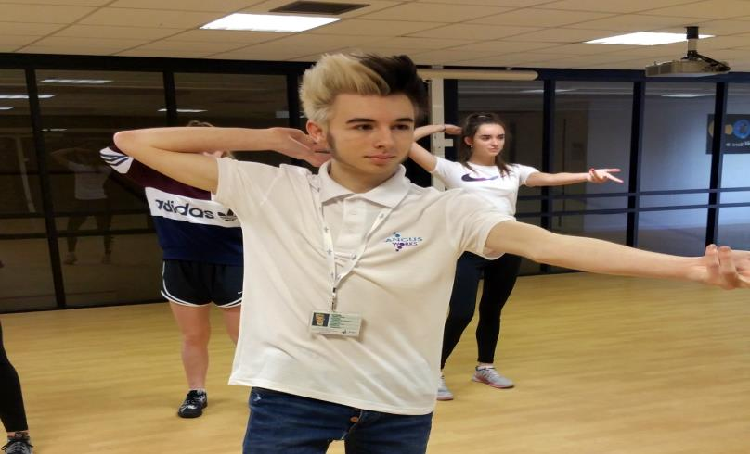
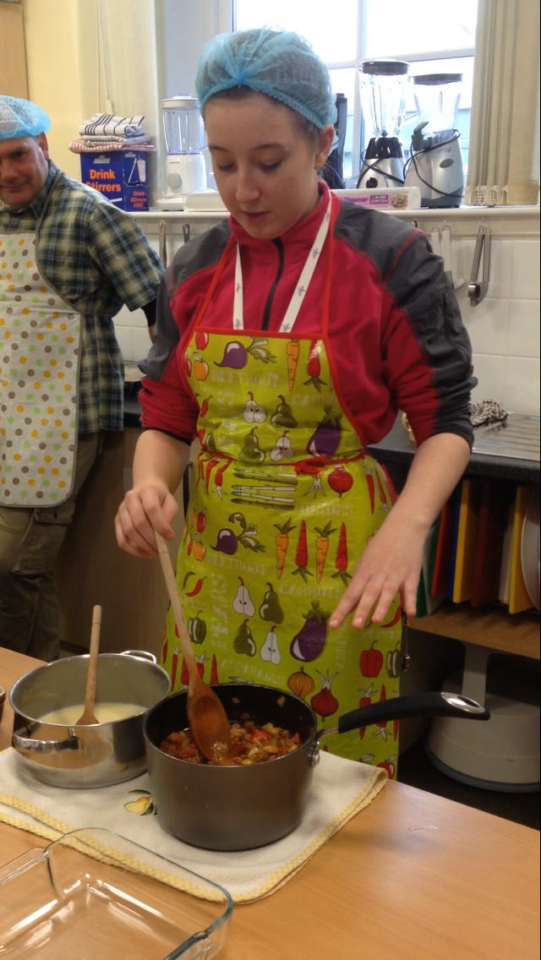
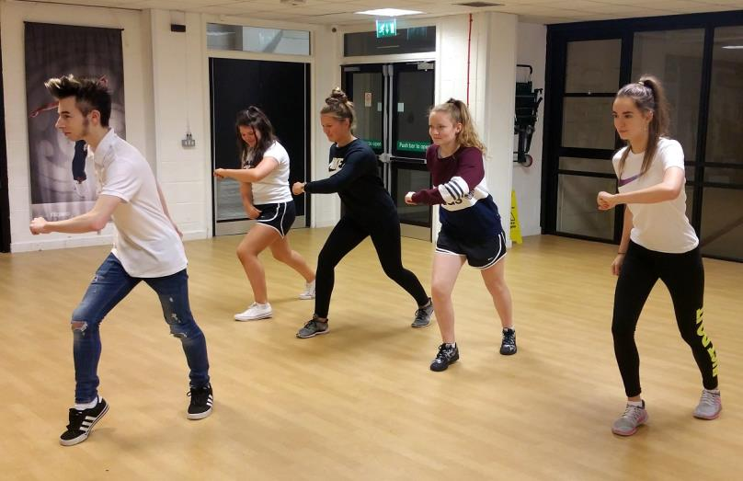
Children and Learning

Slide 12
Contact Information
Catrina Milne, Skills for Work Co-ordinator
01307 476407 / 07825226885
milnec13@angus.gov.uk
Children and Learning

