Slide 1
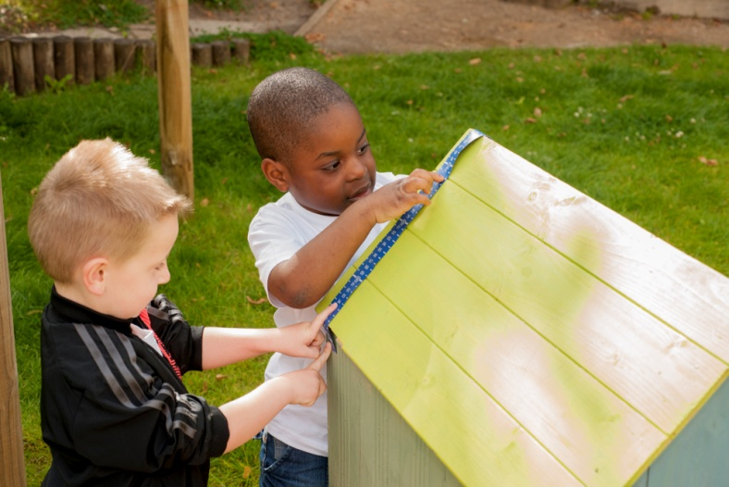
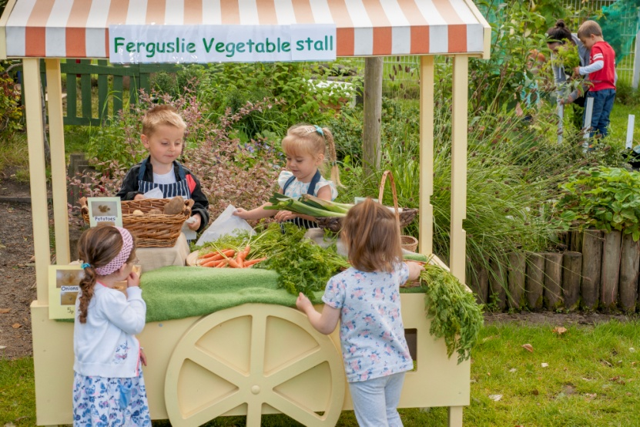
Ferguslie Pre-five Centre
Skills for Learning, Life and Work in the Early Years

Slide 2
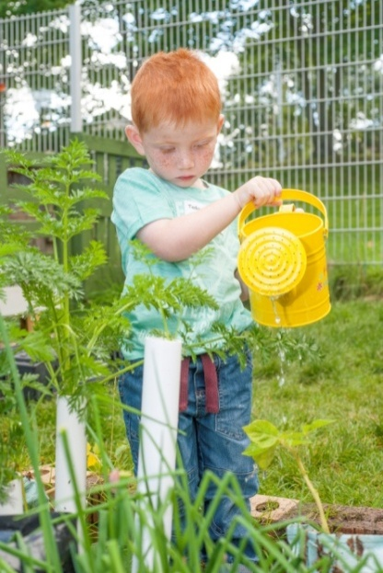
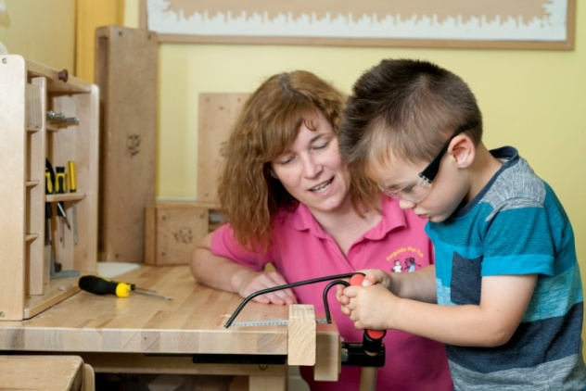
Play: It’s a child’s ‘job’ to play
Deep Play
Deep Learning
Deep Understanding
Application of Knowledge
“Through play: children transform, vary, abstract, develop, imagine, create and innovate as they move into the future” (Bruce, 2012)

Slide 3
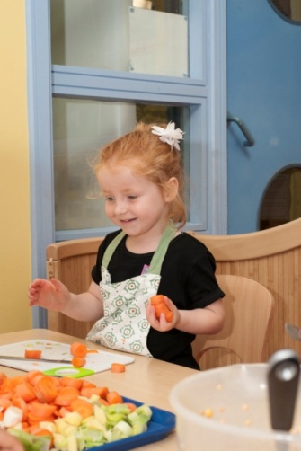
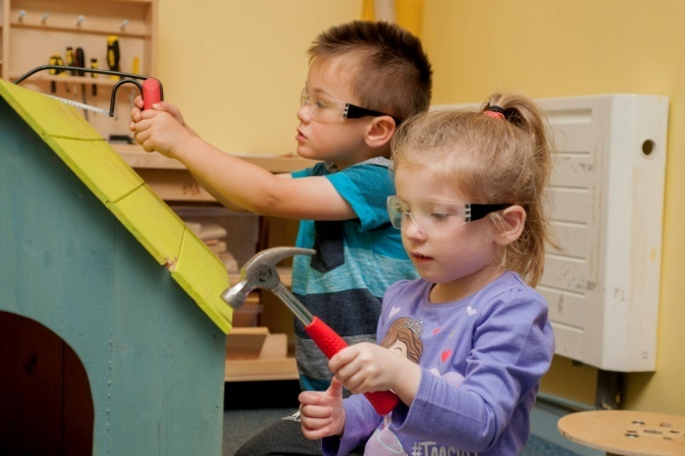
Our Children as learners
We recognise that children learn in different ways: through seeing, hearing, touch, doing and moving
We value the diversity of individuals
We remove any barriers they have to learning

Slide 4
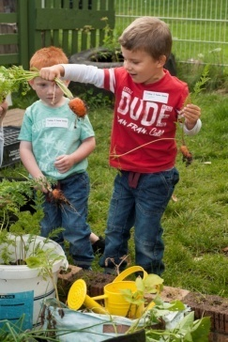
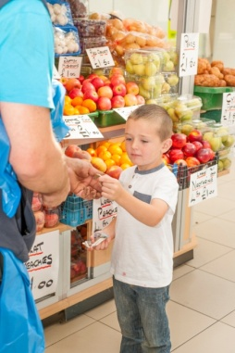
Skills Development through Play
We develop motivation and engagement
We develop transferable skills
We develop higher order thinking skills
We develop literacy and numeracy skills
We develop skills in finding information
We develop skills in managing money
We develop partnerships to promote skills
We develop skills needed for the world of work

Slide 5
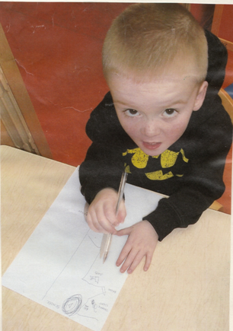
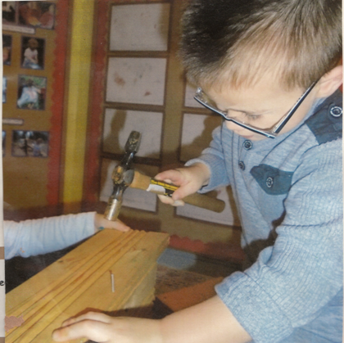
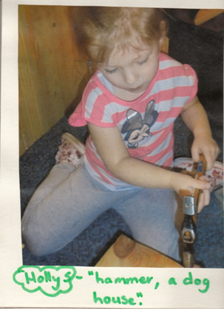
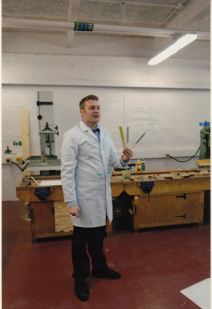
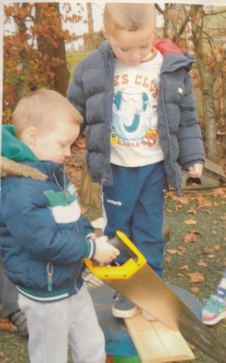
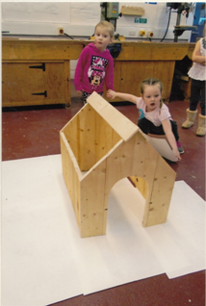
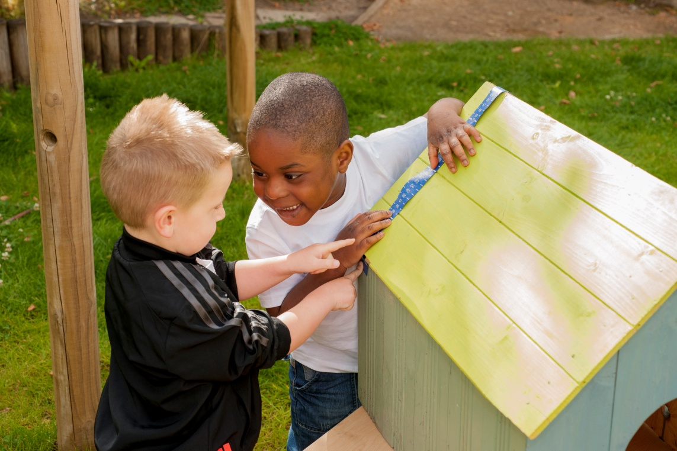
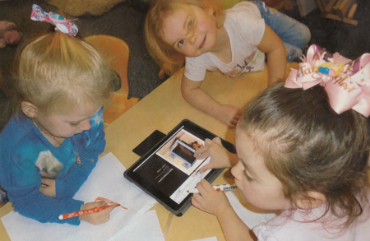
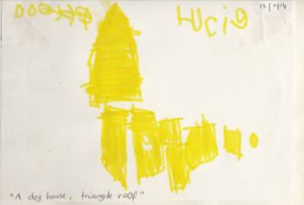
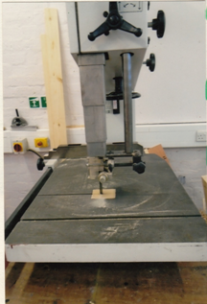
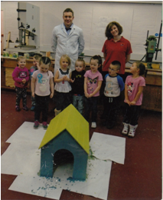
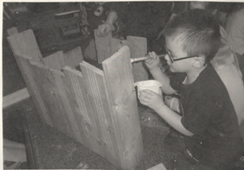
Our Children apply their skills in various contexts: ‘The Dog House’
The children remain motivated and engaged in ‘deep learning’ that involves using the ‘dog house’ in their play
Today I have been working at the high school to create the roof on our ‘dog house’
Today I have been using skills that I have previously learned to put our construction together
Today I have been finding out information on ‘Google Earth’ to draw a map to the high school
Today I have been developing my literacy and numeracy skills
Today I have been finding information

Slide 6
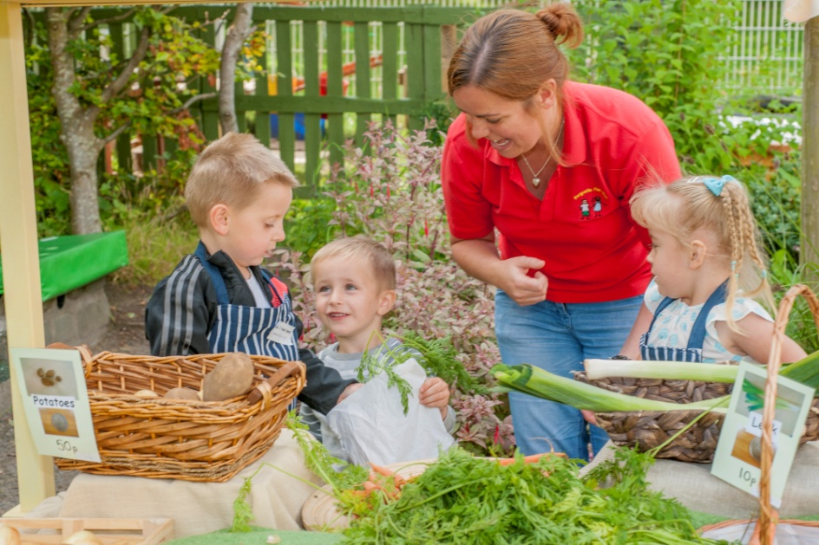
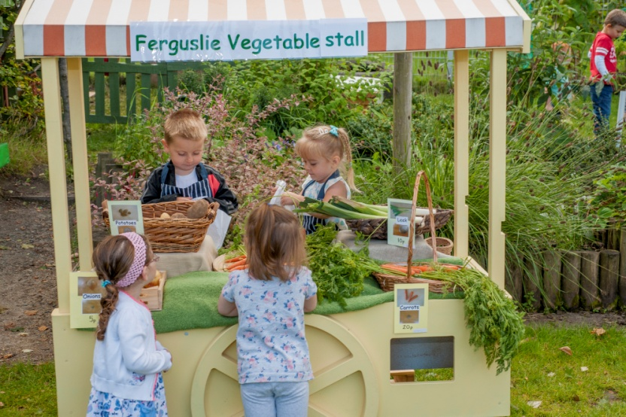
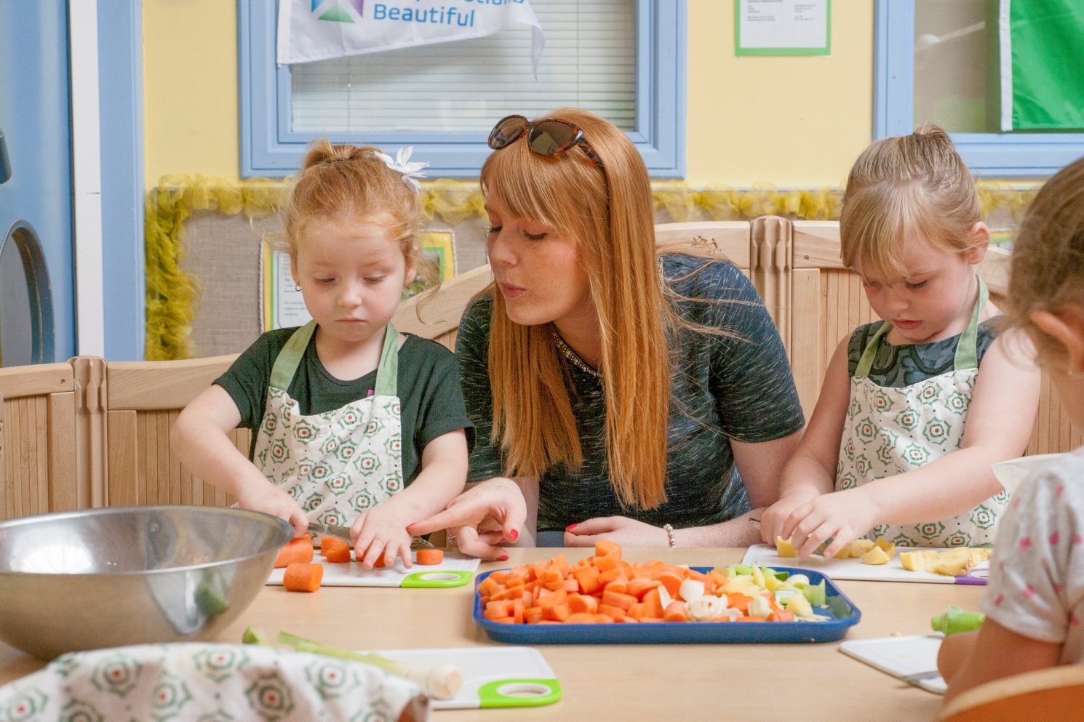
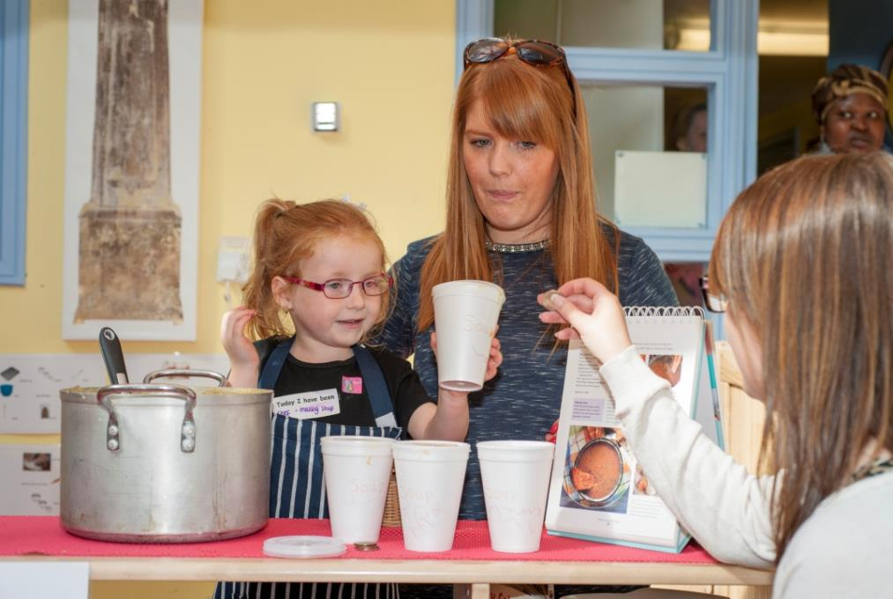
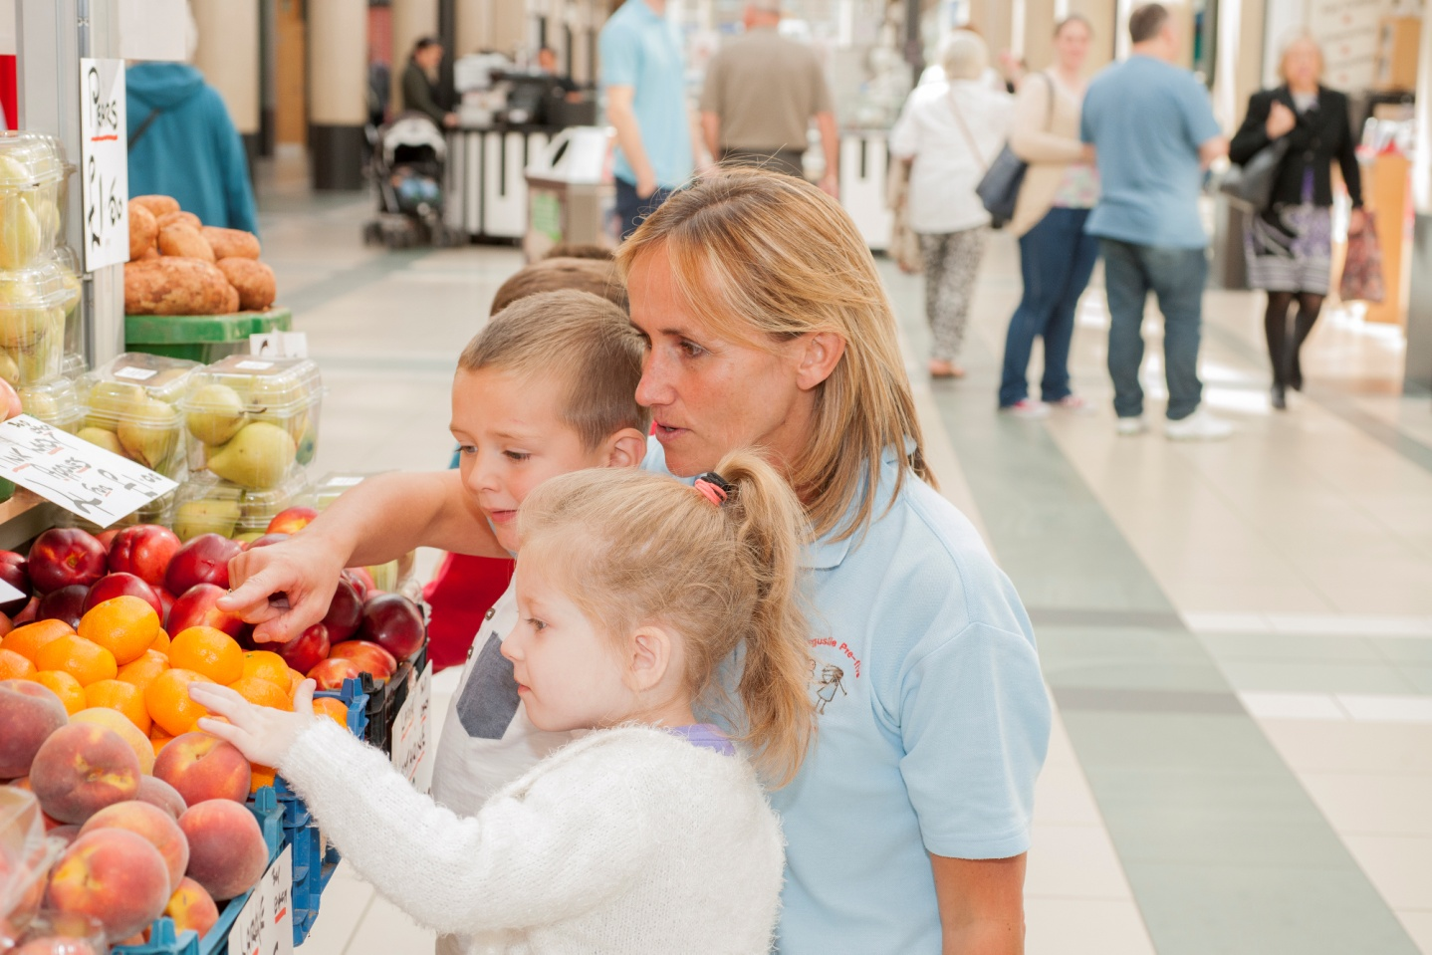
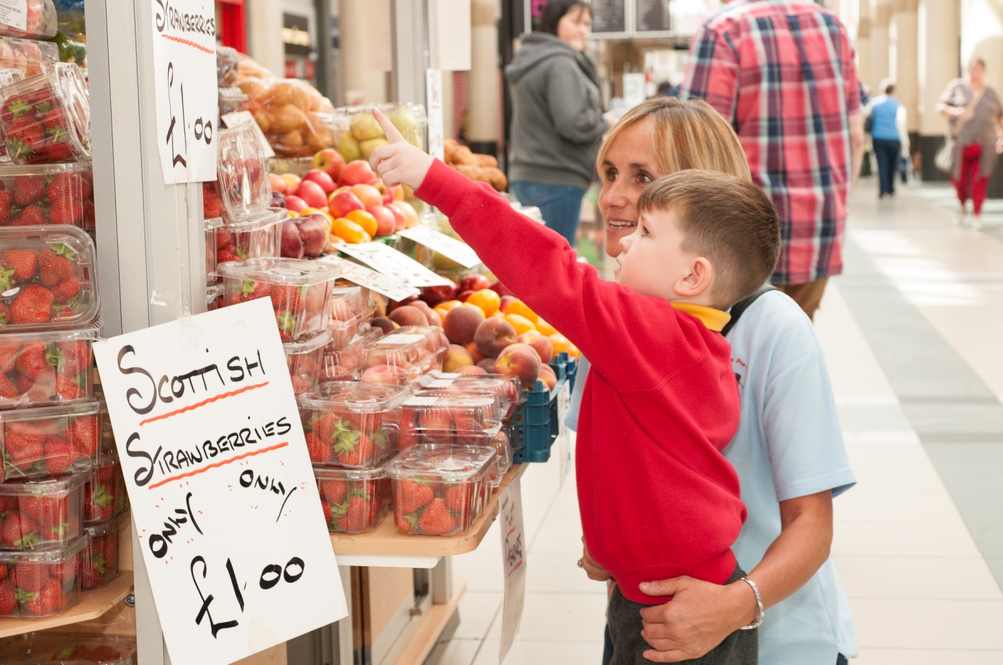
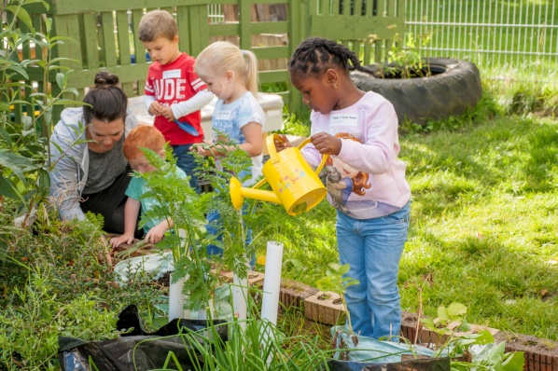
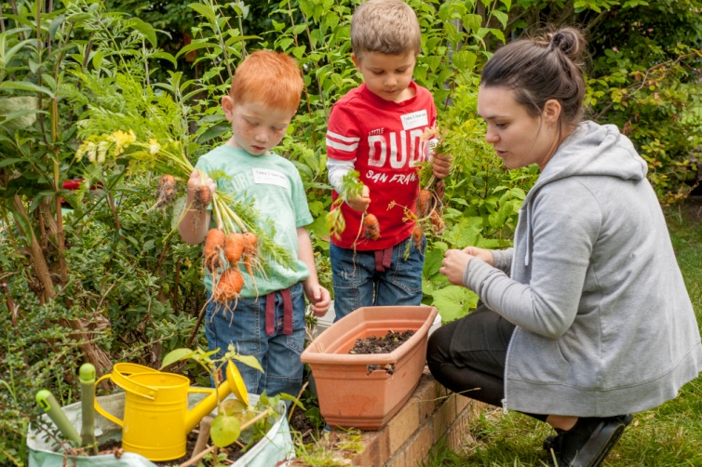
Our Children apply their skills in various contexts: ‘Growing our Vegetables’
Today I have experienced the world of work
Today I have been a chef
Today I have been managing money
Today I have been a gardener

Slide 7
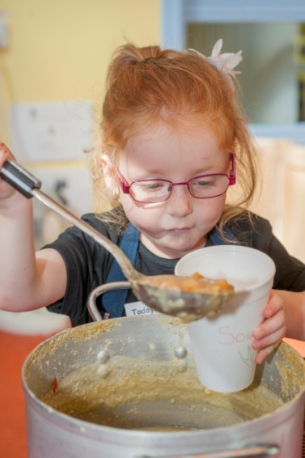
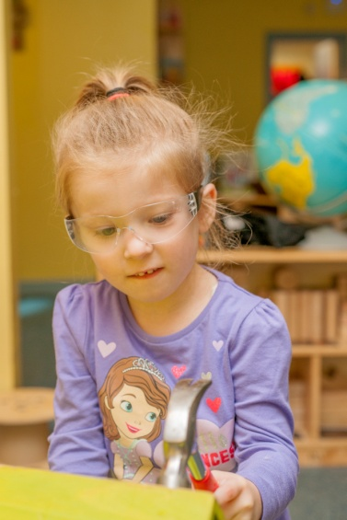
At Ferguslie Pre-five Centre our children have a natural curiosity about the world around them. Through a variety of play contexts our children understand the different jobs people do within the world of work. They engage in projects that develops a depth of learning and to scaffold this we connect to and work with local businesses and professions. We value the uniqueness of each child connected to our centre within an environment where they develop their skills to make choices, know the decisions they make during their play are valued and can understand what success feels like as their achievements are celebrated. Passionate educators support the family to nurture this natural curiosity and through working together give our children the skills to be all they can be and the desire to be even more.

