Slide 1

Improving Environments for High-Quality Learning
Examples from Clackmannanshire and Stirling

Slide 2

The purpose of this resource is to offer examples of learning environments in various settings in Clackmannanshire and Stirling.
The photographs and video clips are courtesy of Clackmannanshire and Stirling councils and are intended to provoke discussion and to offer insight into how these settings have focused on improving the environments for learning in their own context.

Slide 3
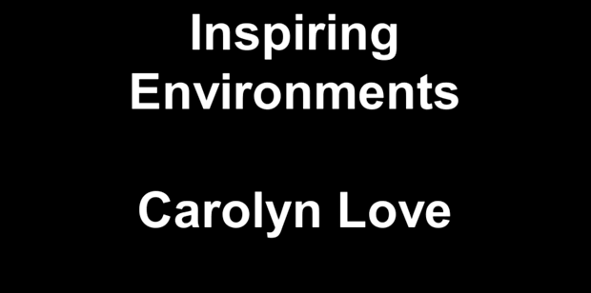
Importance and purpose
Why is the environment so important?
You can also view this video on Glow (log-in required).

Slide 4
Which of these reflect best the rationale for securing a high-quality learning environment for children.
Why?
‘…more than simply the planned space in the setting; it is everything that is encountered from the point of entry to the setting to the point of departure’.
Abbot, L. & Langston, A. (2004)
“Early childhood environments should be inviting and cultivate children’s curiosity, wonder and imagination.”
Curtis and Carter (2003)
‘Richness’ of the environment can be
tested through two principles:
Diversity - how broad is the horizon of possible experiences?; and,
Depth - how much is there to be discovered?
Laevers (2005, p. 22)

Slide 5
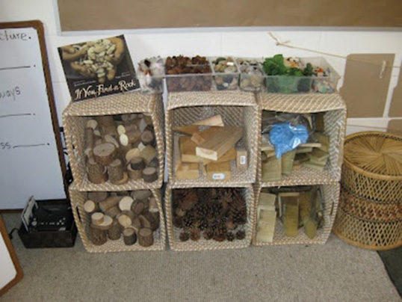
Importance and purpose
Why is the environment so important?
“…children learn through play, either in play chosen or initiated by the child or in play activities or experiences planned by staff. Children play for much of the session in small groups, are free to move about and talk during play and have high levels of adult support available for their emotional and learning needs.”
Building the curriculum, 2: Active learning in the early years
“The learning environment – both indoors and outdoors – needs to provide challenge and opportunity to explore exciting learning possibilities. All early years settings need to provide flexible and stimulating environments to fully engage children in their learning. At all stages this requires activities, space and resources to be well planned and organised.”
Building the curriculum, 2: Active learning in the early years

Slide 6
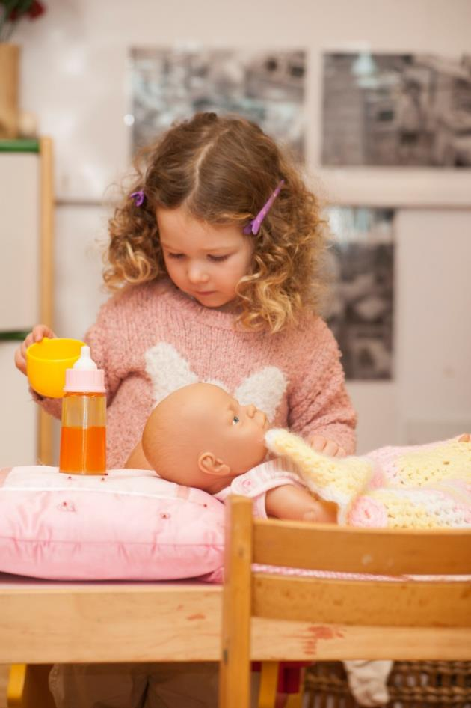
How does your environment support play?
In their play, children use the first-hand experiences that they have in life.
Children make up rules as they play, and so keep control of their play.
Children make play props.
Children choose to play. They cannot be made to play.
Children rehearse the future in their role play.
Children pretend when they play.
Taken from T. Bruce (2004) Developing Learning in Early Childhood

Slide 7
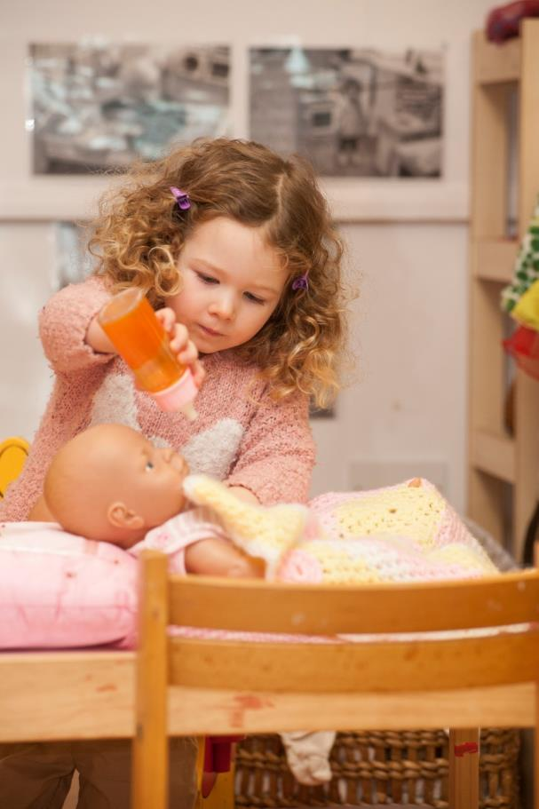
Children play alone sometimes.
Children and/or adults play together, in parallel, associatively, or co-operatively in pairs or groups.
Each player has a personal play agenda, although they may not be aware of this.
Children playing will be deeply involved, and difficult to distract from their deep learning. Children at play wallow in learning.
Children try out their most recent learning, skills and competencies when they play. They seem to celebrate what they know.
Children at play co-ordinate their ideas, feelings and make sense of relationships with their family, friends and culture. When play is co-ordinated it flows along in a sustained way. It is called free-flow play.
Taken from T. Bruce (2004) Developing Learning in Early Childhood

Slide 8
Examples from practice – children’s space

Slide 9
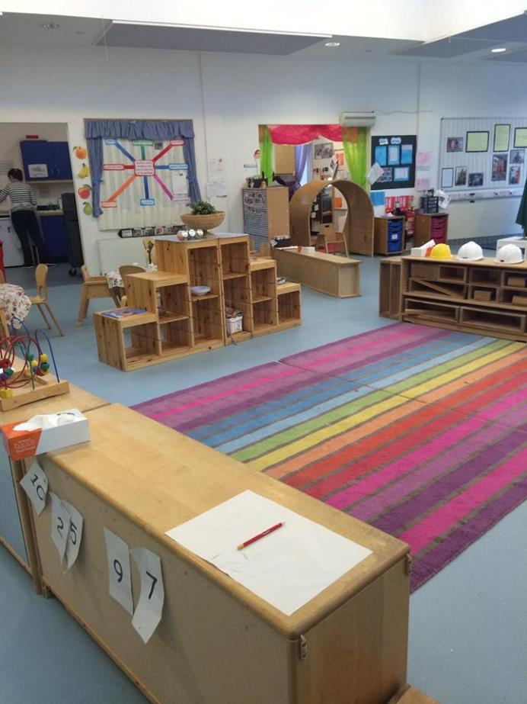
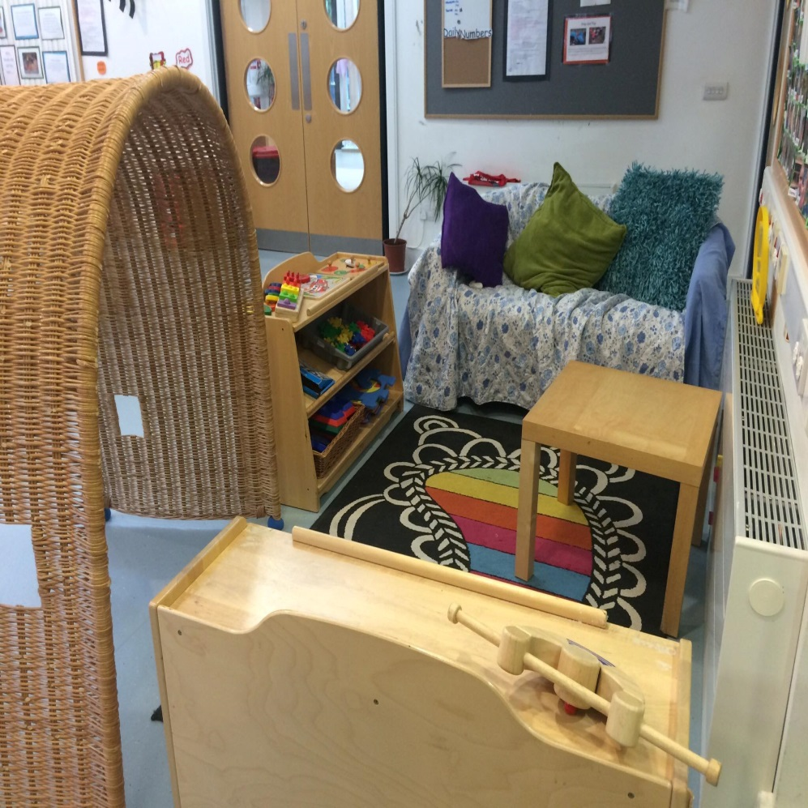

Slide 10
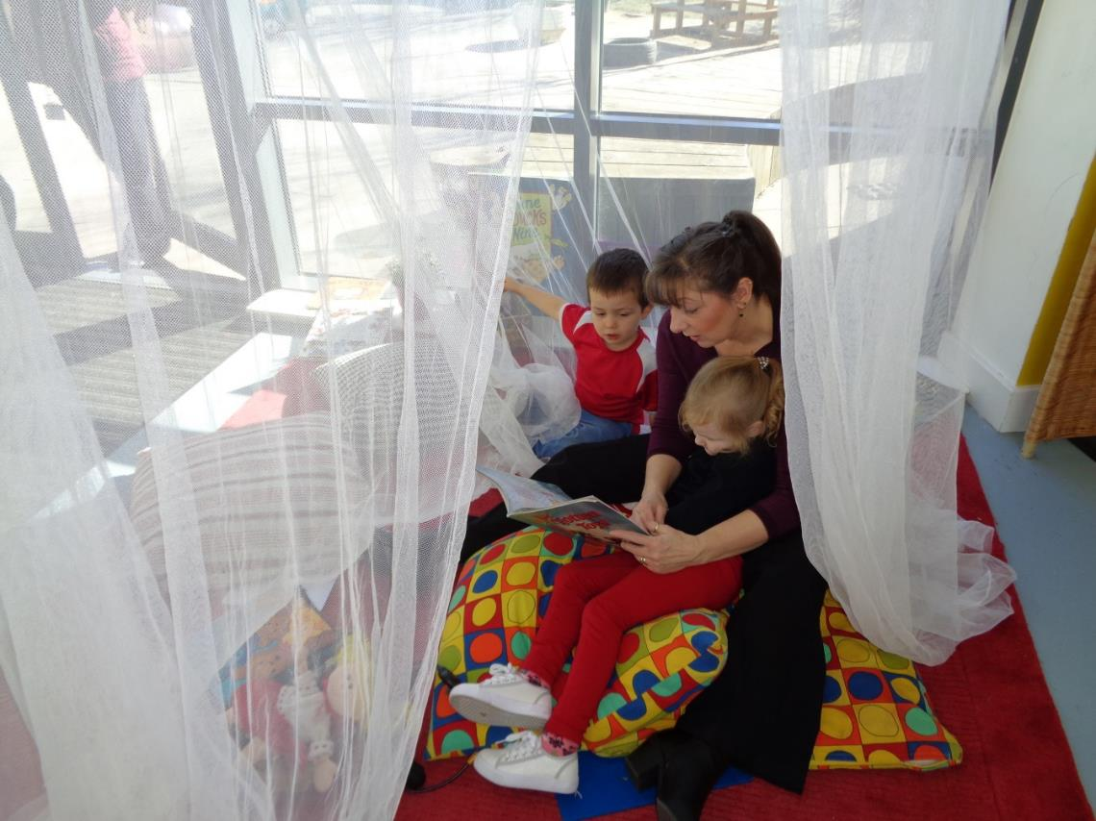
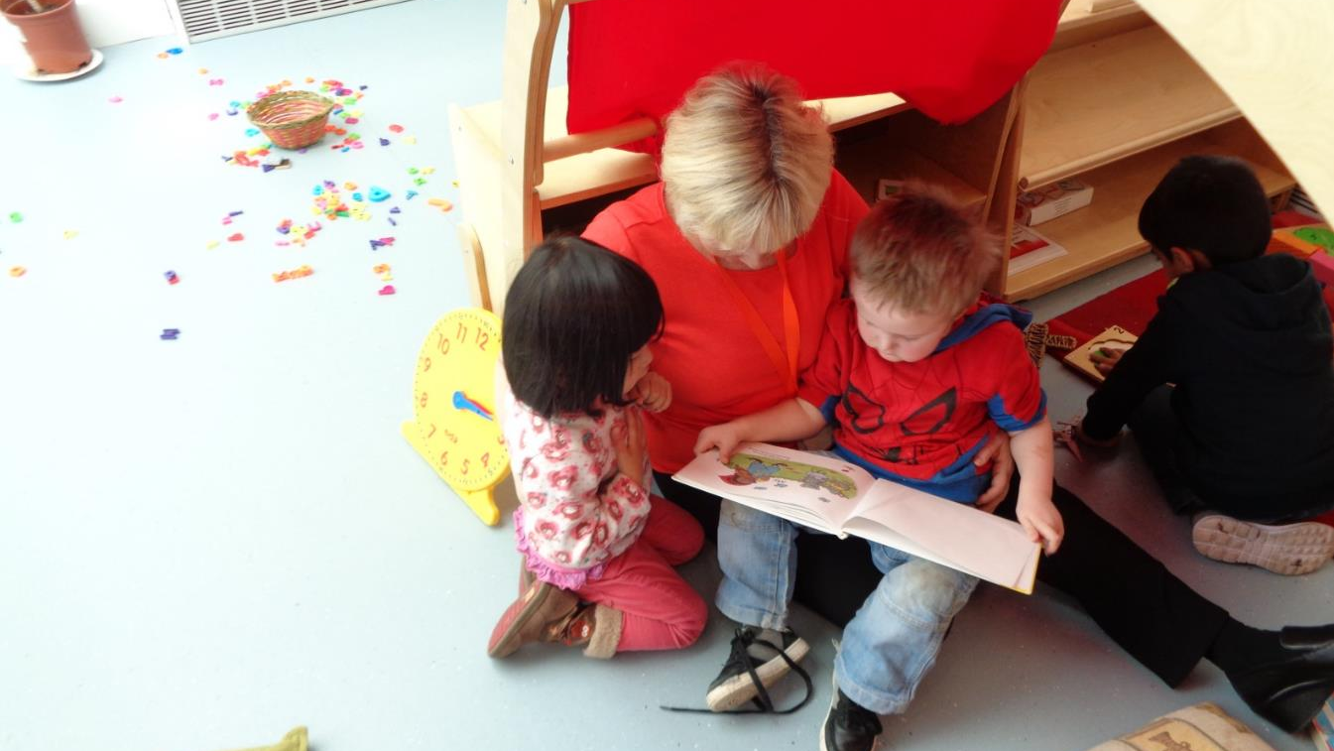

Slide 11
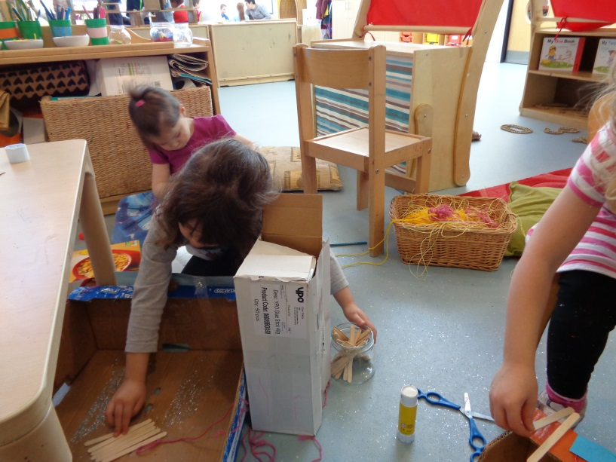
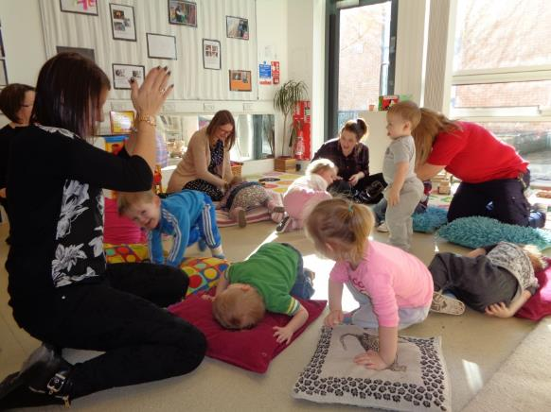
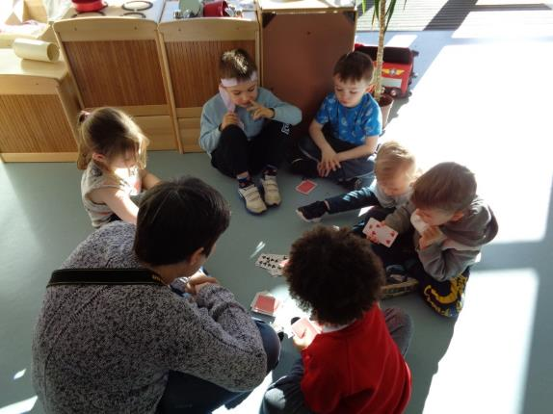

Slide 12
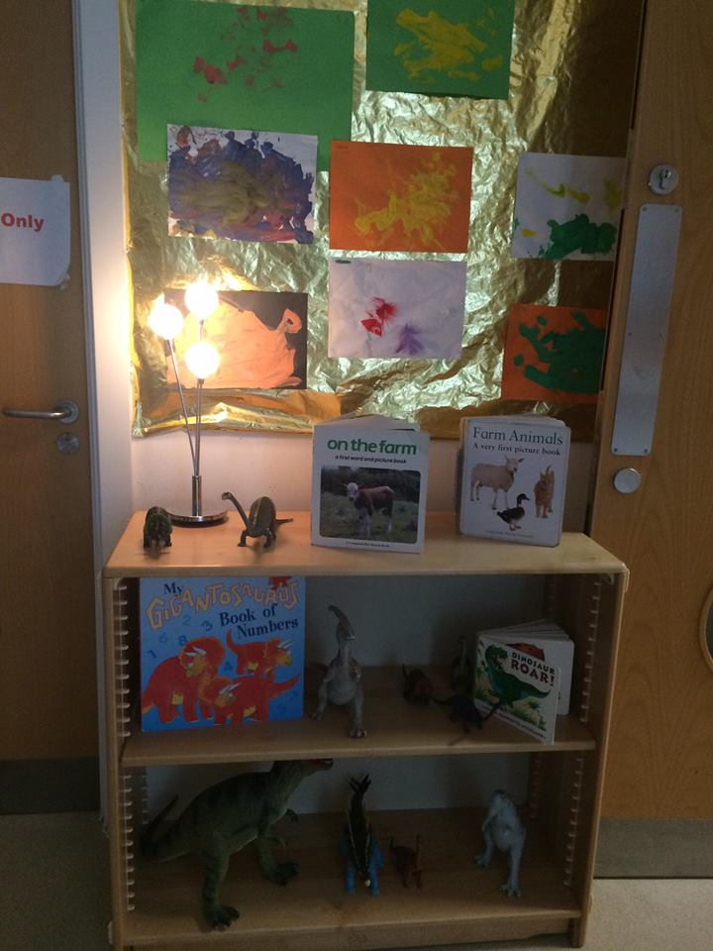
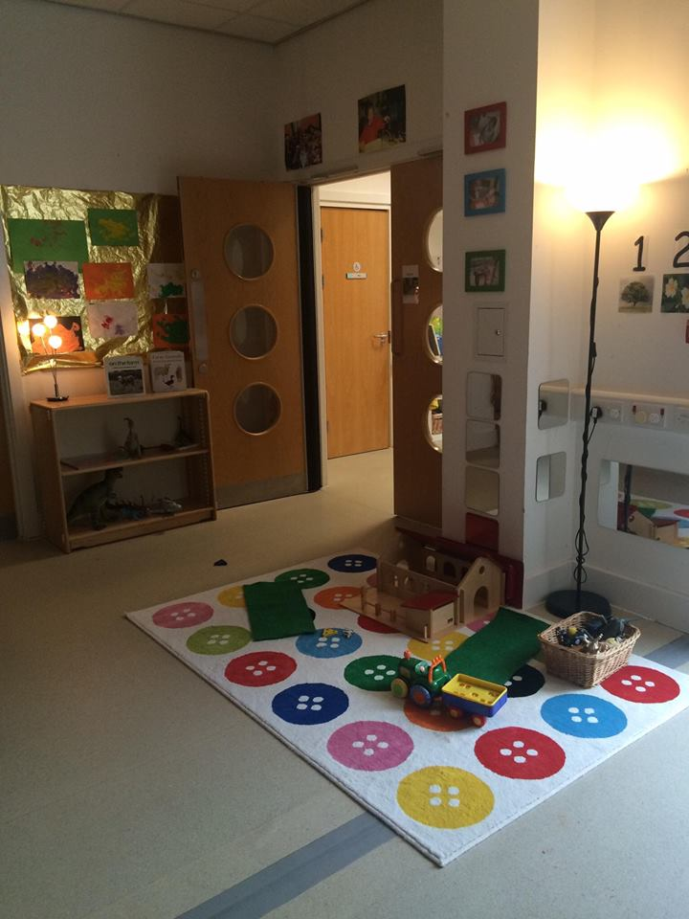

Slide 13
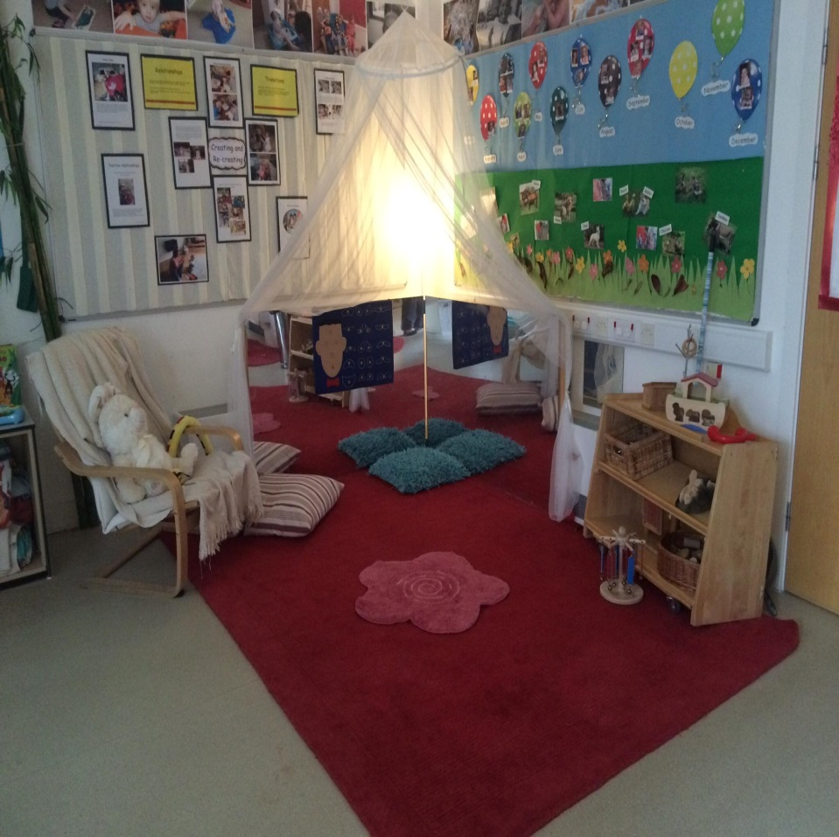

Slide 14
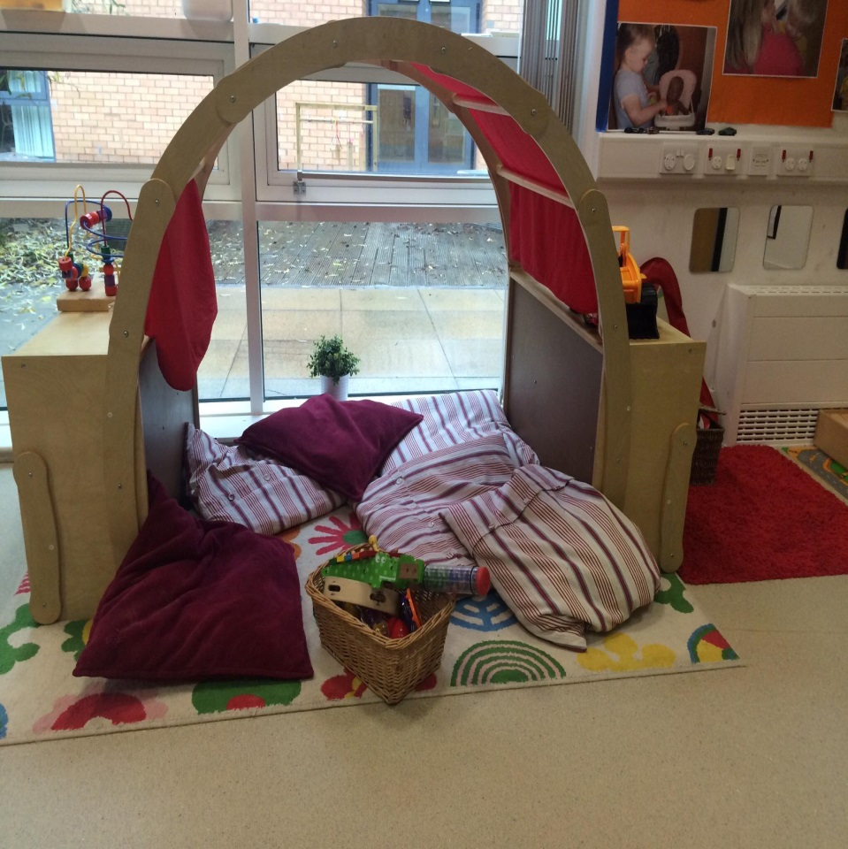

Slide 15
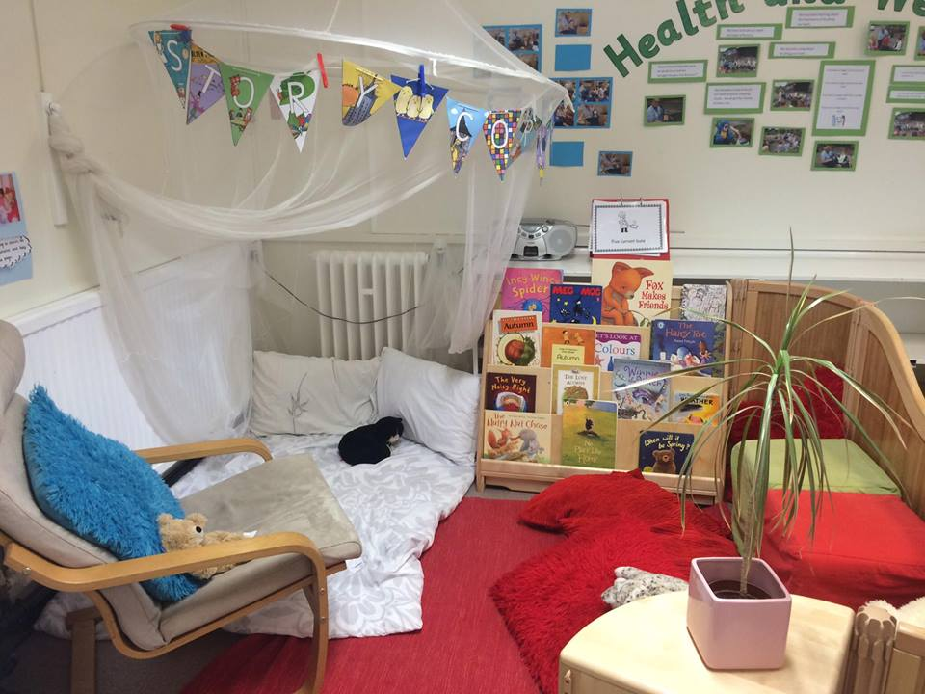

Slide 16
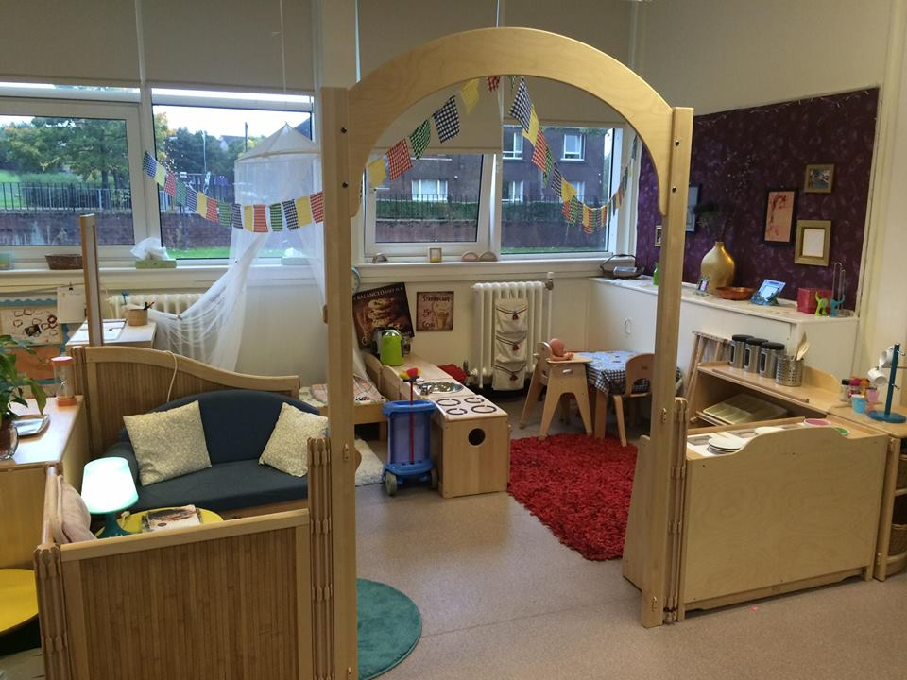

Slide 17
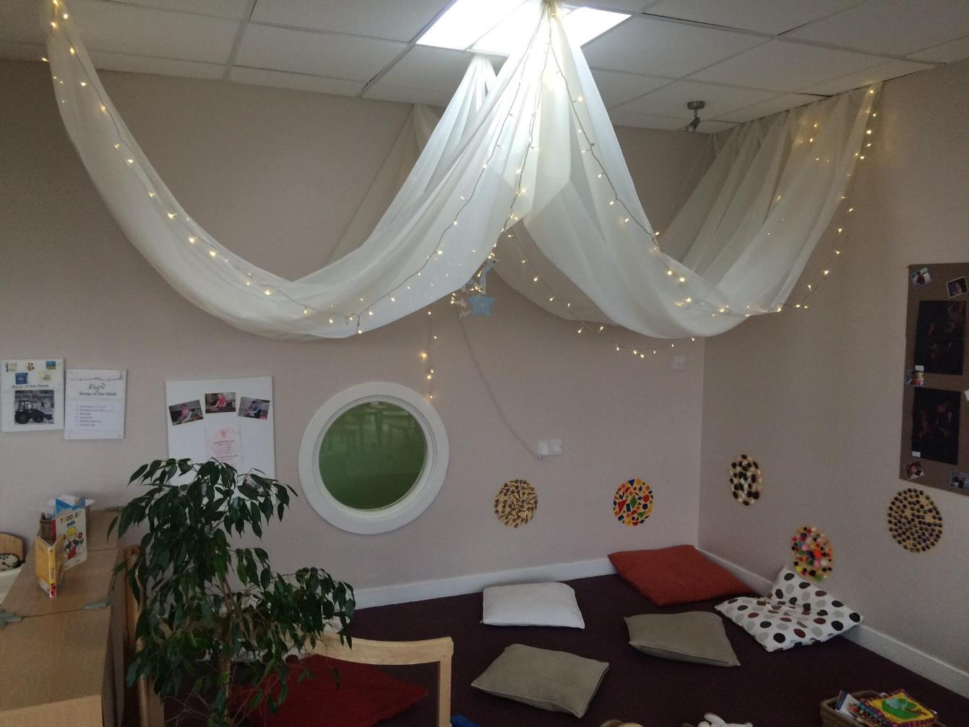

Slide 18
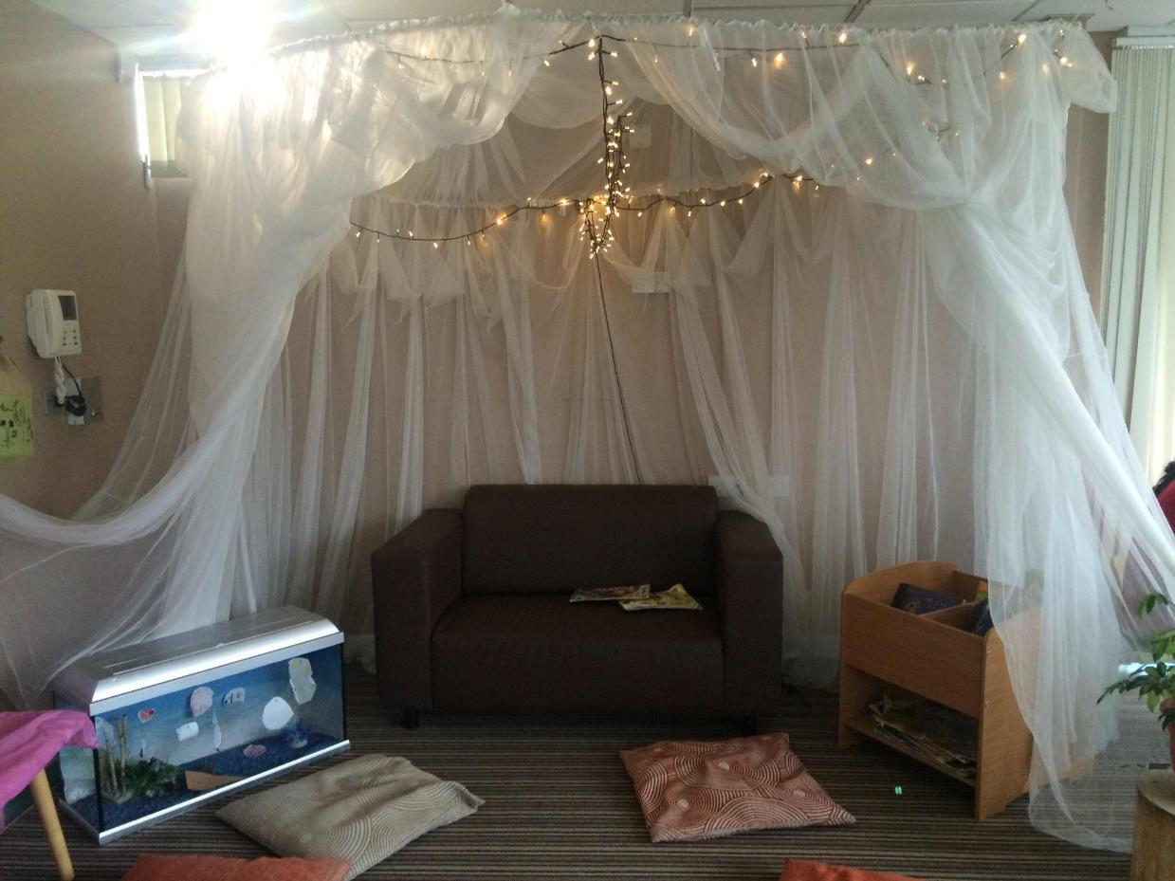
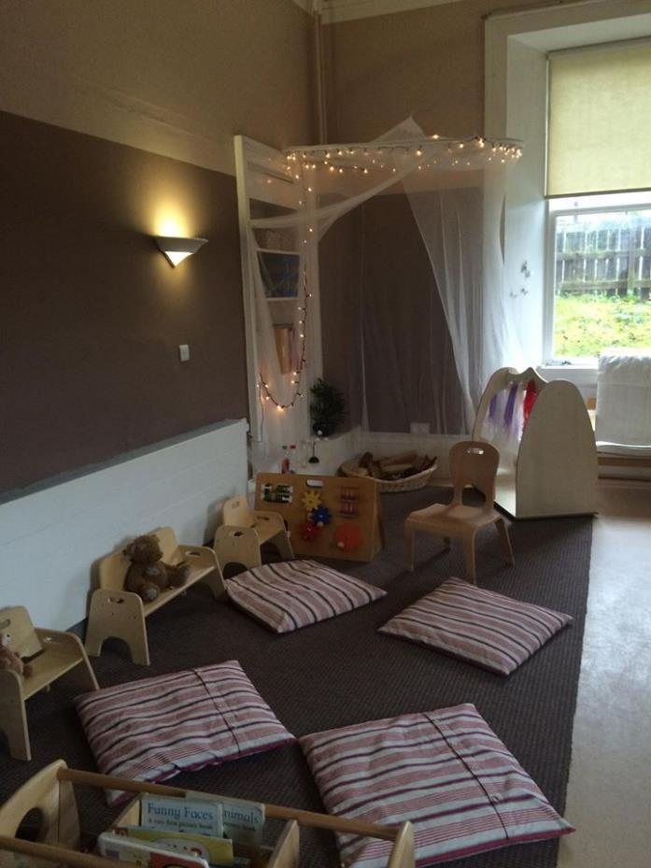

Slide 19
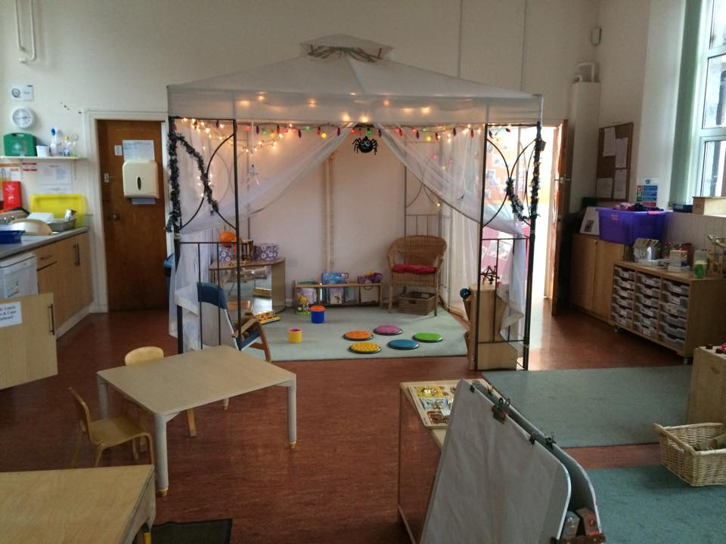

Slide 20
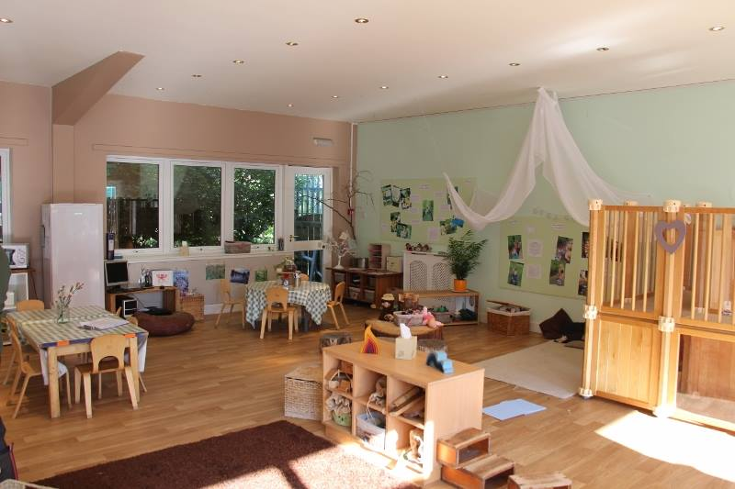

Slide 21
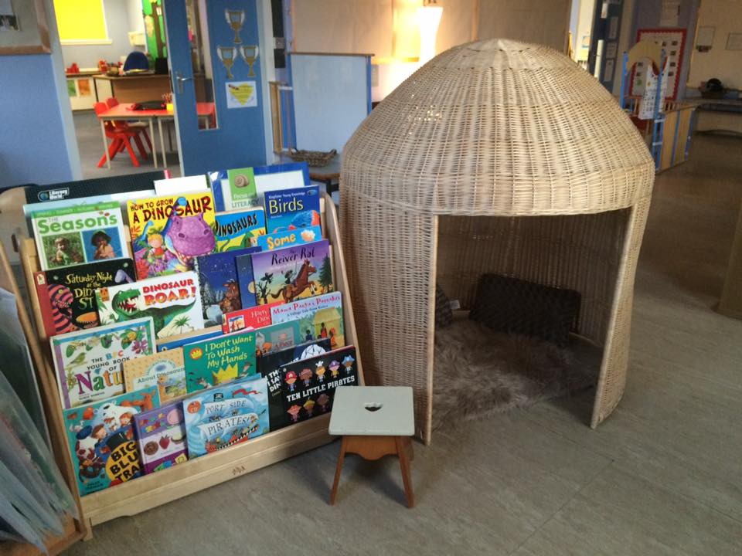

Slide 22
What messages do children get from the environment of your setting?
Time to reflect
When thinking about your playroom environment, do you focus more on the furniture or the space?
How often do you look at the space from the eyes of children?
How do you know that your playroom is ‘working’ for children?
How important is the environment in your setting? What do you value most about the environment?

Slide 23
Materials and
Resources

Slide 24
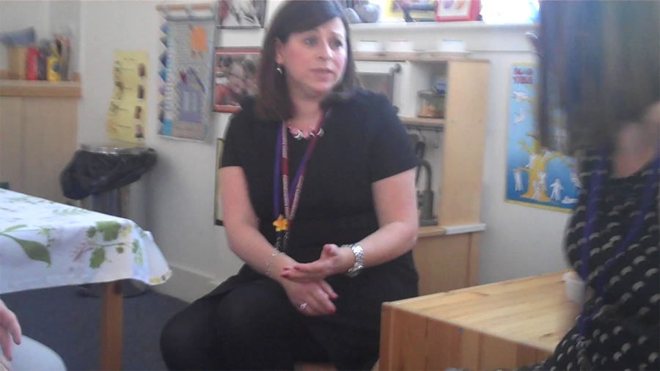
You can also view this video on Glow (log-in required).

Slide 25
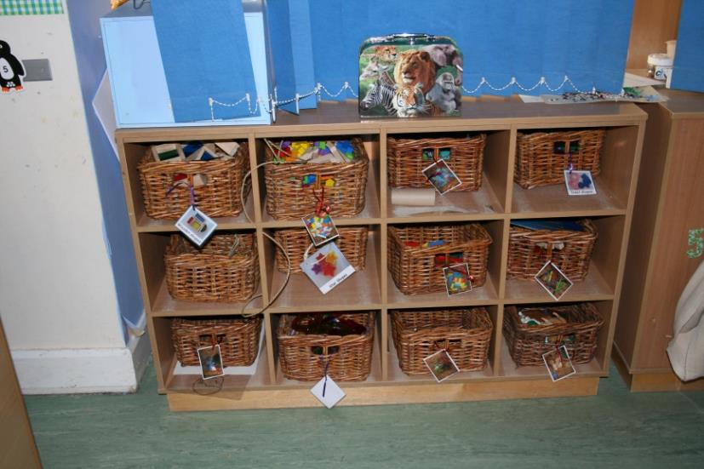
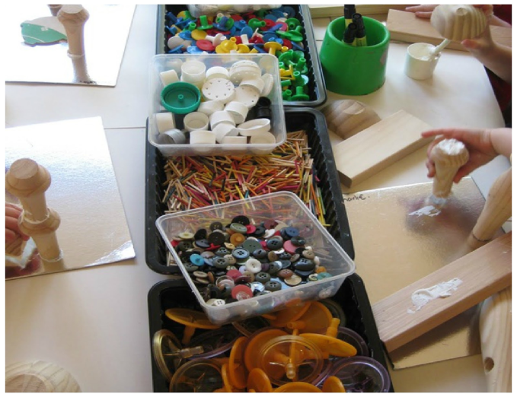
Features
Materials and Resources
Environments should allow free access to a rich range of materials that promote open-ended opportunities for play, representation and creativity.
Froebel Principle

Slide 26
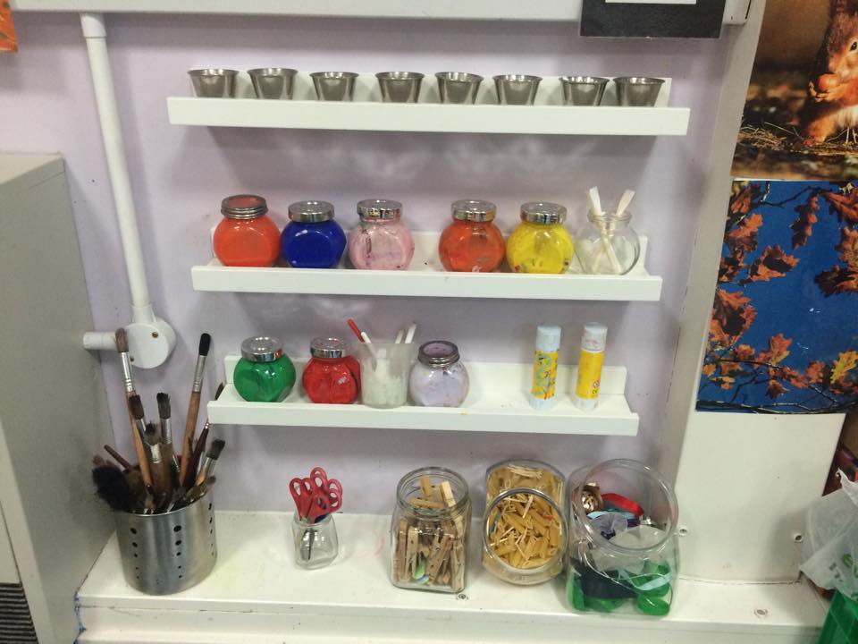

Slide 27
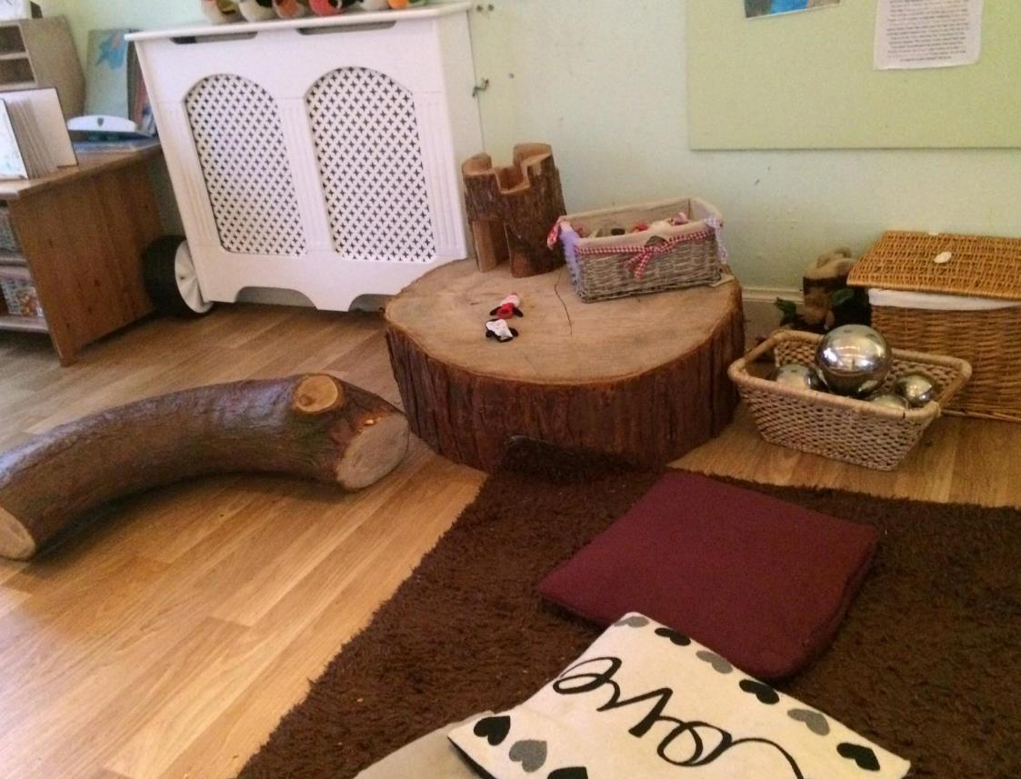
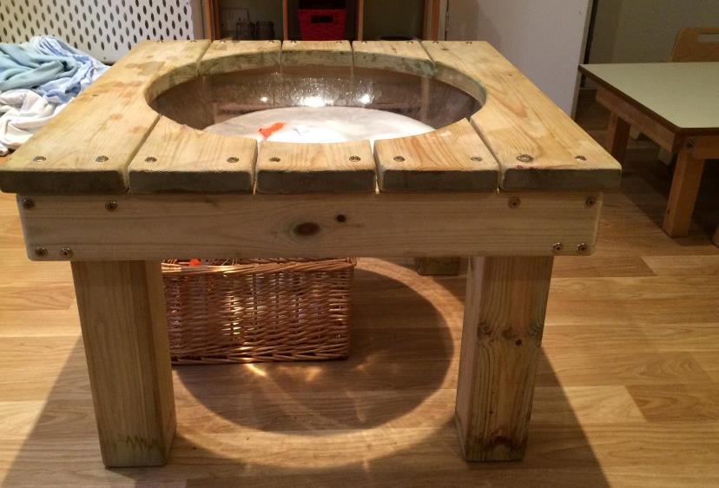

Slide 28
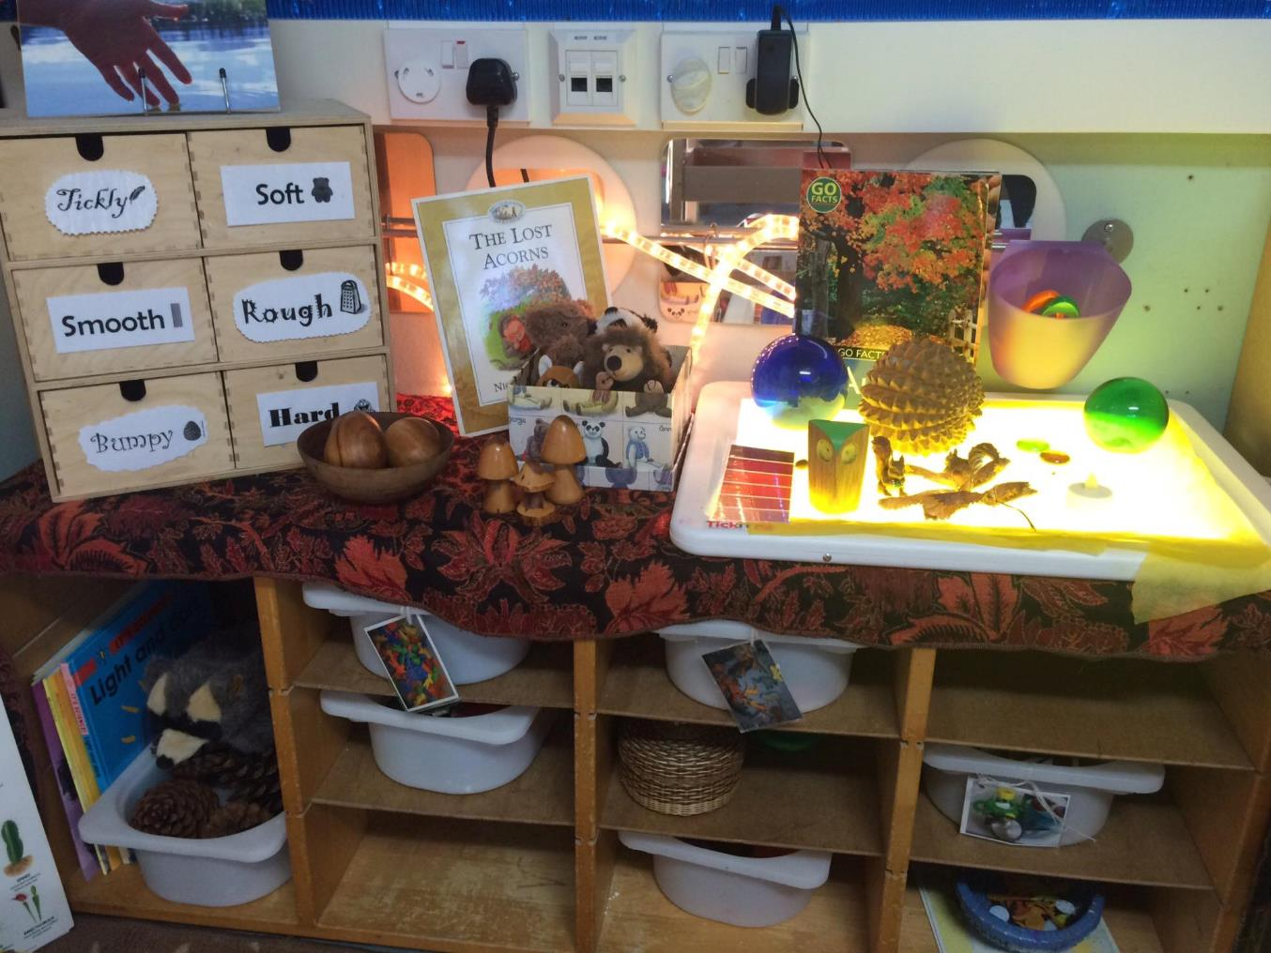

Slide 29
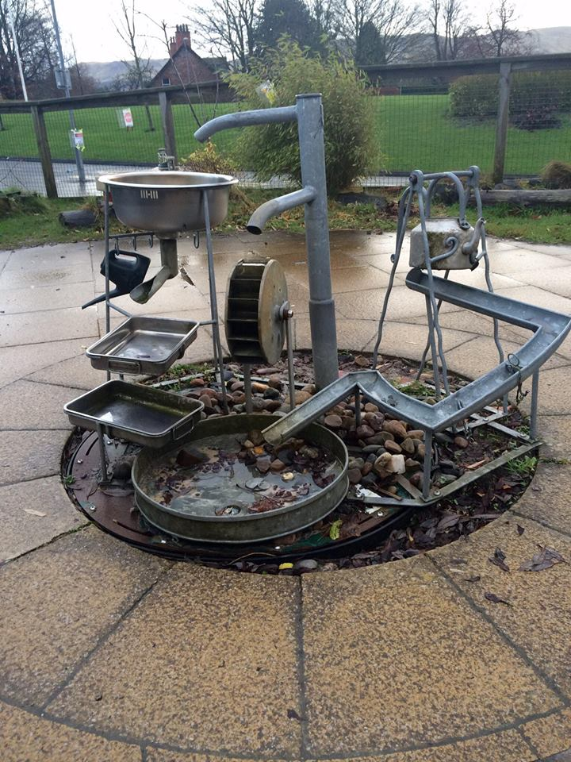

Slide 30
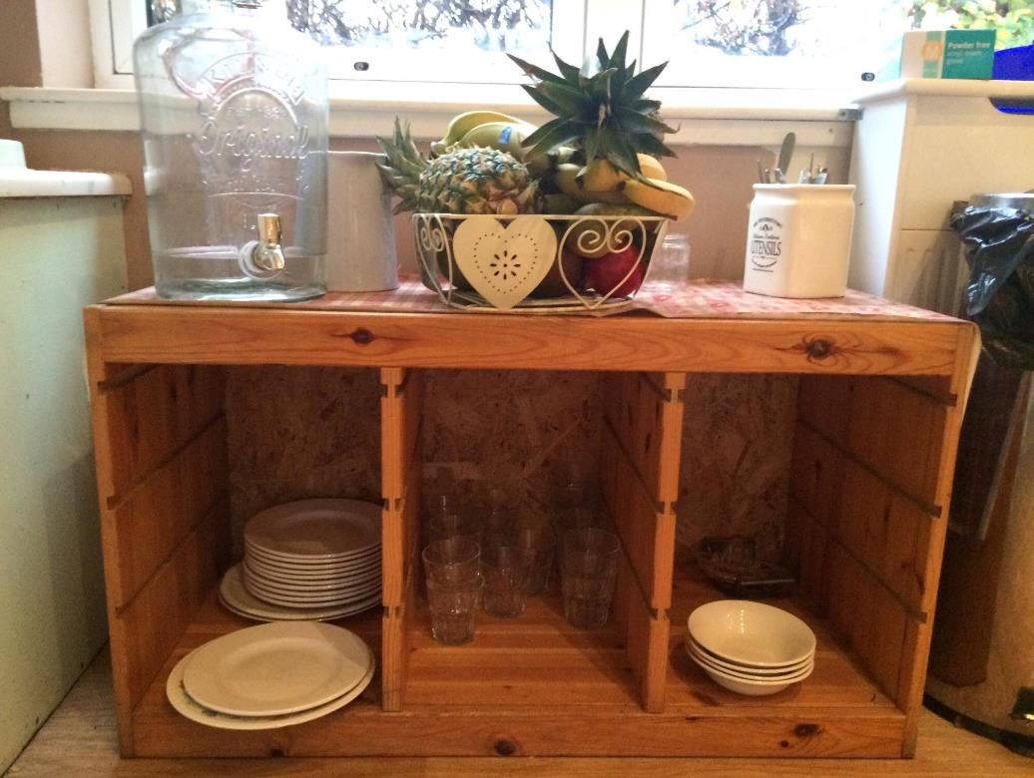
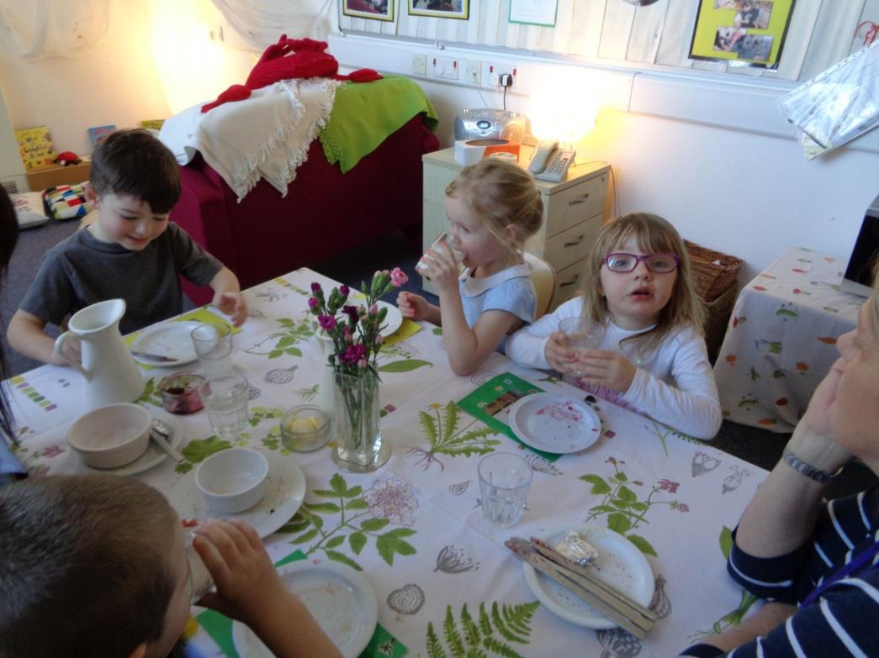

Slide 31
What personality is conveyed through the environment of your setting?
Time to reflect
Think more about richness? What materials in your setting are ‘rich’? How do you know?
What items within the environment of your setting might capture children’s imagination?
Do children feel ‘at home’ in your setting? What could be added to make them feel more so?
How important are natural materials in your setting? What opportunities are offered by such materials?

Slide 32

Education Scotland
Denholm House
Almondvale Business Park
Almondvale Way
Livingston EH54 6GA
T +44 (0)141 282 5000
E enquiries@educationscotland.gov.uk
www.educationscotland.gov.uk

