Slide 1


Slide 2
Implementation Science
Turning evidence into practice
Gail Nowek, Education Scotland
Crona Neil, Glasgow Psychological Service

Slide 3
Outcomes for session:
An understanding of Implementation Science and why it is important
A consideration of the optimal conditions for successful implementation
A consideration of possible barriers for successful implementation
Increased confidence in the implementation and evaluation of any evidenced based approach

Slide 4
There’s an elephant in the room...!
Change is hard!
Change is stressful!
Someone needs to lead for
change to happen.
Even when we think it is a good idea
change is difficult

Slide 5
Implementation Science
“one of the most critical problems our schools face is not resistance to innovation, but the fragmentation, overload, and incoherence resulting from the uncritical and uncoordinated acceptance of too many different innovations”
(Fullan and Stiegelbauer)
Implementation Science is the science of making interventions and programmes effective in real world contexts.
It seeks to understand the behaviour of professionals and other stakeholders as a key variable in successful sustainable implementation
It explores the barriers to successful implementation
It highlights core elements that need to be in place to support implementation
Notes:
Implementation Science came from the medical world where they looked at why some apparently robust evidence based interventions failed to get off the ground, why some were not sustainable and why some interventions started off well but quickly lost momentum.
People can read up on this more if they require to. Will just be discussing some of the basic concepts today and translating this into practical steps for you to go away with.
It is slightly different from improvement science and the PDSA model- this is focused on small scale change- here the emphasis is on what key components make for effective implementation
The inclusion team has used this framework, plus the change science work done by Kotter, to come up with an implementation framework that accompanies this module- all should have this to hand

Slide 6
What is Implementation Science?
Explores the barriers to successful interventions
Evolved from the failure to transfer evidence based interventions into real world contexts.
Focus on the implementation science fidelity instead of an outcome measure. Implementation fidelity refers to the degree to which an intervention or programme is delivered as intended.

Slide 7

Our vision The real world???
Resistance from staff
Resources
Time
Capacity for training
A nurturing approach that supports all our staff, children, parents and partners
How to measure impact
Parental support

Slide 8
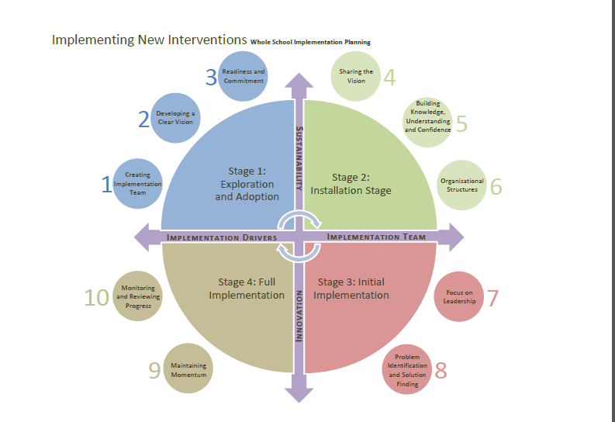

Slide 9
Stage 1: Getting Ready for Change
(Exploration and adaptation)
Creating an implementation team
Stage 1: Getting ready for change
Stage 2
Stage 4:
Stage 3
Developing a clear vision
Readiness and commitment

Slide 10
Developing a Clear Vision: Needs Analysis
Assess your current readiness for change – readiness checklist
Collect hard data - look at school demographics
Consult with cluster primary head-teachers about the current and emerging needs of pupils in their schools (look towards the future needs of your pupils).
Consult with staff/pupils/parents/carers/partner agencies through focus groups and questionnaires on school issues that need to be addressed.
Ask Educational Psychology Service to support a needs analysis
Tailor existing surveys to ensure you are asking about key aspects of practices

Slide 11
Stage 2: Capturing Hearts and Minds
(Installation) c
Sharing the vision
Stage 2: Capturing Hearts and Minds
Stage 3
Stage 4:
Stage 1
Building knowledge & under-standing
Organisational structures

Slide 12

Organisational Structures – what is going to help?
Coaching in context
Coaching is a key part of taking an initiative forward and helping staff to feel supported throughout the process.
Types of coaching:
Learning rounds
Support and Development Groups
Video Enhanced Reflective Practice
Digital communities
Teacher Learning Communities
Working groups
Action Research Groups
Image: iStockphoto

Slide 13
Stage 3: Getting the ball rolling
(Initial Implementation) cc
Focus on leadership
Stage 3:
Getting the ball rolling
Stage 4:
Stage 1:
Stage 2:
Problem identification
Solution finding

Slide 14
Focus on Leadership / Identification and removing of obstacles
Keeping team on track
Setting achievable goals
Identification / feedback of success
Keeping abreast of implementation steps, roles and progress
Accepting barriers / problems as part of the process
Providing opportunities and time to identify / remove barriers
Continue to gather evidence and data

Slide 15
Stage 4: Making it Natural
(Full Implementation) ccc
Stage 4:
Making it natural
Stage 1
Stage 2
Stage 3
Monitoring & reviewing
Maintain momentum

Slide 16
Maintaining Momentum / Monitoring & Reviewing Progress
Maintaining the feeling of value in staff
Refreshing / developing roles / processes / ideas
Distributed leadership
Continuing to highlight innovation and flexibility
Gather appropriate evidence in relation to progress
Embedding systems / language long term into natural routine
Considering new systems losing effect and appeal

Slide 17

Evaluation and measurement
Discuss what evaluation and measurements you might use to evaluate the impact of any evidence based approach
Consider:
Hard and soft data (quantitative and qualitative)
Wellbeing and Attainment data/measures
Staff/pupil/parents/stakeholders
Image: iStockphoto

Slide 18
Sustainability & Innovation
Planning for short & long term
All through the process keep considering how you will sustain the initiative
How will you know if it is making a difference?
How will you measure impact and outcomes?
How will you involve stakeholders?
What hard and soft measures will you look at ?
What ethos and relational aspects can be measured?
What aspects of wellbeing, achievement and attainment will be covered?

Slide 19

Education Scotland
Denholm House
Almondvale Business Park
Almondvale Way
Livingston EH54 6GA
T +44 (0)141 282 5000
E enquiries@educationscotland.gov.uk
www.educationscotland.gov.uk

