Slide 1
A Constructivist Approach to Improving Numeracy at Hareleeshill
Kate Fisher, Head Teacher
Chiara Moscardini McKenna, Acting Principal Teacher ASN

Slide 2
Overview
Where we were
Model of Change
Examples
Impact
Where we are now

Slide 3
Previously at Hareleeshill
Initial pace in the early years was too fast
Moved away from concrete materials
Not enough time to talk to share practice
Maths as an individual activity not a group activity
Algorithm to word problem
Resource-led numeracy : (A to B) + Z pages/Y days
Behaviourist/transmission teaching

Slide 4
What we changed
Cognitively Guided Instruction (CGI)
Research-based
Pupils learning mathematical concepts in context through specific word problems
Building on intuitive mathematical understanding- not teaching processes or procedures to follow

Slide 5
Making Connections
Professional noticing: teachers carefully observing children’s mathematical thinking and using this to inform their planning and next steps
Assessing children’s thinking- Considering not just if a child got the correct answer, but how they got the answer they did
Heavy focus on discussion of thinking and understanding-dynamic assessment and questioning to challenge
Connecting mathematical ideas and concrete to abstract

Slide 6
Model of Change
Not using a trickle down approach
Masters module: Children’s development in numeracy- An introduction to CGI
Working directly with original CGI researchers from USA through Strathclyde Numeracy Project
Appointing a Numeracy Specialist Teacher in school
Numeracy Working party- all staff
Ongoing peer observations
Shared learning board in staffroom

Slide 7
Numeracy Clinics
Twice weekly sessions for teachers
Voluntary
Led by Numeracy Teacher
Monday- group study and development
Thursday- planning support sessions
Have now introduced Literacy and ASN clinics following on from the success of these

Slide 8
Strathclyde Numeracy Project
Connecting with CPD leaders and ‘experts’ in an ongoing manner
Ongoing CPD in school- CAT sessions, working party and in-service
Regular Skype sessions with professors from USA
Structured support visits from professors and senior lecturer- demonstrations, observations, support and guidance

Slide 9
Tracking Impact
Teacher judgements
Summative assessments- assessing thinking and strategy use as well as ability to get correct answer
Observations
Records of teacher learning and changes in teacher attitude and understanding taken as part of numeracy project

Slide 10
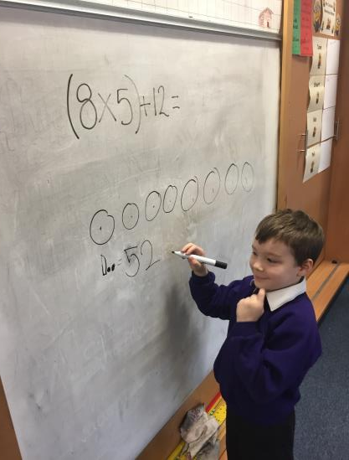
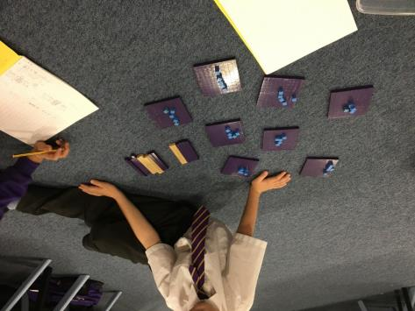
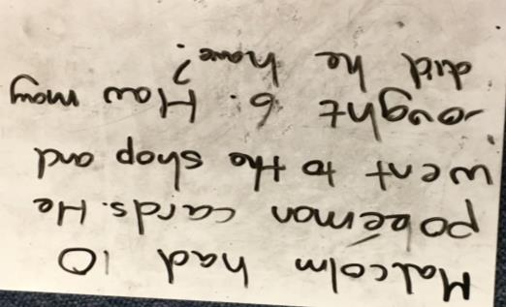
The new us
Notes:
The new us. So what did we do.
We started from scratch, we went on the course at Strathclyde University, we asked lots of questions, we learned.
We bought lots of dienes materials, white boards and pens.
Then we took a deep breath and experimented. We tried it with groups, individuals and whole classes to find out what happened and what suited each teacher and class.
We now start with the word problem and work towards the algorithm.
The pupils are relaxed about using concrete materials and drawing the problem or a mixture of both.
They feel a senses of achievement when they complete a challenging task.
They enjoy sharing their learning.

Slide 11
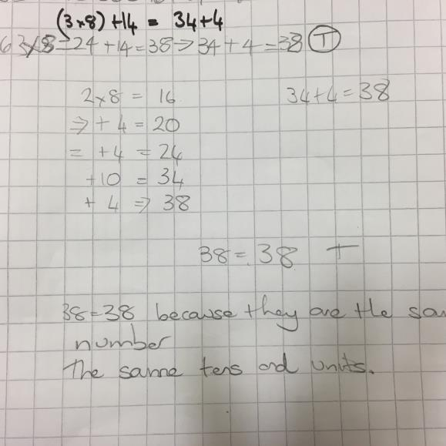
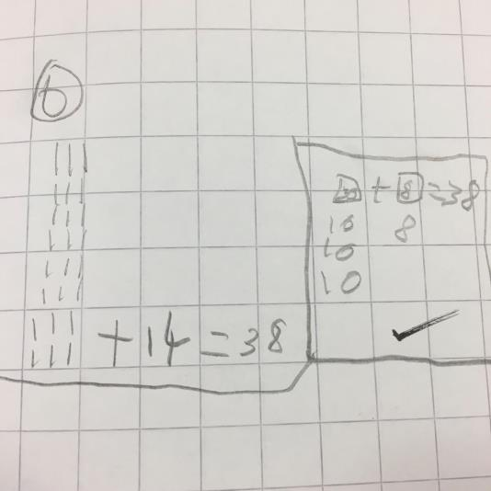
The new us

Slide 12
In the classroom
Flexible groups- not set ability groupings
Focus on understanding, making connections and challenging thinking
Pupils taught in the way that makes sense to them
Strategy used as important as the answer
Lots of discussion and
questioning

Slide 13
Impact
Supporting pupils as individuals
Improved teacher understanding and knowledge
Less stress and more positive attitude towards maths
Improved engagement
Assessment is dynamic
Development of problem solving skills, higher order thinking
Children operating at a level far beyond previously thought
Pupils becoming more independent
Notes:
We see pupils more as individuals now. We have a greater knowledge of pupils understanding which allows us to set more effective next steps.
Pupils are less stressed by maths
Because there is an understanding that it is okay to draw or use concrete materials no pupils can fail at maths before they have been given time to develop their understanding.

